Slide 1
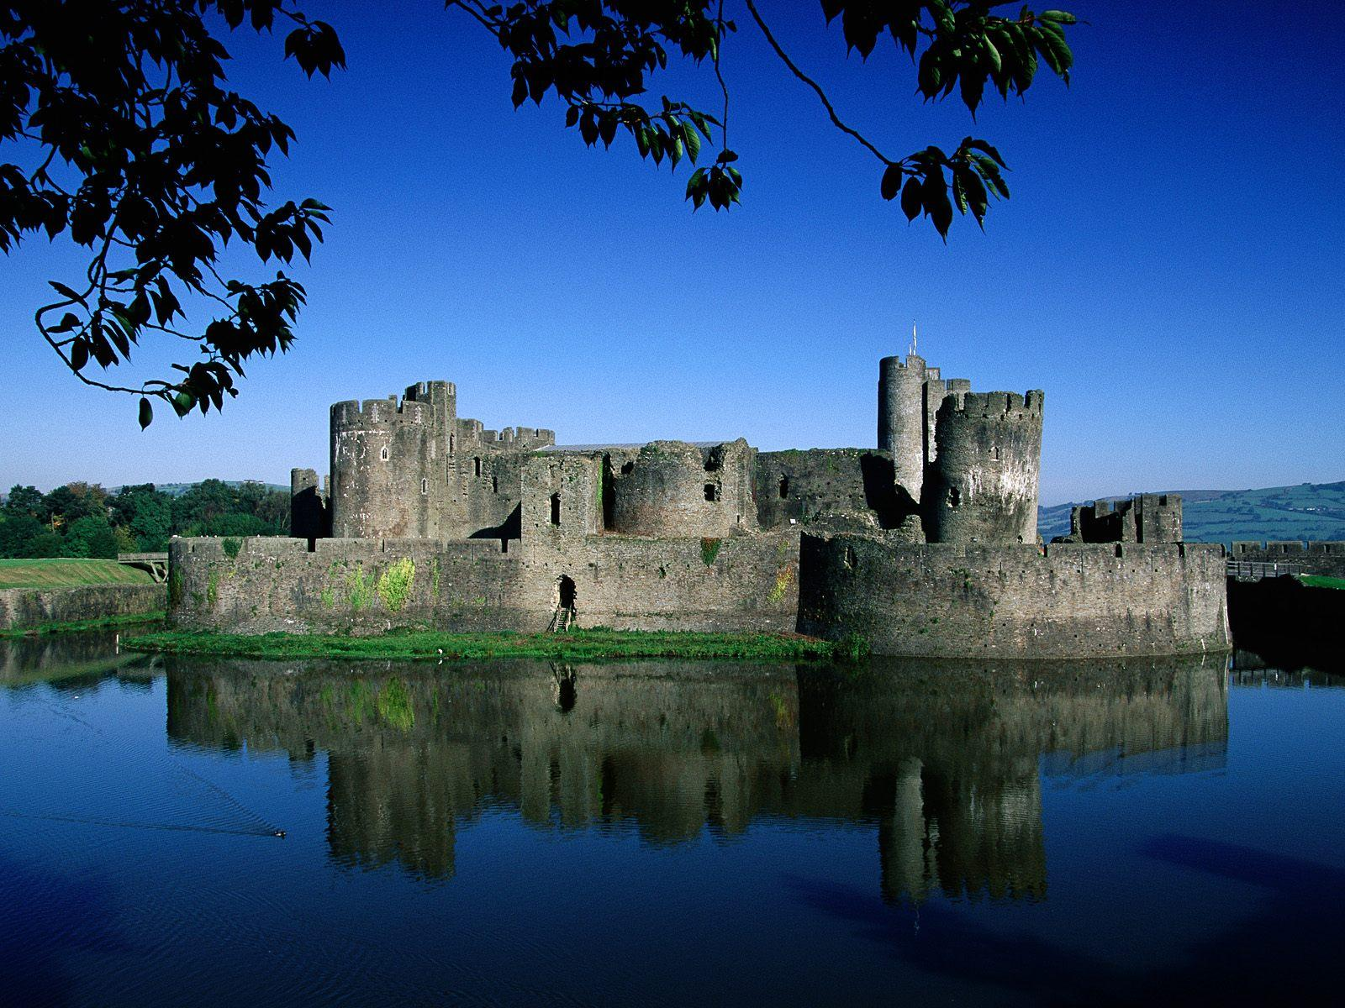
The Kingdom of God

Slide 2
The Kingdom of God: Ambassadors for the King
Part 1

Slide 3
What do you think of when you hear…
Barney
Lady Gaga
Hitler
Starbucks
Frances Cordova
Buddha
Indiana
Purdue
Chi Alpha

Slide 4
Romans 10:13-15
“Everyone who calls on the name of the Lord will be saved.”
¹⁴ How, then, can they call on the one they have not believed in? And how can they believe in the one of whom they have not heard? And how can they hear without someone preaching to them? ¹⁵ And how can they preach unless they are sent? As it is written, “How beautiful are the feet of those who bring good news!”

Slide 5
2 Corinthians 5:20
(around p. 803 in visitor Bibles)

Slide 6
The Chi Alpha Name
Chi = X = christos
Alpha = A = apostoli (ambassadors)

Slide 7
Revelation 3:1-2
“To the angel of the church in Sardis write: These are the words of him who holds the seven spirits of God and the seven stars. I know your deeds; you have a reputation of being alive, but you are dead. Wake up! Strengthen what remains and is about to die, for I have not found your deeds complete in the sight of my God. Remember, therefore, what you have received and heard; obey it, and repent. But if you do not wake up, I will come like a thief, and you will not know at what time I will come to you.

Slide 8
Webster’s Dictionary
Ambassador: the highest-ranking representative appointed by one country or government to represent it in another.

Slide 9
Earthly Kingdom Kingdom of God
Personally appointed
Highest ranking diplomat
Represent king to another nation
Diplomatic immunity
Given control of embassy
Keep king well informed
Protect & defend fellow countrymen
Maintain the amicable relations
Not on vacation but a mission!
Can't take "time out"
Not citizens of that country
Christ chose us (Jn 15:16)
Christ delegates His authority to us
Represent Christ to all nations
Not subject to law of sin & death!
Delegated authority for mission
Communicate with Christ
Look out for brothers & sisters!
Love the lost
"We are Christ's ambassadors"
Always representing Christ!
Citizenship in heaven! (Phil. 3:20)

Slide 10
Ambassador Characteristics
Property of the king
We are God's possession (Eph 1:13)

Slide 11
Ephesians1:13-14
Having believed, you were marked in him with a seal, the promised Holy Spirit, ¹⁴ who is a deposit guaranteeing our inheritance until the redemption of those who are God’s possession—to the praise of his glory.

Slide 12
Ambassador Characteristics
Property of the king
All needs taken care of by king
Do/say only what King says/does
We are God's possession (Eph 1:13)
God supplies all our needs (Ph. 4:19)
We extend His Kingdom on earth (Mt. 6:10)

Slide 13
Lord’s Prayer = Ambassador Prayer!
Our Father in heaven, hallowed be Your name, ¹⁰ Your kingdom come, Your will be done on earth as it is in heaven. ¹¹ Give us today our daily bread. ¹² Forgive us our debts, as we also have forgiven our debtors. ¹³ And lead us not into temptation, but deliver us from the evil one, for Yours is the kingdom and the power and the glory forever. Amen.

Slide 14
2 Corinthians 5:14-15
¹⁴For Christ’s love compels us, because we are convinced that one died for all, and therefore all died. ¹⁵And He died for all, that those who live should no longer live for themselves but for Him who died for them and was raised again.

Slide 15
1 Corinthians 9:16
Yet when I preach the gospel, I cannot boast, for I am compelled to preach. Woe to me if I do not preach the gospel!

Slide 16
Romans 1:16
I am not ashamed of the gospel, because it is the power of God for the salvation of everyone who believes: first for the Jew, then for the Gentile.

