Slide 1
The Kingdom of God

Slide 2
The Kingdom of God: Ambassadors for the King
Part 2

Slide 3
Christ’s Ambassadors
Chi Alpha = Christo Apostoli (Christ’s sent ones)
Represent King’s interests, not your own
On mission, not vacation
Citizenship = heaven
All needs met by King

Slide 4
Witness Protection Program

Slide 5
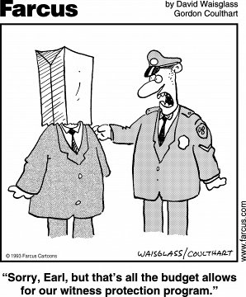

Slide 6
Who…me? Witness??

Slide 7
Excuse #1: That’s the Pastor’s Job
Ephesians 4:11-12, 13 It was he who gave some to be apostles, some to be prophets, some to be evangelists, and some to be pastors and teachers, to prepare God’s people for works of service, so that the body of Christ may be built up…and become mature…

Slide 8
Excuse #1: That’s the Missionary’s Job
Acts 6:2-7 It would not be right for us to neglect the ministry of the word of God in order to wait on tables. ³ Brothers, choose seven men from among you who are known to be full of the Spirit and wisdom. We will turn this responsibility over to them ⁴and will give our attention to prayer and the ministry of the word.”…..They chose Stephen, a man full of faith and of the Holy Spirit; also Philip….

Slide 9
Excuse #1: That’s the Missionary’s Job
God does not call you to a place or a position; He calls you to a PEOPLE!

Slide 10
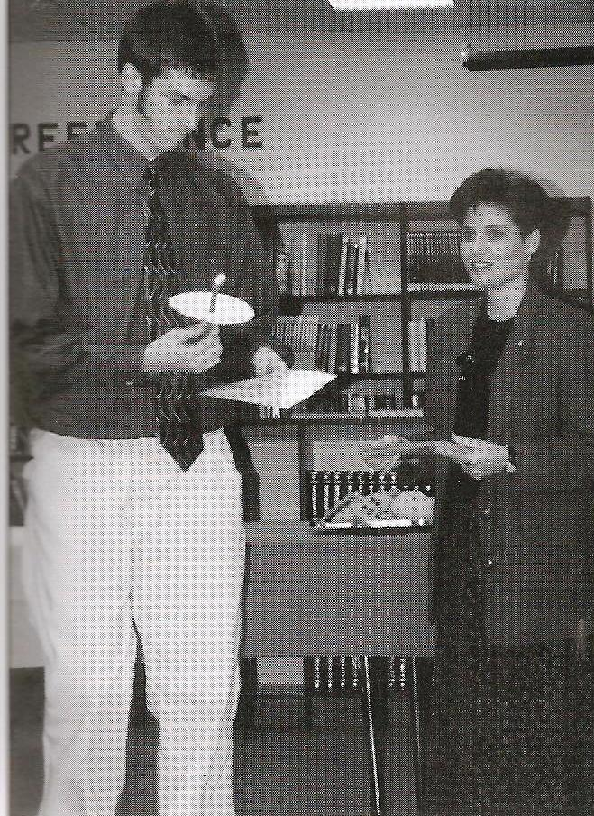
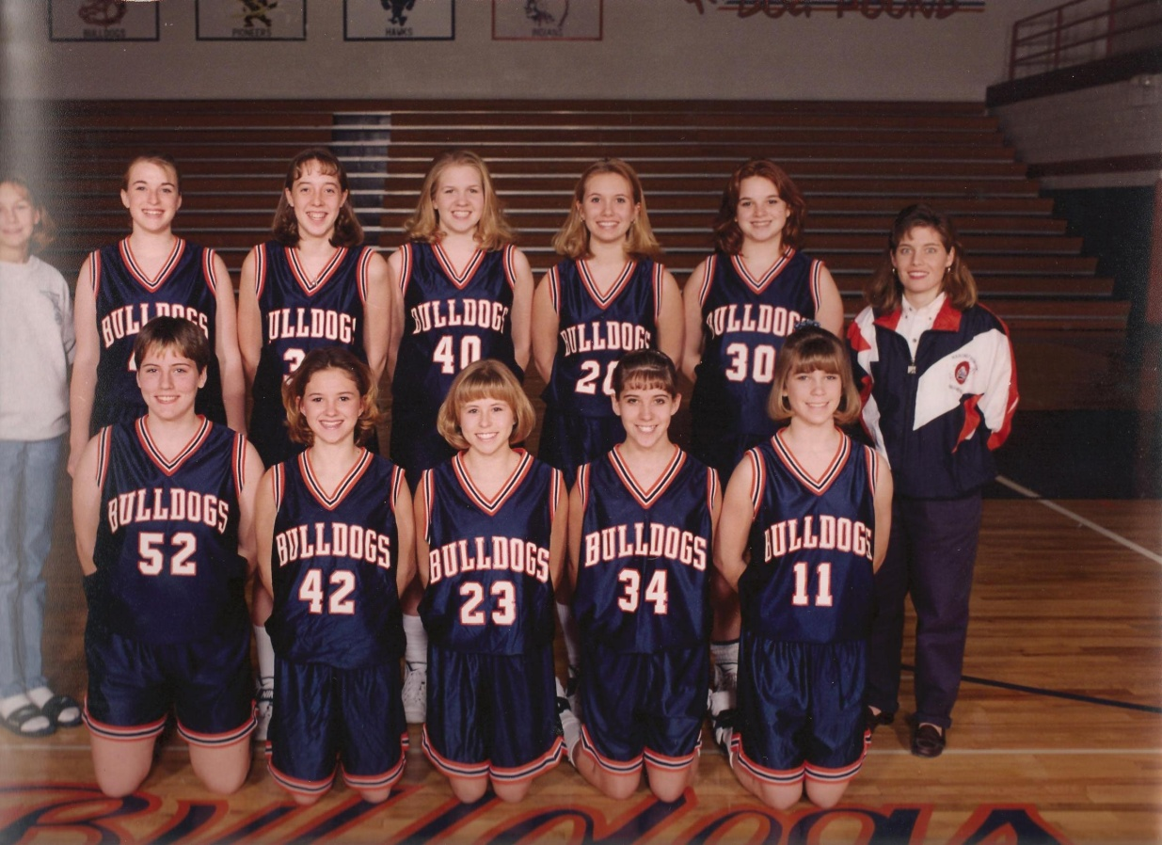
1995-2000
1995-2000

Slide 11
Excuse #2: I Don’t Have My Act Together
Matthew 28:17
When they saw him, they worshiped him; but
some doubted.
Philemon 6 I pray that you may be active in sharing your faith, so that you will have a full understanding of every good thing we have in Christ.

Slide 12
Excuse #3: I’ll Go On A Missions Trip
Matthew 28:19
Therefore go and make disciples of all
nations…

Slide 13
Excuse #4: I’m Afraid I’ll Mess Up
Matthew 28:19-20
“And surely I am with you always,
to the very end of the age.”
1 Timothy 2:3-4
This is good, and pleases God our
Savior, who wants all men to be saved
and to come to a knowledge of the truth.

Slide 14
Excuse #5: I’m Not a Bible Scholar
Acts 4:13 When they saw the courage of Peter and John and
realized that they were unschooled, ordinary
men, they were astonished and they took note that
these men had been with Jesus.
Matthew 4:19
“Come, follow me,” Jesus said, “and I
will make you fishers of men.”

Slide 15
Excuse #6: I Don’t Know What to Say
Acts 4:20
For we cannot help speaking about
we have seen and heard.

Slide 16
Romans 1:16
I am not ashamed of the gospel, because it is the power of God for the salvation of everyone who believes: first for the Jew, then for the Gentile.

Slide 17
John 6:44
No one can come to Me
unless the Father who sent Me draws him…

Slide 18
THE ENGEL SCALE
Spiritual Decision Process Model
+3
+2
+1
- -
-1
-2
-3
-4
-5
-6
-7
-8

Slide 19
THE ENGEL SCALE
Spiritual Decision Process Model
+3
+2
+1
- -
-1
-2
-3
-4
-5
-6
-7
Awareness of Supreme Being but no effective knowledge of Gospel.
-8

Slide 20
THE ENGEL SCALE
+3
+2
+1
- -
-1
-2
-3
-4
-5
-6
-7
Initial awareness of Gospel.
-8
Awareness of Supreme Being but no effective knowledge of Gospel.

Slide 21
THE ENGEL SCALE
+3
+2
+1
- -
-1
-2
-3
-4
-5
-6
Awareness of fundamentals of Gospel.
-7
Initial awareness of Gospel.
-8
Awareness of Supreme Being but no effective knowledge of Gospel.

Slide 22
THE ENGEL SCALE
+3
+2
+1
- -
-1
-2
-3
-4
-5
Grasp of implications of Gospel.
-6
Awareness of fundamentals of Gospel.
-7
Initial awareness of Gospel.
-8
Awareness of Supreme Being but no effective knowledge of Gospel.

Slide 23
THE ENGEL SCALE
+3
+2
+1
- -
-1
-2
-3
-4
Positive attitude toward Gospel.
-5
Grasp of implications of Gospel.
-6
Awareness of fundamentals of Gospel.
-7
Initial awareness of Gospel.
-8
Awareness of Supreme Being but no effective knowledge of Gospel.

Slide 24
THE ENGEL SCALE
+3
+2
+1
- -
-1
-2
-3
Count the Cost.
-4
Positive attitude toward Gospel.
-5
Grasp of implications of Gospel.
-6
Awareness of fundamentals of Gospel.
-7
Initial awareness of Gospel.
-8
Awareness of Supreme Being but no effective knowledge of Gospel.

Slide 25
THE ENGEL SCALE
+3
+2
+1
- -
-1
-2
DECISION TO ACT
-3
Count the cost.
-4
Positive attitude toward Gospel.
-5
Grasp of implications of Gospel.
-6
Awareness of fundamentals of Gospel.
-7
Initial awareness of Gospel.
-8
Awareness of Supreme Being but no effective knowledge of Gospel.

Slide 26
THE ENGEL SCALE
+3
+2
+1
- -
-1
Repentance and faith in Christ.
-2
DECISION TO ACT
-3
Personal problem recognition.
-4
Positive attitude toward Gospel.
-5
Grasp of implications of Gospel.
-6
Awareness of fundamentals of Gospel.
-7
Initial awareness of Gospel.
-8
Awareness of Supreme Being but no effective knowledge of Gospel.

Slide 27
THE ENGEL SCALE
+3
+2
+1
- -
A “NEW CREATION”
-1
Repentance and faith in Christ.
-2
DECISION TO ACT
-3
Personal problem recognition.
-4
Positive attitude toward Gospel.
-5
Grasp of implications of Gospel.
-6
Awareness of fundamentals of Gospel.
-7
Initial awareness of Gospel.
-8
Awareness of Supreme Being but no effective knowledge of Gospel.

Slide 28
THE ENGEL SCALE
+3
+2
+1
Post-decision evaluation (H₂0 & Spirit baptisms)
- -
A “NEW CREATION”
-1
Repentance and faith in Christ.
-2
DECISION TO ACT
-3
Personal problem recognition.
-4
Positive attitude toward Gospel.
-5
Grasp of implications of Gospel.
-6
Awareness of fundamentals of Gospel.
-7
Initial awareness of Gospel.
-8
Awareness of Supreme Being but no effective knowledge of Gospel.

Slide 29
THE ENGEL SCALE
+3
+2
Incorporation into Body.
+1
Post-decision evaluation (water baptism, Spirit baptism).
- -
A “NEW CREATION”
-1
Repentance and faith in Christ.
-2
DECISION TO ACT
-3
Personal problem recognition.
-4
Positive attitude toward Gospel.
-5
Grasp of implications of Gospel.
-6
Awareness of fundamentals of Gospel.
-7
Initial awareness of Gospel.
-8
Awareness of Supreme Being but no effective knowledge of Gospel.

Slide 30
ETERNITY
THE ENGEL SCALE
+3
Conceptual and behavioral growth begins.
+2
Incorporation into Body.
+1
Post-decision evaluation (water baptism, Spirit baptism).
- -
A “NEW CREATION”
-1
Repentance and faith in Christ.
-2
DECISION TO ACT
-3
Personal problem recognition.
-4
Positive attitude toward Gospel.
-5
Grasp of implications of Gospel.
-6
Awareness of fundamentals of Gospel.
-7
Initial awareness of Gospel.
-8
Awareness of Supreme Being but no effective knowledge of Gospel.

Slide 31
ETERNITY
God
Humans
+3
Conceptual and behavioral growth begins.
+3
+2
Incorporation into Body.
+1
Post-decision evaluation (baptisms)
--
A “NEW CREATION”
-1
Repentance and faith in Christ.
-2
DECISION TO ACT
-3
Count cost .
-4
Positive attitude toward Gospel.
-5
Grasp of implications of Gospel.
-6
Awareness of fundamentals of Gospel.
-7
Initial awareness of Gospel
-8
Awareness of Supreme Being but no effective knowledge of Gospel.

Slide 32
ETERNITY
God
Humans
+3
Conceptual and behavioral growth begins.
+3
+2
Incorporation into Body.
+1
Post-decision evaluation (baptisms)
--
A “NEW CREATION”
-1
Repentance and faith in Christ.
-2
DECISION TO ACT
-3
Count cost .
-4
Positive attitude toward Gospel.
-5
Grasp of implications of Gospel.
-6
Awareness of fundamentals of Gospel.
Proclamation
-7
Initial awareness of Gospel
-8
Awareness of Supreme Being but no effective knowledge of Gospel.

Slide 33
ETERNITY
God
Humans
+3
Conceptual and behavioral growth begins.
+3
+2
Incorporation into Body.
+1
Post-decision evaluation (baptisms)
--
A “NEW CREATION”
Persuasion
-1
Repentance and faith in Christ.
-2
DECISION TO ACT
-3
Count cost .
-4
Positive attitude toward Gospel.
-5
Grasp of implications of Gospel.
-6
Awareness of fundamentals of Gospel.
Proclamation
-7
Initial awareness of Gospel
-8
Awareness of Supreme Being but no effective knowledge of Gospel.

Slide 34
ETERNITY
God
Humans
+3
Conceptual and behavioral growth begins.
+3
+2
Incorporation into Body.
Follow-up
+1
Post-decision evaluation (baptisms)
--
A “NEW CREATION”
Persuasion
-1
Repentance and faith in Christ.
-2
DECISION TO ACT
-3
Count cost .
-4
Positive attitude toward Gospel.
-5
Grasp of implications of Gospel.
-6
Awareness of fundamentals of Gospel.
Proclamation
-7
Initial awareness of Gospel
-8
Awareness of Supreme Being but no effective knowledge of Gospel.

Slide 35
ETERNITY
God
Humans
+3
Conceptual and behavioral growth begins.
+3
Discipleship
+2
Incorporation into Body.
Follow-up
+1
Post-decision evaluation (baptisms)
--
A “NEW CREATION”
Persuasion
-1
Repentance and faith in Christ.
-2
DECISION TO ACT
-3
Count cost .
-4
Positive attitude toward Gospel.
-5
Grasp of implications of Gospel.
-6
Awareness of fundamentals of Gospel.
Proclamation
-7
Initial awareness of Gospel
-8
Awareness of Supreme Being but no effective knowledge of Gospel.

Slide 36
ETERNITY
God
Humans
Service
+3
Conceptual and behavioral growth begins.
+3
Discipleship
+2
Incorporation into Body.
Follow-up
+1
Post-decision evaluation (baptisms)
--
A “NEW CREATION”
Persuasion
-1
Repentance and faith in Christ.
-2
DECISION TO ACT
-3
Count cost .
-4
Positive attitude toward Gospel.
-5
Grasp of implications of Gospel.
-6
Awareness of fundamentals of Gospel.
Proclamation
-7
Initial awareness of Gospel
-8
Awareness of Supreme Being but no effective knowledge of Gospel.

Slide 37
ETERNITY
God
Humans
Service
+3
Conceptual and behavioral growth begins.
+3
Discipleship
+2
Incorporation into Body.
Follow-up
+1
Post-decision evaluation (baptisms)
--
A “NEW CREATION”
Persuasion
-1
Repentance and faith in Christ.
-2
DECISION TO ACT
-3
Count cost .
-4
Positive attitude toward Gospel.
-5
Grasp of implications of Gospel.
-6
Awareness of fundamentals of Gospel.
Proclamation
-7
Initial awareness of Gospel
General Revelation
-8
Awareness of Supreme Being but no effective knowledge of Gospel.

Slide 38
ETERNITY
God
Humans
Service
+3
Conceptual and behavioral growth begins.
+3
Discipleship
+2
Incorporation into Body.
Follow-up
+1
Post-decision evaluation (baptisms)
--
A “NEW CREATION”
Persuasion
-1
Repentance and faith in Christ.
-2
DECISION TO ACT
-3
Count cost .
-4
Positive attitude toward Gospel.
-5
Grasp of implications of Gospel.
-6
Awareness of fundamentals of Gospel.
Conviction
Proclamation
-7
Initial awareness of Gospel
General Revelation
-8
Awareness of Supreme Being but no effective knowledge of Gospel.

Slide 39
ETERNITY
God
Humans
Service
+3
Conceptual and behavioral growth begins.
+3
Discipleship
+2
Incorporation into Body.
Follow-up
+1
Post-decision evaluation (baptisms)
--
A “NEW CREATION”
Salvation
Persuasion
-1
Repentance and faith in Christ.
-2
DECISION TO ACT
-3
Count cost .
-4
Positive attitude toward Gospel.
-5
Grasp of implications of Gospel.
-6
Awareness of fundamentals of Gospel.
Conviction
Proclamation
-7
Initial awareness of Gospel
General Revelation
-8
Awareness of Supreme Being but no effective knowledge of Gospel.

Slide 40
ETERNITY
God
Humans
Service
+3
Conceptual and behavioral growth begins.
+3
Discipleship
+2
Incorporation into Body.
Enter Kingdom
Follow-up
+1
Post-decision evaluation (baptisms)
--
A “NEW CREATION”
Salvation
Persuasion
-1
Repentance and faith in Christ.
-2
DECISION TO ACT
-3
Count cost .
-4
Positive attitude toward Gospel.
-5
Grasp of implications of Gospel.
-6
Awareness of fundamentals of Gospel.
Conviction
Proclamation
-7
Initial awareness of Gospel
General Revelation
-8
Awareness of Supreme Being but no effective knowledge of Gospel.

Slide 41
ETERNITY
God
Humans
Service
+3
Conceptual and behavioral growth begins.
+3
Sanctification
Discipleship
+2
Incorporation into Body.
Enter Kingdom
Follow-up
+1
Post-decision evaluation (baptisms)
--
A “NEW CREATION”
Salvation
Persuasion
-1
Repentance and faith in Christ.
-2
DECISION TO ACT
-3
Count cost .
-4
Positive attitude toward Gospel.
-5
Grasp of implications of Gospel.
-6
Awareness of fundamentals of Gospel.
Conviction
Proclamation
-7
Initial awareness of Gospel
General Revelation
-8
Awareness of Supreme Being but no effective knowledge of Gospel.

Slide 42
ETERNITY
God
Humans
Service
+3
Conceptual and behavioral growth begins.
+3
Sanctification
Discipleship
+2
Incorporation into Body.
Enter Kingdom
Follow-up
+1
Post-decision evaluation (baptisms)
--
A “NEW CREATION”
Salvation
Persuasion
-1
Repentance and faith in Christ.
-2
DECISION TO ACT
-3
Count cost.
-4
Positive attitude toward Gospel.
-5
Grasp of implications of Gospel.
-6
Awareness of fundamentals of Gospel.
Conviction
Proclamation
-7
Initial awareness of Gospel
General Revelation
-8
Awareness of Supreme Being but no effective knowledge of Gospel.

Slide 43
Questions you can ask:
Do you believe in God?
What do you think God is like?
Were you raised in church?
Can I pray for you?
If you were to die right now, how sure are you you’d go to heaven?

Slide 44
Tow Trucks Are No Fun

Slide 45
Excuse #7: I’m Scared!
2 Corinthians 5:14-15
¹⁴For Christ’s love compels us, because we are convinced that one died for all, and therefore all died. ¹⁵And He died for all, that those who live should no longer live for themselves but for Him who died for them and was raised again.

Slide 46
Excuse #7: I’m Scared!
Ephesians 6:19-20
Pray also for me, that whenever I open my mouth, words may be given me so that I will fearlessly make known the mystery of the gospel, for which I am an ambassador in chains. Pray that I may declare it fearlessly, as I should.

Slide 47
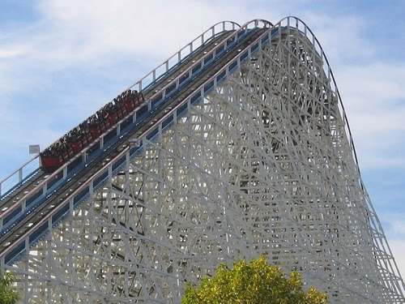

Slide 48
Excuse #7: I’m Scared!
Acts 1:8 But you will receive power when the Holy Spirit comes on you; and you will be my witnesses in Jerusalem, and in all Judea and Samaria, and to the ends of the earth.

Slide 49
Ephesians 1:22-23
And God placed all things under His feet and appointed Him to be head over everything for the church, ²³which is His body, the fullness of Him who fills everything in every way.

Slide 50
Romans 10:13-15
“Everyone who calls on the name of the Lord will be saved.” ¹⁴ How, then, can they call on the one they have not believed in? And how can they believe in the one of whom they have not heard? And how can they hear without someone preaching to them? ¹⁵ And how can they preach unless they are sent? As it is written, “How beautiful are the feet of those who bring good news!”

Slide 51
Isaiah 6:8-9
Then I heard the voice of the Lord saying, “Whom shall I send? And who will go for Us?” And I said, “Here am I. Send me!” ⁹He said, “Go and tell this people…
http://www.youtube.com/watch?v=NUAg8B9sXkc&feature=related

