Slide 1
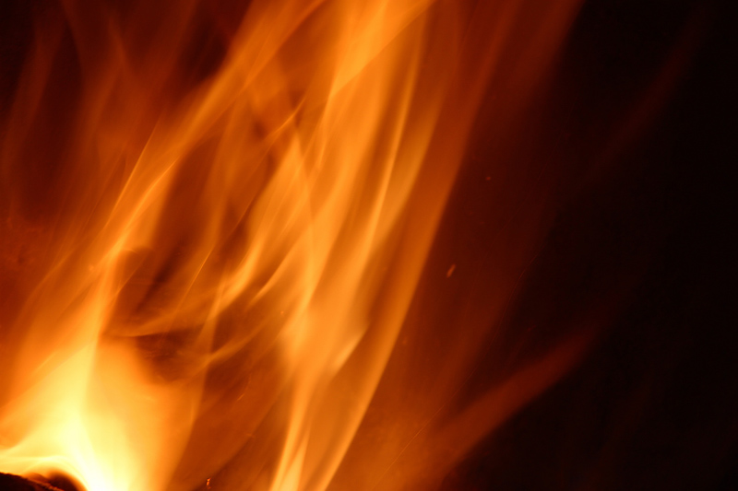
The Baptism in the Holy Spirit

Slide 2
Ezekiel 36:26-28
I will give you a new heart and put a new spirit in you; I will remove from you your heart of stone and give you a heart of flesh. And I will put My Spirit in you and move you to follow My decrees and be careful to keep My laws.

Slide 3
“Whoever believes in Me, as the Scripture has said, streams of living water will flow from within him. By
this He meant the Spirit,
whom those who
believed in Him
were later to
receive.”
—Jesus
(John 7:38-39)

Slide 4
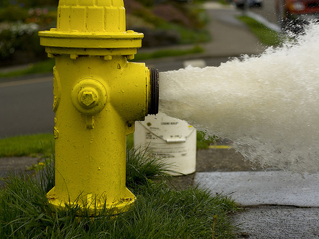
“Whoever believes in Me, as the Scripture has said, streams of living water will flow from within him. By
this He meant the Spirit,
whom those who
believed in Him
were later to
receive.”
—Jesus
(John 7:38-39)

Slide 5
It is a gift from God
Acts 1:4-5 On one occasion, while He [Jesus] was eating with them, He gave them this command: "Do not leave Jerusalem, but wait for the gift My Father promised, which you have heard Me speak about. For John baptized with water, but in a few days you will be baptized with the Holy Spirit."

Slide 6
Luke 3:16
John answered them all, “I baptize you with water. But one more powerful than I will come, the thongs of whose sandals I am not worthy to untie. He will baptize you with the Holy Spirit and with fire.

Slide 7
Ephesians 1:13
And you also were included in Christ when you heard the word of truth, the gospel of your salvation. Having believed, you were marked in Him with a seal, the promised Holy Spirit

Slide 8
John 20:21-22
On the evening of that first day of the week, when the disciples were together, with the doors locked for fear of the Jews, Jesus came and stood among them and said, “Peace be with you!” After he said this, he showed them his hands and side. The disciples were overjoyed when they saw the Lord. Again Jesus said, “Peace be with you! As the Father has sent me, I am sending you.” And with that he breathed on them and said, “Receive the Holy Spirit.”

Slide 9
Acts 1:4-5
On one occasion, while He [Jesus] was eating with them, He gave them this command: "Do not leave Jerusalem, but wait for the gift My Father promised, which you have heard Me speak about. For John baptized with water, but in a few days you will be baptized with the Holy Spirit."

Slide 10
Luke 24:49
I am going to send you what my Father has promised; but stay in the city until you have been clothed with power from on high.”

Slide 11
Purpose = dynamic witnesses
Acts 1:8
But you will receive power when the Holy Spirit comes on you; and you will be My witnesses in Jerusalem, and in all Judea and Samaria, and to the ends of the earth.
Power = dunamis = inherent power/ability

Slide 12
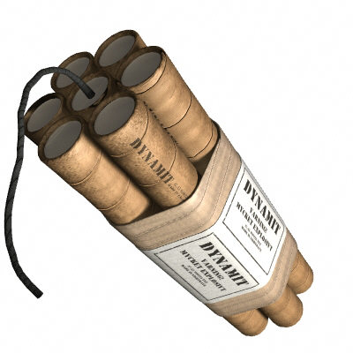

Slide 13
Purpose = dynamic witnesses
Acts 1:8
But you will receive power when the Holy Spirit comes on you; and you will be My witnesses in Jerusalem, and in all Judea and Samaria, and to the ends of the earth.
Witnesses = martus = martyr

Slide 14
Account #1 = Acts 2:1-4
When the day of Pentecost came, they were all together in one place. Suddenly a sound like the blowing of a violent wind came from heaven and filled the whole house where they were sitting. They saw what seemed to be tongues of fire that separated and came to rest on each of them. All of them were filled with the Holy Spirit and began to speak in other tongues as the Spirit enabled them.

Slide 15
Account #1 = Acts 2:1-4
When the day of Pentecost came, they were all together in one place. Suddenly a sound like the blowing of a violent wind came from heaven and filled the whole house where they were sitting. They saw what seemed to be tongues of fire that separated and came to rest on each of them. All of them were filled with the Holy Spirit and began to speak in other tongues as the Spirit enabled them.

Slide 16
Account #1 = Acts 2:1-4
When the day of Pentecost came, they were all together in one place. Suddenly a sound like the blowing of a violent wind came from heaven and filled the whole house where they were sitting. They saw what seemed to be tongues of fire that separated and came to rest on each of them. All of them were filled with the Holy Spirit and began to speak in other tongues as the Spirit enabled them.

Slide 17
Account #1 = Acts 2:1-4
When the day of Pentecost came, they were all together in one place. Suddenly a sound like the blowing of a violent wind came from heaven and filled the whole house where they were sitting. They saw what seemed to be tongues of fire that separated and came to rest on each of them. All of them were filled with the Holy Spirit and began to speak in other tongues as the Spirit enabled them.

Slide 18
Account #2 = Acts 10:44-46
While Peter was still speaking these words, the Holy Spirit came on all who heard the message. The circumcised believers who had come with Peter were astonished that the gift of the Holy Spirit had been poured out even on the Gentiles. For they heard them speaking in tongues and praising God.

Slide 19
Account #3 = Acts 19:1-7
While Apollos was at Corinth, Paul took the road through the interior and arrived at Ephesus. There he found some disciples and asked them, "Did you receive the Holy Spirit when you believed?" They answered, "No, we have not even heard that there is a Holy Spirit." So Paul asked, "Then what baptism did you receive?" "John's baptism," they replied.
Paul said, "John's baptism was a baptism of repentance. He told the people to believe in the one coming after him, that is, in Jesus." On hearing this, they were baptized into the name of the Lord Jesus. When Paul placed his hands on them, the Holy Spirit came on them, and they spoke in tongues and prophesied. There were about twelve men in all.

Slide 20
Account #4 = Acts 8:14-20
When the apostles in Jerusalem heard that Samaria had accepted the word of God, they sent Peter and John to them. When they arrived, they prayed for them that they might receive the Holy Spirit, because the Holy Spirit had not yet come upon any of them; they had simply been baptized into the name of the Lord Jesus. Then Peter and John placed their hands on them, and they received the Holy Spirit.
When Simon saw that the Spirit was given at the laying on of the apostles' hands, he offered them money and said, "Give me also this ability so that everyone on whom I lay my hands may receive the Holy Spirit."
Peter answered: "May your money perish with you, because you thought you could buy the gift of God with money!

Slide 21
Account #5 = Acts 9:17-18
Then Ananias went to the house and entered it. Placing his hands on Saul, he said, "Brother Saul, the Lord—Jesus, who appeared to you on the road as you were coming here—has sent me so that you may see again and be filled with the Holy Spirit." Immediately, something like scales fell from Saul's eyes, and he could see again. He got up and was baptized, and after taking some food, he regained his strength.

Slide 22
Apostle Paul
Acts 2:4 All of them were filled with the Holy Spirit and began to speak in other tongues as the Spirit enabled them.
1 Cor. 14:18 I thank God that I speak in tongues more than all of you.
1 Cor. 14:39 Therefore, my brothers, be eager to prophesy, and do not forbid speaking in tongues.

Slide 23
Tongues = initial physical evidence
Mark 16:17
“…And these signs will accompany those who believe: In My name they will drive out demons; they will speak in new tongues…”

Slide 24
1 Cor. 1:27-29
But God chose the foolish things of the world to shame the wise; God chose the weak things of the world to shame the strong. He chose the lowly things of this world and the despised things—and the things that are not—to nullify the things that are, so that no one may boast before Him.

Slide 25
Benefits of praying in tongues
Romans 8:26-27 …the Spirit helps us in our weakness. We do not know what we ought to pray for, but the Spirit Himself intercedes for us with groans that words cannot express. And He who searches our hearts knows the mind of the Spirit, because the Spirit intercedes for the saints in accordance with God’s will.
1 Cor. 14:4 He who speaks in a tongue edifies himself…

Slide 26
Benefits of praying in tongues
Jude 20 “But you, dear friends, build yourselves up in your most holy faith and pray in the Holy Spirit.”
Ephesians 6:18 And pray in the Spirit on all occasions with all kinds of prayers and requests.

Slide 27
The gift is for all who desire it
Acts 2:17-18
In the last days, God says, “I will pour out My Spirit on all people. Your sons and daughters will prophesy, your young men will see visions, your old men will dream dreams. Even on My servants, both men and women, I will pour out My Spirit in those days, and they will prophesy.”

Slide 28
Luke 11:11-13
"Which of you fathers, if your son asks for a fish, will give him a snake instead? Or if he asks for an egg, will give him a scorpion? If you then, though you are evil, know how to give good gifts to your children, how much more will your Father in heaven give the Holy Spirit to those who ask Him!"

Slide 29
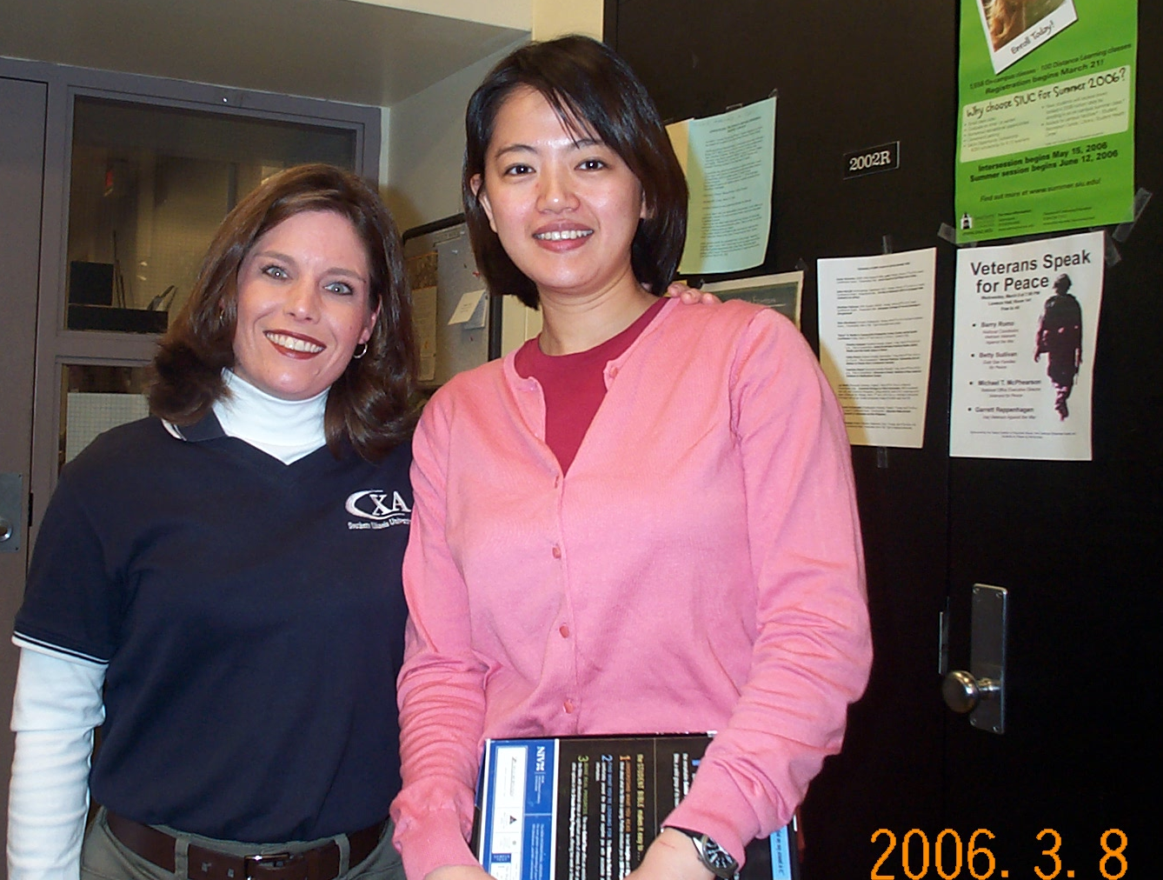

Slide 30
Do you want to receive His gift?
You can’t earn it!
He will not force it on you!
Come like a child, and receive
Your job is to speak; His job is to turn it into a language that releases the Spirit within you!

