Slide 1
Draw Near to God
and He will draw near to you
James 4:8
Waiting on God
Jan. 15 - Feb. 4

Slide 2
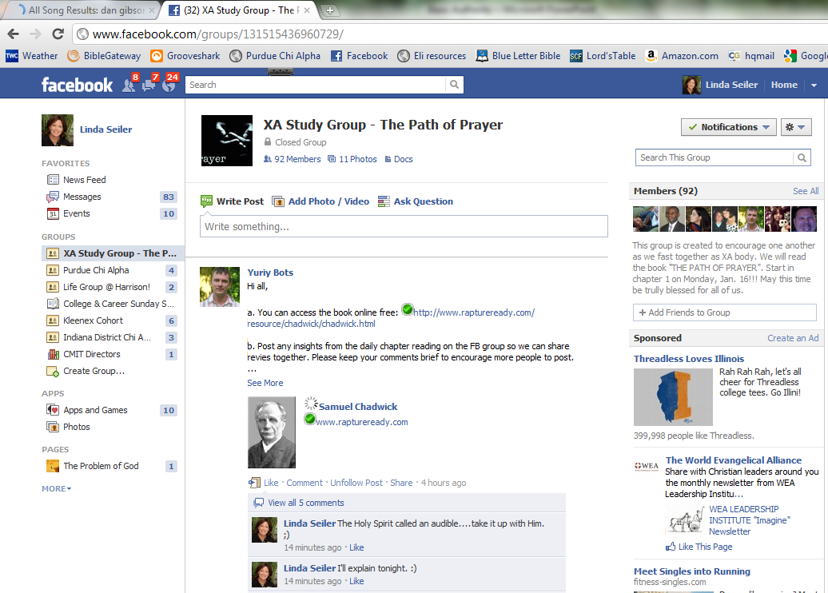

Slide 3
triad
s
Name/major/hometown
What are you most looking forward to in 2012?
Share about a time when you were a little kid and you did something you knew was wrong and didn’t want to tell anyone about it.

Slide 4
The Kingdom of God
Authority

Slide 5
Why we hate authority:
Don’t understand Kingdom principle
Authority abused & never corrected
Don’t WANT an authority over us!

Slide 6
Questions
Where does authority come from?
Does God require blind obedience, or is obedience conditional?
Is there a difference between obeying and submitting?
What does it mean to honor your parents?
What do I do if I know something is God’s will and my authority advises me against it?
What if my authority is unsaved or downright evil—do I still have to submit?
What if an authority tells me to do something wrong?

Slide 7
June 2012

Slide 8
Genesis 3
(around page 2 in visitor Bibles)

Slide 9
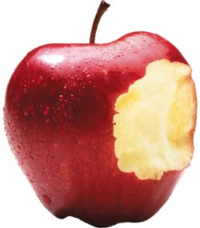

Slide 10
If you don’t believe God is good,
you will be
AFRAID of Him
(and of authority in general).

Slide 11
Free Will
Will you trust God with obedience instead of trusting your own reason?

Slide 12
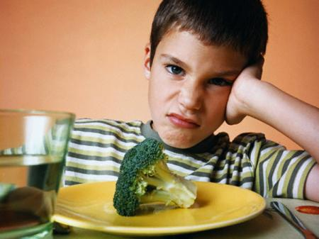

Slide 15
It’s safe to obey God instead of trusting your limited human reason because…
He’s good
He’s smarter than you are
He has already “reasoned it out” so you don’t have to!

Slide 16
Romans 13:1-2
Everyone must submit himself to the governing authorities, for there is no authority except that which God has established. The authorities that exist have been established by God.
Consequently, he who rebels against the authority is rebelling against what God has instituted, and those who do so will bring judgment on themselves.

Slide 17
God and His delegated authority are inseparable.
If you touch authority, you touch God.

Slide 18
“Our entire relationship with God is regulated by whether or not we have met authority. If we have, then we shall encounter authority everywhere, and being thus restrained by God we can begin to be used by Him.”
—Watchman Nee, Spiritual Authority

Slide 19
Types of Delegated Authority
Family
Government
Church
Business

Slide 20
Purpose of Delegated Authority
Grow you in wisdom & character

Slide 21
Luke 2:49-52
⁴⁹ “Why were you searching for me?” he asked. “Didn’t you know I had to be in my Father’s house?” ⁵⁰ But they did not understand what he was saying to them.
⁵¹ Then he went down to Nazareth with them and was obedient to them. But his mother treasured all these things in her heart. ⁵²And Jesus grew in wisdom and stature, and in favor with God and men.

Slide 22
Character Development
God is more concerned about what He does IN you than what He does THROUGH you.

Slide 23
“As long as our heart is not softened, suffering will not leave us. Our way lies in many sufferings; the easy-goers and pleasure-lovers are useless before God. Let us therefore learn to obey in suffering.”
—Watchman Nee, Spiritual Authority

Slide 24
Purpose of Delegated Authority
Grow you in wisdom & character
Protect you

Slide 28
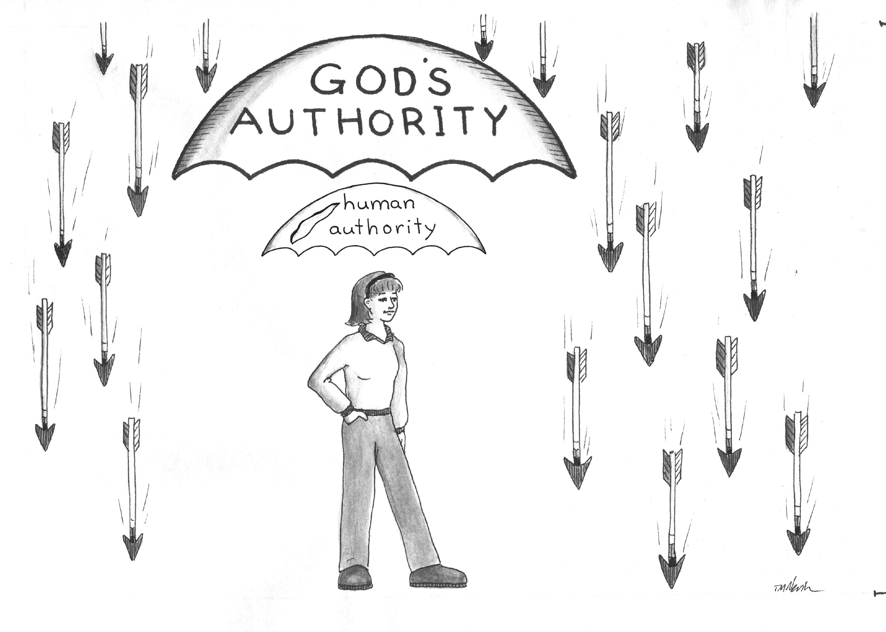

Slide 29
Separate the
POSITION
from the
PERSONALITY

Slide 31
Judge & Condemn
or
Discern & Intercede

Slide 33
Purpose of Delegated Authority
Grow you in wisdom & character
Protect you
Guide you

Slide 34
Recap
God is good!
All authority is from God & for our good to:
Grow character
Protect us
Guidance
You will meet authority everywhere you go—pray for revelation of God’s ways!

Slide 35
triad
s
What do you think?
Do you see God as good? Why or why not?
Have you ever experienced delegated authority being for your own good?
Is there an authority in your life right now you have difficulty submitting to? Why?
Pray for each other

