Slide 1
Being An Embracing Community God’s Way

Slide 2
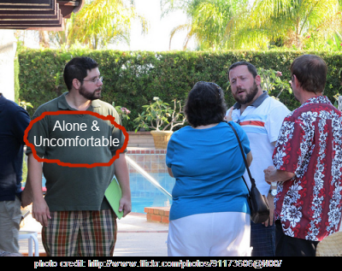
What an Embracing Community is Not “THE LONELY PARTY GOER”

Slide 3
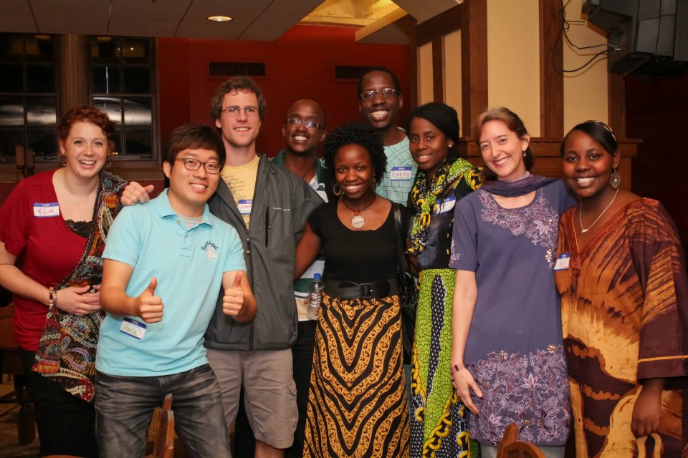
Alain’s Story What an Embracing Community Looks Like

Slide 4
“They were there for me and showed me what being a Christian looked like.”
-Alain Shema

Slide 5
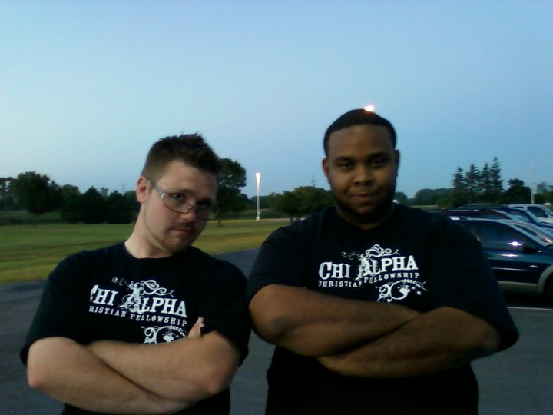
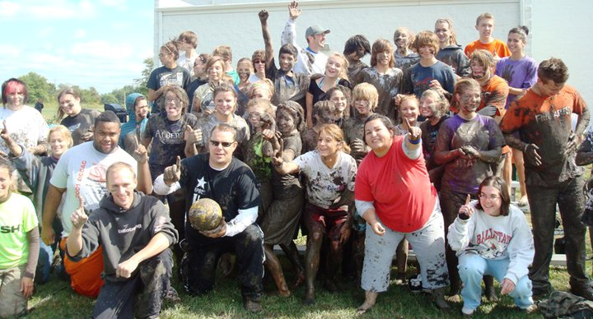
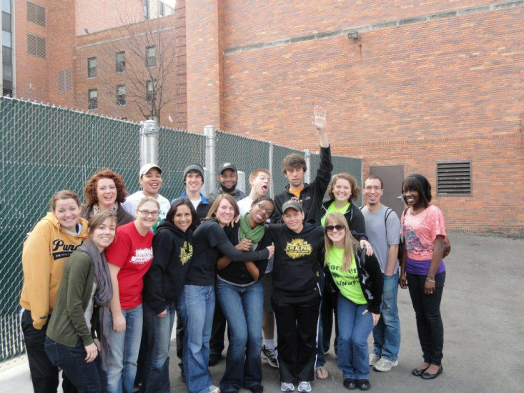
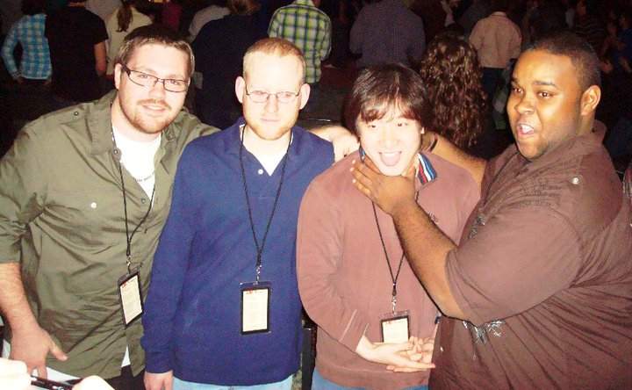
My Story

Slide 6
How do we continue to be an embracing community?
Romans 12 Road

Slide 7
Be a Sacrifice and Be Transformed
Therefore, I urge you, brothers and sisters, in view of God’s mercy, to offer your bodies as a living sacrifice, holy and pleasing to God—this is your true and proper worship. 2 Do not conform to the pattern of this world, but be transformed by the renewing of your mind. Then you will be able to test and approve what God’s will is —his good, pleasing and perfect will.

Slide 8
Discover your Motivational Gift
6 We have different gifts, according to the grace given to each of us. If your gift is prophesying, then prophesy in accordance with your[a] faith; 7 if it is serving, then serve; if it is teaching, then teach; 8 if it is to encourage, then give encouragement; if it is giving, then give generously; if it is to lead,[b] do it diligently; if it is to show mercy, do it cheerfully.

Slide 9
Resources
www.xapurdue.com
Discovering Your God Given Motivational Gift

Slide 10
LOVE GENUINELY (NO FAKE STUFF)
Love must be sincere. Hate what is evil; cling to what is good. 10 Be devoted to one another in love. Honor one another above yourselves. 11 Never be lacking in zeal, but keep your spiritual fervor, serving the Lord. 12 Be joyful in hope, patient in affliction, faithful in prayer. 13 Share with the Lord’s people who are in need. Practice hospitality.

Slide 11
LOVE OUR ENEMIES “Our Witness to the World”
Bless those who persecute you; bless and do not curse. 15 Rejoice with those who rejoice; mourn with those who mourn. 16 Live in harmony with one another. Do not be proud, but be willing to associate with people of low position. Do not be conceited.
17 Do not repay anyone evil for evil. Be careful to do what is right in the eyes of everyone. 18 If it is possible, as far as it depends on you, live at peace with everyone. 19 Do not take revenge, my dear friends, but leave room for God’s wrath, for it is written: “It is mine to avenge; I will repay,” says the Lord. 20 On the contrary:
“If your enemy is hungry, feed him;
if he is thirsty, give him something to drink.
In doing this, you will heap burning coals on his head.”[e]
21 Do not be overcome by evil, but overcome evil with good.

Slide 12
Life Group Questions
How can you use your motivational gift to help grow new believers in their faith?
What are some practical ways we can show genuine love?
Pray for each other’s needs.
Lets hang out!!!!!!!!!!!!!!!

