Slide 1
What Makes Christianity Different From All Other World Religions?

Slide 2
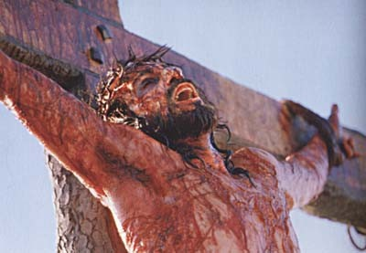
Next Week:
What Really Happened at the Cross

Slide 4
1. Christianity is a religion of absolute certainty
1 John 5:13
(around page 846 in visitor Bibles)

Slide 5
Other Religions
Christianity
God
God
Man
Man

Slide 6
Christianity
“ …for all have sinned and fall short of the glory of God.”
- Romans 3:23
God
“For the wages of sin is death, but the gift of God is eternal life in Christ Jesus our Lord.”
- Romans 6:23
Man

Slide 7
2. Christianity is a relationship with a loving Father who comes to you and provides payment for your sin
John 3:16
(around page 751 in visitor Bibles)

Slide 9
Man
Jesus
God

Slide 10
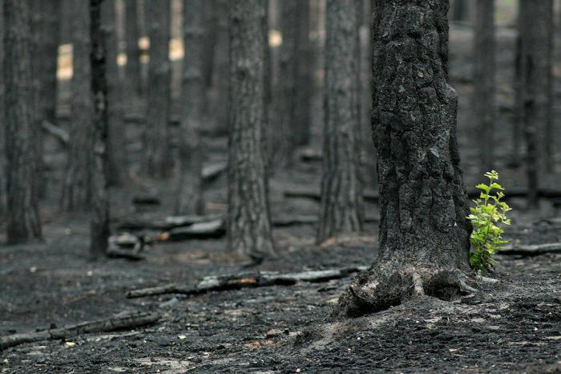

Slide 11
Romans 10:9
“If you confess with your mouth, ‘Jesus is Lord,’ and believe in your heart that God raised Him from the dead, you will be saved.”

Slide 12
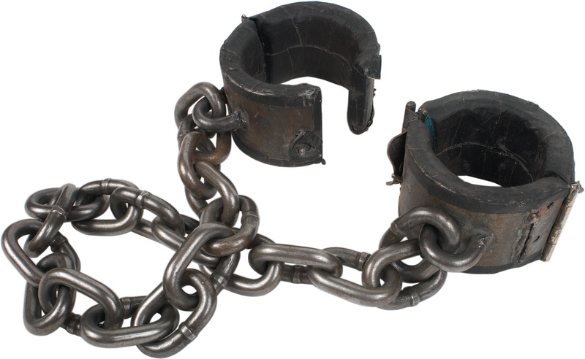
3. Christianity is only the religion that can set you free from your sin nature

Slide 13
3. Christianity is only the religion that can set you free from your sin nature
“I will give you a new heart and put a new spirit in you; I will remove from you your heart of stone and give you a heart of flesh. And I will put my Spirit in you and move you to follow my decrees and be careful to keep my laws.”
- Ezekiel 36:26-27

Slide 14
Romans 10:9
“If you confess with your mouth, ‘Jesus is Lord,’ and believe in your heart that God raised Him from the dead, you will be saved.”

