Slide 1
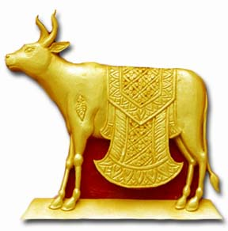
Dating God’s Way:
Killing the Golden Calf of Marriage

