Slide 1
Authority, Part 3:
What if Your Authority is Evil?

Slide 2
Romans 13:1-2 (around page 788 in visitor Bibles)
“Everyone must submit himself to the governing authorities, for there is no authority except that which God has established. The authorities that exist have been established by God. Consequently, he who rebels against the authority is rebelling against what God has instituted, and those who do so will bring judgment on themselves.”

Slide 3
God and His delegated authority are inseparable.
If you touch authority, you touch God.

Slide 4
Types of Delegated Authority
Family

Slide 5
Ephesians 6:2-3
“Honor your father and mother”—which is the first commandment with a promise—”that it may go well with you and that you may enjoy long life on the earth.”

Slide 6
Deuteronomy 27:16
Cursed is the man who dishonors his father or his mother.

Slide 9
Romans 13:1-2 (around page 788 in visitor Bibles)
“…he who rebels against the authority is rebelling against what God has instituted, and those who do so will bring judgment on themselves.”

Slide 10
“There is no possibility of rebellion without judgment.”
—Watchman Nee, Spiritual Authority

Slide 12
Proverbs 21:1
The king’s heart is in the hand of the LORD;
He directs it like a watercourse wherever He pleases.

Slide 13
Questions
Who is my authority if my parents are divorced?
The parent who is legally responsible for you

Slide 14
Questions
When do you stop being out from under your parents’ authority?
Marriage
Financially independent
Still listen to their counsel

Slide 15
Types of Delegated Authority
Family
Government

Slide 16
1 Peter 2:13-14
Submit yourselves for the Lord’s sake to every authority instituted among men: whether to the king, as the supreme authority, or to governors, who are sent by him to punish those who do wrong and to commend those who do right.

Slide 17
Types of Delegated Authority
Family
Government
Church

Slide 18
Hebrews 13:17
Have confidence in your leaders and submit to their authority, because they keep watch over you as those who must give an account. Do this so that their work will be a joy, not a burden, for that would be of no benefit to you.

Slide 19
Types of Delegated Authority
Family
Government
Church
Business

Slide 20
1 Peter 2:18
Slaves, submit yourselves to your masters with all respect, not only to those who are good and considerate, but also to those who are harsh.

Slide 21
Question
What if my authority is downright evil?

Slide 22
If your authority is evil:
God is aware
He sometimes appoints evil authority on purpose! (for a greater purpose)

Slide 24
1 Samuel 15:1-23
(around page 197 in visitor Bibles)

Slide 25
Satan is not afraid of us preaching Word of Christ;
he’s afraid of us being subject to the authority of Christ

Slide 26
1 Samuel 15:22-23
To obey is better than sacrifice, and to heed is better than the fat of rams. For rebellion is like the sin of divination, and arrogance like the evil of idolatry.

Slide 27
Witchcraft
To control/manipulate others with illicit authority

Slide 28
Acts 23:5
Paul replied, “Brothers, I did not realize that he was the high priest; for it is written: ‘Do not speak evil about the ruler of your people.’”

Slide 29
“Rebellious words ascend to heaven
and are heard by God.”
—Watchman Nee, Spiritual Authority

Slide 30
Exodus 22:28
Do not blaspheme God or curse the ruler of your people.

Slide 31
1 Samuel 26:9
Who can lay a hand on the Lord’s anointed and be guiltless?

Slide 32
Why would God allow a Saul in your life?
To rip the Saul out of your own heart!

Slide 33
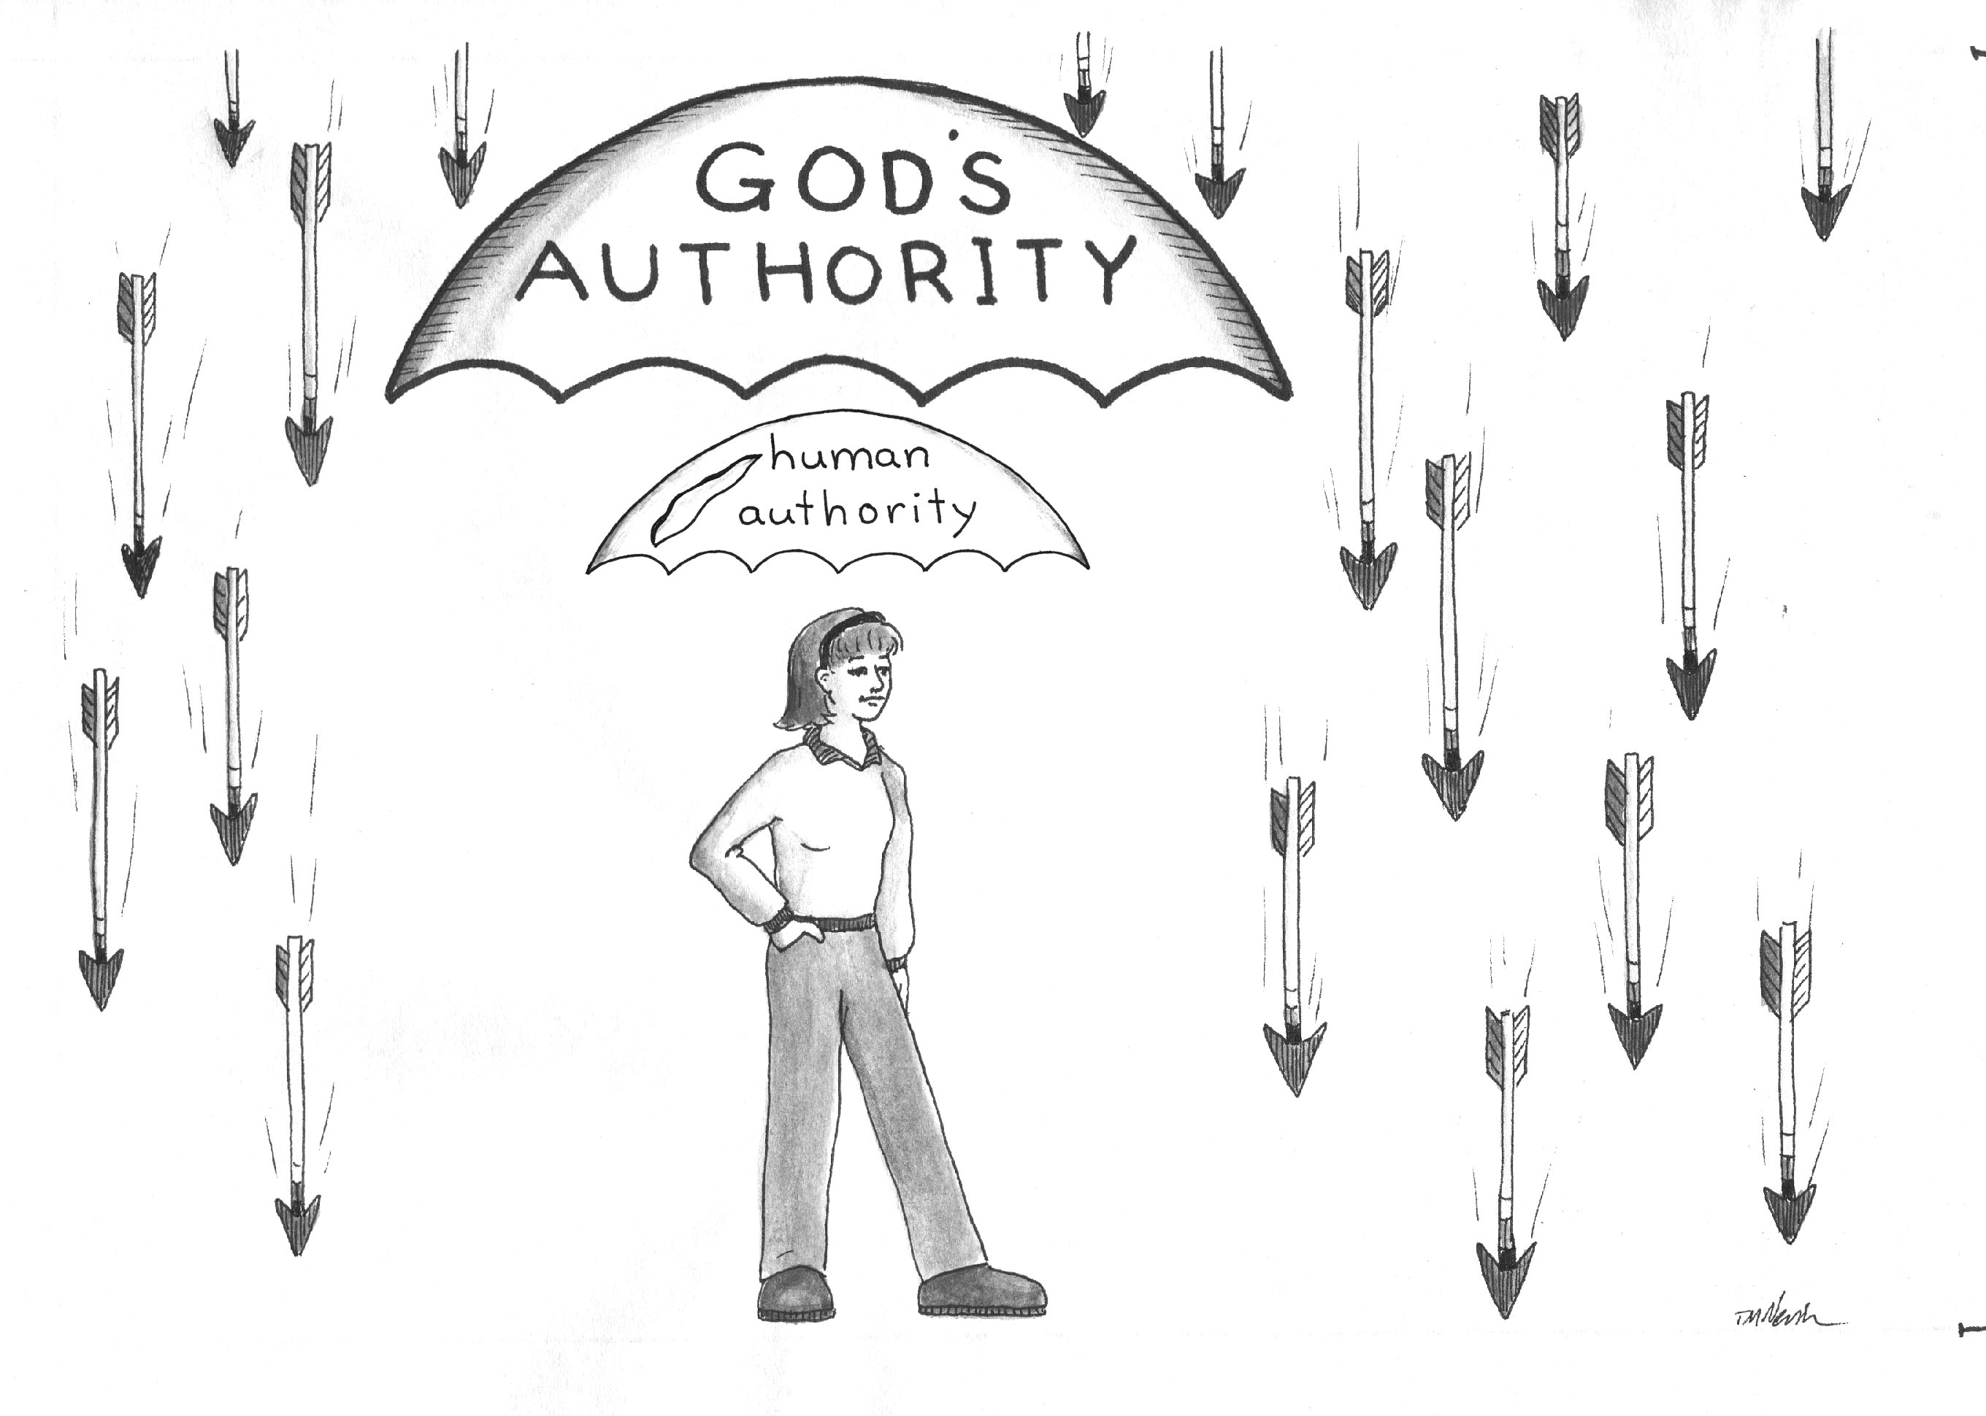

Slide 34
Separate the
POSITION
from the
PERSONALITY

Slide 35
Judge & Condemn
or
Discern & Intercede

Slide 36
Luke 6:37:38
“Do not judge, and you will not be judged. Do not condemn, and you will not be condemned. Forgive, and you will be forgiven. ³⁸ Give, and it will be given to you. A good measure, pressed down, shaken together and running over, will be poured into your lap. For with the measure you use, it will be measured to you.”

Slide 37
Our response to our leaders’ weaknesses is the greatest indicator of our spiritual maturity.

Slide 38
James 1:2-4
Consider it pure joy, my brothers, when you face trials of many kinds because you know that the testing of your faith develops perseverance. Perseverance must finish its work in you so that you may be mature and complete, not lacking anything.

Slide 39
1 Peter 2:20
But if you suffer for doing good, and you endure it, this is commendable before God. To this you were called because Christ suffered for you, leaving you an example, that you should follow in His steps. “He committed no sin, and no deceit was found in His mouth.” When they hurled insults at Him, He did not retaliate; when He suffered, He made no threats. Instead, He entrusted Himself to Him who judges justly.

Slide 40
Romans 12:19
Do not take revenge, my friends, but leave room for God’s wrath, for it is written: “It is mine to avenge; I will repay,” says the Lord.

Slide 41
Checklist to see if you’ve “met” authority:
Soft & tender heart
Afraid of being wrong
Never likes to be in authority
Never seeks position/power, only seeks the Lord
Meek & humble
Always trying to replace themselves
Keeps mouth shut - takes burdens to God instead of gossiping
No careless words, slander

Slide 42
Checklist to see if you’ve “met” authority:
Sensitive to rebellion around you
Don’t usurp delegated authority
Protect leaders like an armor bearer
You seek out authority in every situation and resolve to submit unconditionally to them.
The first question when in new situation is, “Who is in charge; whom do I need to submit myself to?”
Able to submit to any authority regardless of their age, competency level, experience, or relationship to you.

Slide 43
Checklist to see if you’ve “met” authority:
You rejoice in the God-given protection of your authorities and fear getting out from under that.
When in authority, you know your authority comes from God and you see your role as empowering others rather than oppressing them; you never have to remind them you are in authority or tell them to submit to you

Slide 44
Psalm 51:16-17
You do not delight in sacrifice, or I would bring it;
You do not take pleasure in burnt offerings.
The sacrifices of God are a broken spirit;
A broken and contrite heart, O God, You will not despise.

Slide 45
triad
s
What do you think?
Are you dealing with a “Saul” in your life? What should be your response?
How do you see “Saul” in your own heart?
Pray for each other

