Slide 1
Waiting, Dating, and Mating

Slide 2
Top 15 Christian Pick-up Lines:
15. What are you doing for the rest of your afterlife?
You and me, we’re like loaves and fishes…we just
might be a miracle.
Did you say your name was Esther? Oh, I guess I just
think you were chosen for such a time as this.
12. Excuse me, I believe one of your ribs belongs to me.
What's your name and number so I can add you to my
"prayer" list?
10. No, I'm not coveting; I intend to make you mine.
9. I didn’t believe in predestination until tonight.

Slide 3
Top 15 Christian Pick-up Lines:
8. Is this the transfiguration…because you are glowing
7. Bible-gateway happens to be my homepage.
6. My favorite species of vegetation is the church plant.
5. Now i know why Solomon had 700 wives… Because he
never met you.
4. You put the ‘cute’ back in persecution…
3. Wanna come over and watch Left Behind?
2. I don’t know if you noticed but, when you walked into
the room, that was me giving up a clap offering.
1. Hi, my name's Will...God's Will

Slide 5
Principle
vs.
Practice
Honor your parents
Call them regularly

Slide 6
1 Thessalonians 4:3-8
(around p.811 in visitor Bibles)

Slide 7
Principle
vs.
Practice
Avoid sexual immorality
Don’t date the way the world does

Slide 8
Matthew 5:8
Blessed are the pure in heart,
for they will see God.

Slide 9
What do you think of when you hear the word
“dating”?

Slide 10
Insanity
in·san·i·ty/inˈsanitē/
Doing the same thing
The same way
Yet expecting different results

Slide 11
body
soul
spirit
mind
emotions
will

Slide 12
God’s Love
Your highest good at my expense.

Slide 13
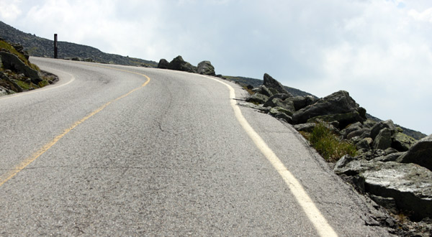
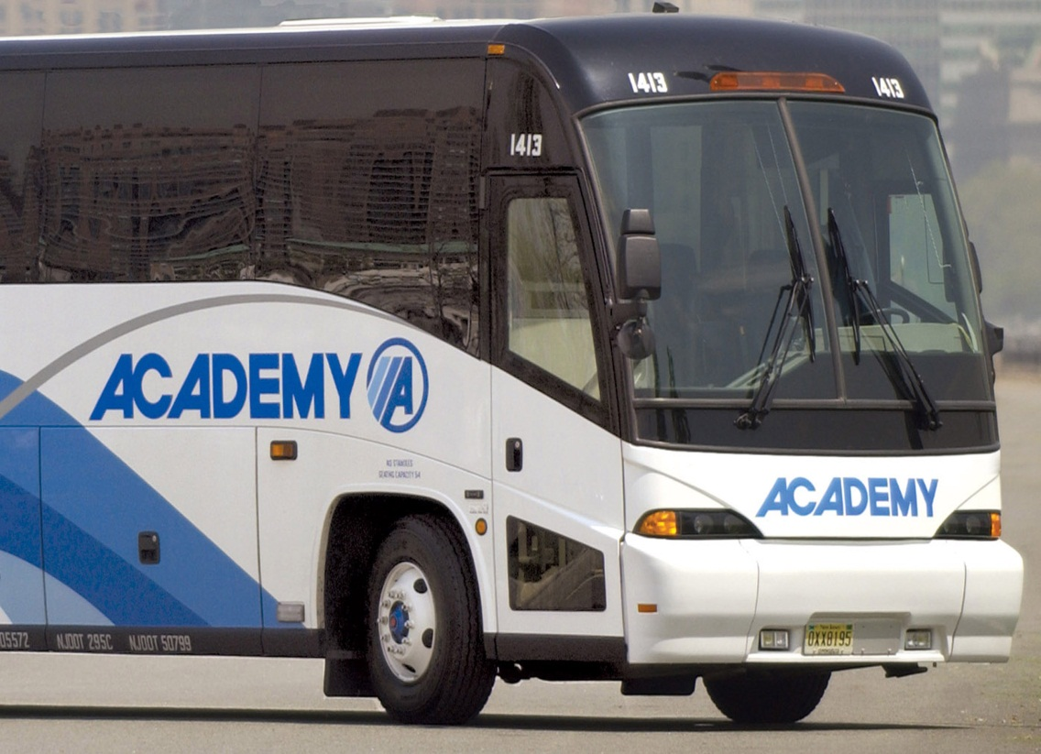

Slide 14
1 Corinthians 6:16-20
Do you not know that he who unites himself with a prostitute is one with her in body? For it is said, “The two will become one flesh.” ¹⁷ But whoever is united with the Lord is one with Him in spirit. ¹⁸ Flee from sexual immorality. All other sins a person commits are outside the body, but whoever sins sexually, sins against their own body. ¹⁹ Do you not know that your bodies are temples of the Holy Spirit, who is in you, whom you have received from God? You are not your own; ²⁰ you were bought at a price. Therefore honor God with your bodies.

Slide 15
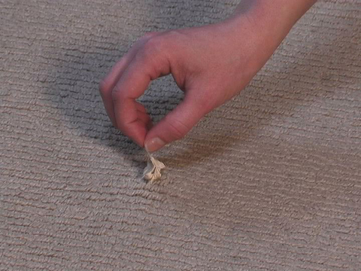

Slide 16
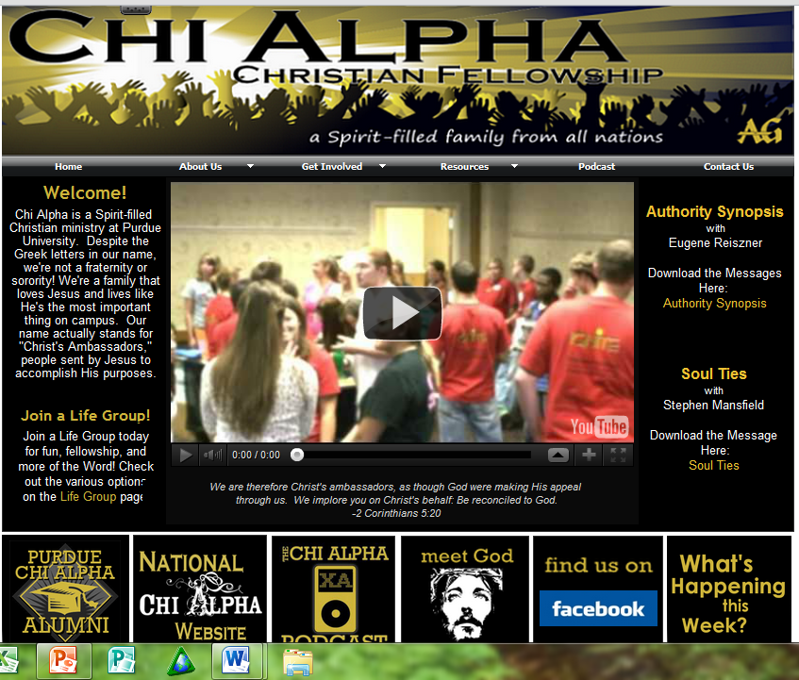

Slide 17
Purpose of Romance
To stir up one another’s sexual desires in order to move towards covenant
(or re-establishing covenant)

Slide 18
Galatians 5:19 (KJV)
Now the works of the flesh are manifest, which are these; adultery, fornication, uncleanness, lasciviousness (NIV & NAS- sensuality)
Lasciviousness = to stir up within ourselves (or others) desires that cannot be righteously fulfilled

Slide 20
Hebrews 13:4
Marriage should be honored by all, and the marriage bed kept pure, for God will judge the adulterer and all the sexually immoral.

Slide 21
Law of Diminishing Returns

Slide 22
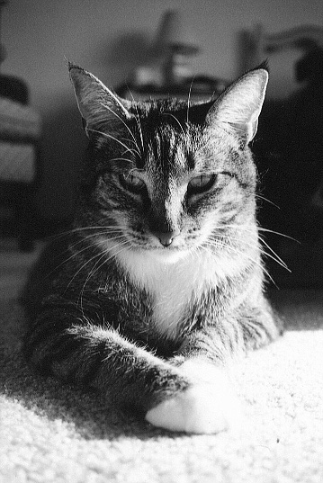

Slide 23
Recreational Dating (dating just to date)
Rewards of marriage w/o responsibility
Only thinks about present
Selfishly motivated

Slide 24
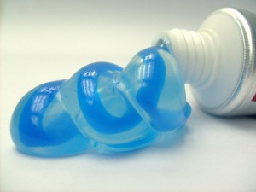

Slide 25
Litmus Test
Q: Would my spouse be OK with my actions?

Slide 26
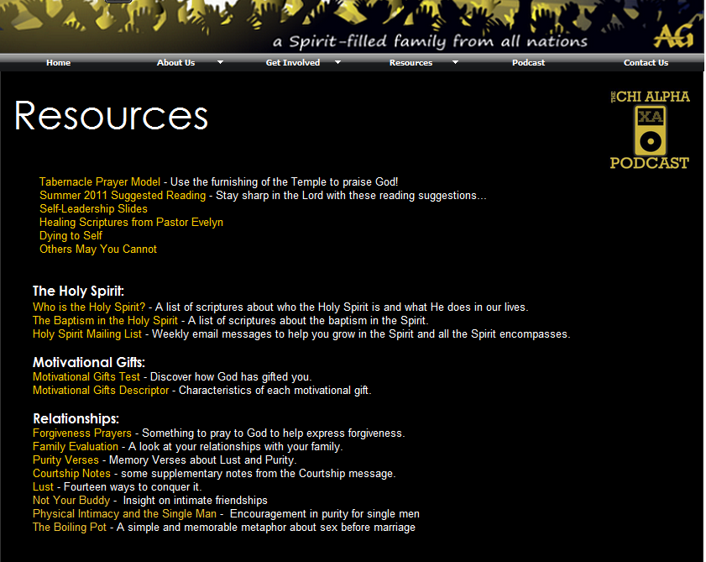

Slide 27
What do I do with attractions!?
Thank God for normal desires!
Don’t tell them!
Give it to God
Get in light with authority
Continue to treat them as brother/sister
Consider alternative to worldly dating

Slide 28
Waiting, Dating, and Mating
(Part 2)
February 24, 2012

Slide 29
Benefits of Courtship
Protect heart
No drama
Treat as brother/sister – maintain friendship after!
Increase spiritual life
Invite community into relationship
Increased accountability/prayer (not secretive)
Objective wisdom for future
Remain whole for spouse
And more!

Slide 31
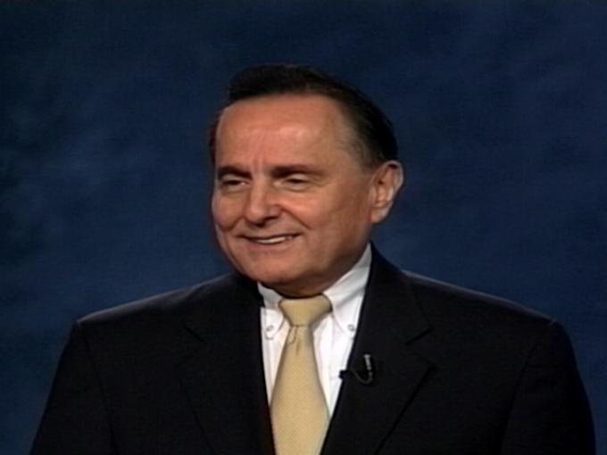
IBLP
Institute in Basic Life Principles
June 24-30

