Slide 1
triad
s
Name/major/hometown
You go home for spring break and want to go to a certain church on Sunday. Your parents, who are atheists, object to your going to church. What do you do?
Tell them you must obey God rather than man—and go to church
Tell them you’re going out with friends—but go to church instead
Stay home—and ask if there’s something you can do to help around the house
Other

Slide 2
The Kingdom of God
Authority, Part 2:
Honor Your Parents

Slide 3
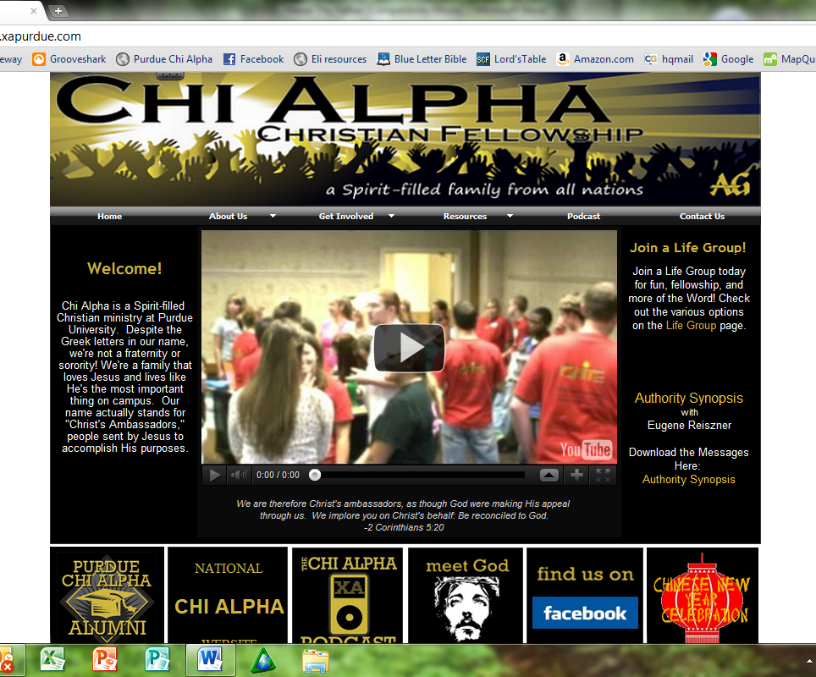

Slide 4
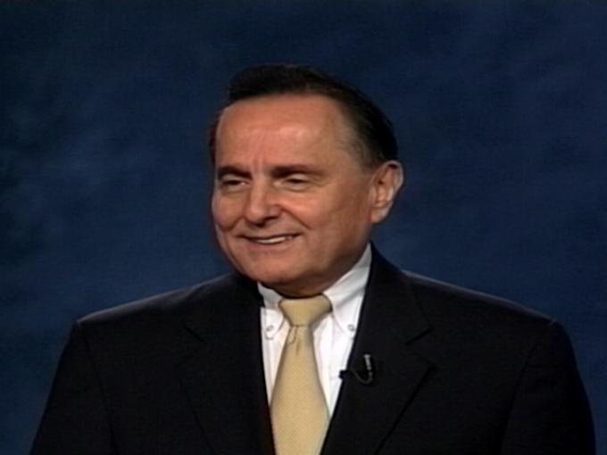
IBLP
Institute in Basic Life Principles
June 24-30

Slide 5
If you don’t believe God is good,
you will be
AFRAID of Him
(and of authority in general).

Slide 6
Where does authority come from?
Romans 13:1-2 (around page 788 in visitor Bibles)

Slide 7
Romans 13:1-2 (around page 788 in visitor Bibles)
“Everyone must submit himself to the governing authorities, for there is no authority except that which God has established. The authorities that exist have been established by God. Consequently, he who rebels against the authority is rebelling against what God has instituted, and those who do so will bring judgment on themselves.”

Slide 8
“All authority on heaven and earth has been given to Me.”
—Jesus, Matt. 28:18

Slide 9
IF God is good,
And every authority is established by God,
THEN…
The authorities in our lives are a good thing!

Slide 10
IF all authority comes from God,
THEN rebelling against authority means…
I am rebelling against God!

Slide 11
God and His delegated authority are inseparable.
If you touch authority, you touch God.

Slide 12
“Our entire relationship with God is regulated by whether or not we have met authority. If we have, then we shall encounter authority everywhere, and being thus restrained by God we can begin to be used by Him.”
—Watchman Nee, Spiritual Authority

Slide 13
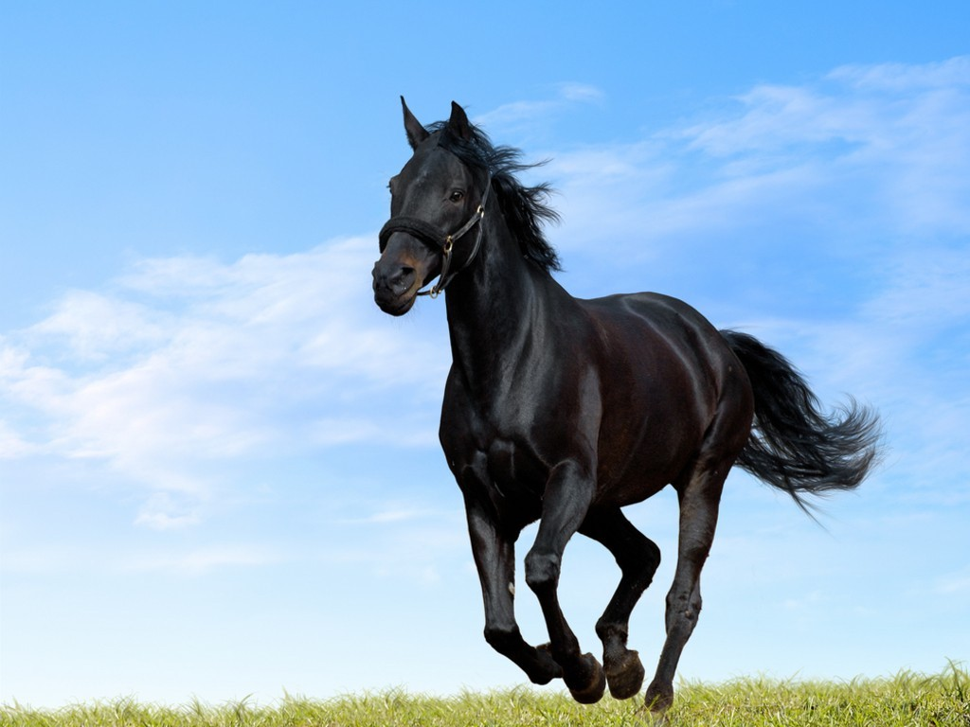

Slide 15
Types of Delegated Authority
Family
Government
Church
Business

Slide 17
Exodus 20:12
Honor your father and mother, so that you may live long in the land the LORD your God is giving you.

Slide 18
Ephesians 6:1-3
Children, obey your parents in the Lord, for this is right. “Honor your father and mother”—which is the first commandment with a promise—”that it may go well with you and that you may enjoy long life on the earth.”

Slide 19
Purpose of Delegated Authority
Grow you in wisdom & character

Slide 20
Luke 2:49-52
“Why were you searching for me?” He asked. “Didn’t you know I had to be in my Father’s house?” ⁵⁰ But they did not understand what He was saying to them.
Then He went down to Nazareth with them and was obedient to them. But his mother treasured all these things in her heart. ⁵²And Jesus grew in wisdom and stature, and in favor with God and men.

Slide 21
Romans 13:1-2
“Everyone must submit himself to the governing authorities, for there is no authority except that which God has established. The authorities that exist have been established by God. Consequently, he who rebels against the authority is rebelling against what God has instituted, and those who do so will bring judgment on themselves.”

Slide 25
Purpose of Delegated Authority
Grow you in wisdom & character
Protect you

Slide 29
Separate the
POSITION
from the
PERSONALITY

Slide 30
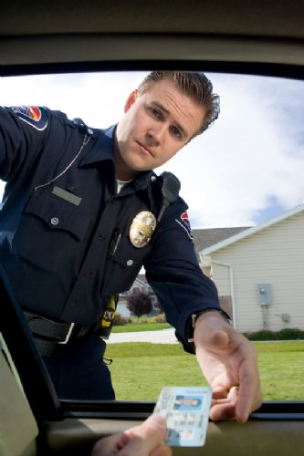

Slide 31
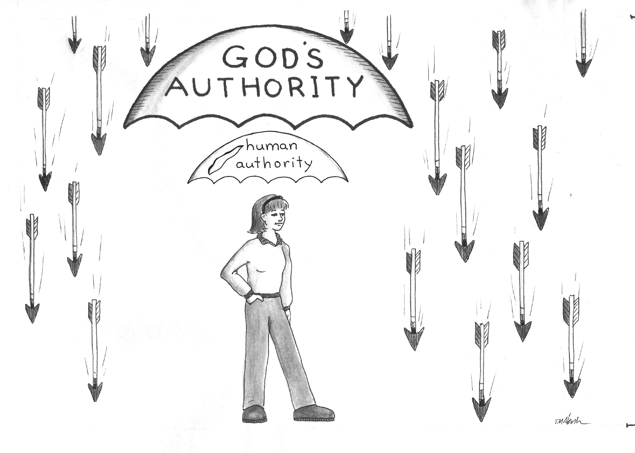

Slide 32
Judge & Condemn
or
Discern & Intercede

Slide 33
Purpose of Delegated Authority
Grow you in wisdom & character
Protect you
Guide you

Slide 34
How to Determine God’s Will:
Does it agree with God’s Word?
Do my authorities agree with it?
Do I have peace in my heart?
Do my circumstances confirm it?

Slide 35
“The king's heart is in the hand of the LORD; He directs it like a watercourse wherever He pleases.”
—Proverbs 21:1

Slide 38
faith

Slide 39
Practical Steps to Honor Your Parents
Submit unto them as unto God.
Be grateful for them; accept them for who they are.
Forgive them for all their faults, hurts, and failures.
Communicate your love and acceptance to them on an ongoing basis.
Speak honorably about them to others.

Slide 40
triad
s
What do you think?
What’s one thing you can do in the next week to honor your parents?
Are you in a test right now? How would God want you to respond?
Pray for each other.

