Slide 1
We have this treasure in earthen vessels…

Slide 2
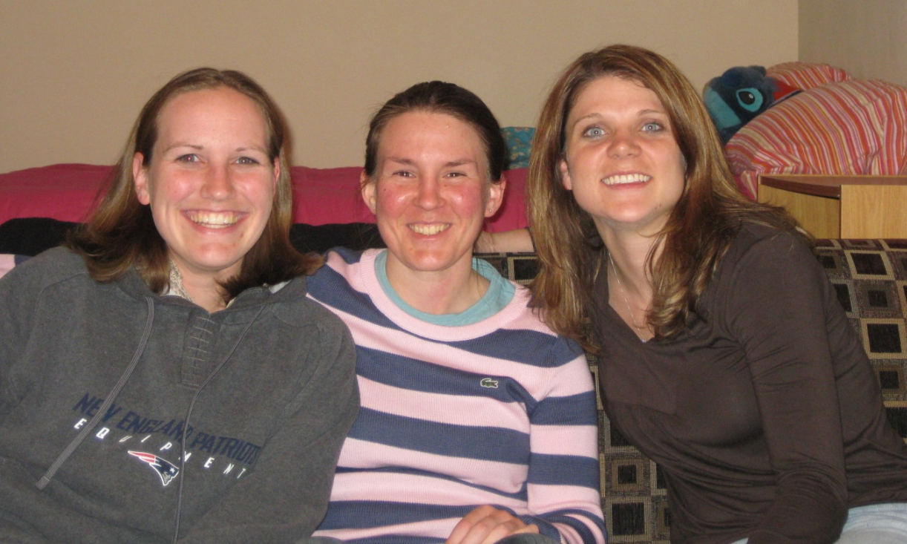
Stacey, Nicole, & Dan
Liz, Nicole, & Jenny

Slide 3
God wants us to grow up!
When I was a child, I talked like a child, I thought like a child, I reasoned like a child. When I became a man, I put childish ways behind me. (1 Corinthians 13:11)

Slide 4
God wants us to grow up!
¹¹ It was he who gave some to be apostles, some to be prophets, some to be evangelists, and some to be pastors and teachers, ¹² to prepare God’s people for works of service, so that the body of Christ may be built up ¹³ until we all reach unity in the faith and in the knowledge of the Son of God and become mature, attaining to the whole measure of the fullness of Christ. ¹⁴ Then we will no longer be infants, tossed back and forth by the waves, and blown here and there by every wind of teaching and by the cunning and craftiness of men in their deceitful scheming. ¹⁵ Instead, speaking the truth in love, we will in all things grow up into him who is the Head, that is, Christ. (Ephesians 4:11-15)

Slide 5
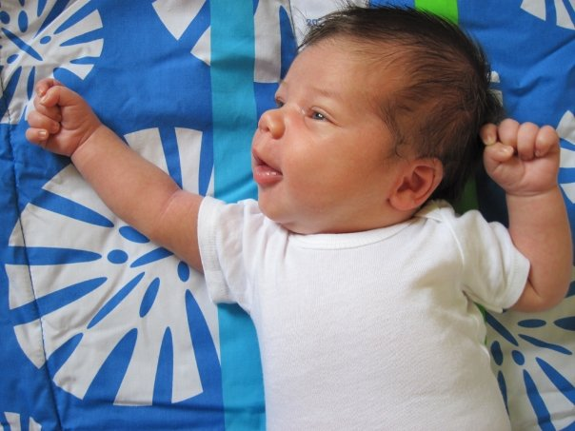
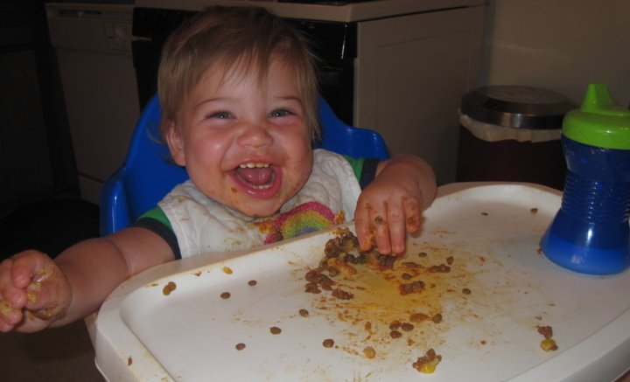

Slide 6
How does God mature us?
² Consider it pure joy, my brothers, whenever you face trials of many kinds, ³ because you know that the testing of your faith develops perseverance. ⁴ Perseverance must finish its work so that you may be mature and complete, not lacking anything. (James 1:2-4)

Slide 7
How does God mature us?
³ Not only so, but we also rejoice in our sufferings, because we know that suffering produces perseverance; ⁴ perseverance, character; and character, hope. ⁵ And hope does not disappoint us, because God has poured out his love into our hearts by the Holy Spirit, whom he has given us. (Romans 5:3-5)

Slide 8
How does God mature us?
⁷ Endure hardship as discipline; God is treating you as sons. For what son is not disciplined by his father? ⁸ If you are not disciplined (and everyone undergoes discipline), then you are illegitimate children and not true sons. ⁹ Moreover, we have all had human fathers who disciplined us and we respected them for it. How much more should we submit to the Father of our spirits and live! ¹⁰ Our fathers disciplined us for a little while as they thought best; but God disciplines us for our good, that we may share in his holiness. ¹¹ No discipline seems pleasant at the time, but painful. Later on, however, it produces a harvest of righteousness and peace for those who have been trained by it. (Hebrews 12:7-11)

Slide 9
Why does God have to break us?
2 Corinthians 4:7

Slide 10
2 Corinthians 4:7
But we have this treasure in earthen vessels, so that the surpassing greatness of the power will be of God and not from ourselves.

Slide 11
Why does God have to break us?
“Due to the distractions of the outward man, the spirit does not seem to function properly. It is basically because the outward man has never been dealt with. For this reason revival, zeal, pleading, and activity are but a waste of time. As we shall see, there is but one basic dealing which can enable man to be useful before God: brokenness.” (Release of the Spirit, Watchman Nee, pp.9-10)

Slide 12
Why does God have to break us?
I tell you the truth, unless a kernel of wheat falls to the ground and dies, it remains only a single seed. But if it dies, it produces many seeds. (John 12:24)
LIFE is in the SEED!

Slide 13
Why does God have to break us?
“Oh we must realize that all the experiences, troubles and trials which the Lord sends us are for our highest good…your daily trials are for your greatest profit.” (p. 13, Release of the Spirit)

Slide 14
Why does God have to break us?
¹⁶ In the wilderness He fed you manna which your fathers did not know, that He might humble you and that He might test you, to do good for you in the end. ¹⁷ Otherwise, you may say in your heart, ‘My power and the strength of my hand made me this wealth.’ (Deuteronomy 8:16-17)

Slide 15
What does brokenness look like?

Slide 16
How long???
¹⁷ Now when Pharaoh had let the people go, God did not lead them by the way of the land of the Philistines, even though it was near; for God said, “The people might change their minds when they see war, and return to Egypt.” ¹⁸ Hence God led the people around by the way of the wilderness to the Red Sea; and the sons of Israel went up in martial array from the land of Egypt. (Exodus 13:17-18)

Slide 17
How long???
²⁹ I will not drive them out before you in a single year, that the land may not become desolate and the beasts of the field become too numerous for you. ³⁰ I will drive them out before you little by little, until you become fruitful and take possession of the land. (Exodus 23:29-30)

Slide 18
How should we respond to God’s breaking?
When He reveals sin to you, repent quickly and ask for His grace to change!

Slide 19
How should we respond to God’s breaking?
When He reveals sin to you, repent quickly and ask for His grace to change!
Don’t let yourself get consumed with YOUR issues

Slide 20
How should we respond to God’s breaking?
When He reveals sin to you, repent quickly and ask for His grace to change!
Don’t let yourself get consumed with YOUR issues
Isaiah 58:9-12

Slide 21
How should we respond to God’s breaking?
When He reveals sin to you, repent quickly and ask for His grace to change!
Don’t let yourself get consumed with YOUR issues
Isaiah 58:9-12
Don’t complain! Thank God instead – HE is answering YOUR prayers ☺

Slide 22
How should we respond to God’s breaking?
¹² Beloved, do not be surprised at the fiery ordeal among you, which comes upon you for your testing, as though some strange thing were happening to you; ¹³ but to the degree that you share the sufferings of Christ, keep on rejoicing, so that also at the revelation of His glory you may rejoice with exultation. (1 Peter 4:12-13)

Slide 23
How will YOU respond?
¹ The word which came to Jeremiah from the LORD saying, ² “Arise and go down to the potter’s house, and there I will announce My words to you.” ³ Then I went down to the potter’s house, and there he was, making something on the wheel. ⁴ But the vessel that he was making of clay was spoiled in the hand of the potter; so he remade it into another vessel, as it pleased the potter to make. ⁵ Then the word of the LORD came to me saying, ⁶ “Can I not, O house of Israel, deal with you as this potter does?” declares the LORD. “Behold, like the clay in the potter’s hand, so are you in My hand, O house of Israel. (Jeremiah 18:1-6)

