Slide 1
"If Jesus ever commanded us to do something that He was unable to equip us to accomplish, He would be a liar. And if we make our own inability a stumbling block or an excuse not to be obedient, it means that we are telling God that there is something which He has not yet taken into account."
- Oswald Chambers

Slide 2
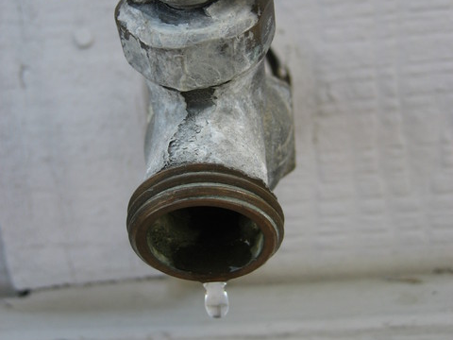

Slide 3
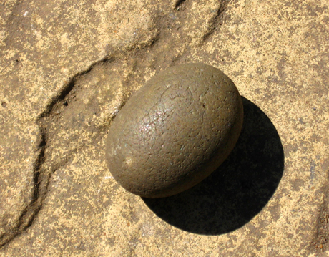

Slide 4
“Catch for us the foxes, the little foxes that ruin the vineyards, our vineyards that are in bloom.”
- Song of Solomon 2:15

Slide 5
He lies in wait like a lion in cover; he lies in wait to catch the helpless; he catches the helpless and drags them off in his net.
- Psalm 10:9

Slide 6
Three Steps to Walking in Victory this Summer!

Slide 7
N = Neutrality
E =
T =

Slide 8
"He who is not with Me is against me, and he who does not gather with Me scatters.” - Mt. 12:30
“You adulterous people, don't you know that friendship with the world is hatred toward God? Anyone who chooses to be a friend of the world becomes an enemy of God.” - James 4:4
“So, because you are lukewarm—neither hot nor cold— I am about to spit you out of My mouth.” - Rev. 3:16

Slide 9
N = Neutrality
E = Entitlement
T =

Slide 10
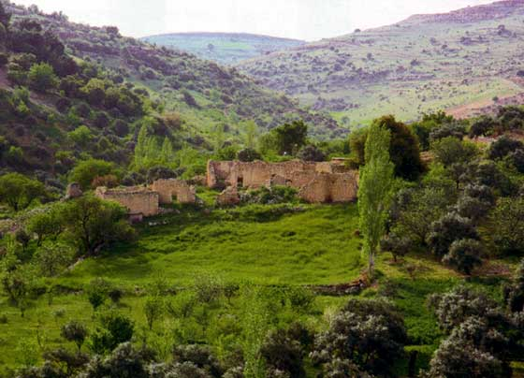
Genesis 13:8-13
(p.8)

Slide 11
“Do not be deceived: God cannot be mocked. A man reaps what he sows. The one who sows to please his sinful nature, from that nature will reap destruction; the one who sows to please the Spirit, from the Spirit will reap eternal life.”
- Galatians 6:7-8

Slide 12
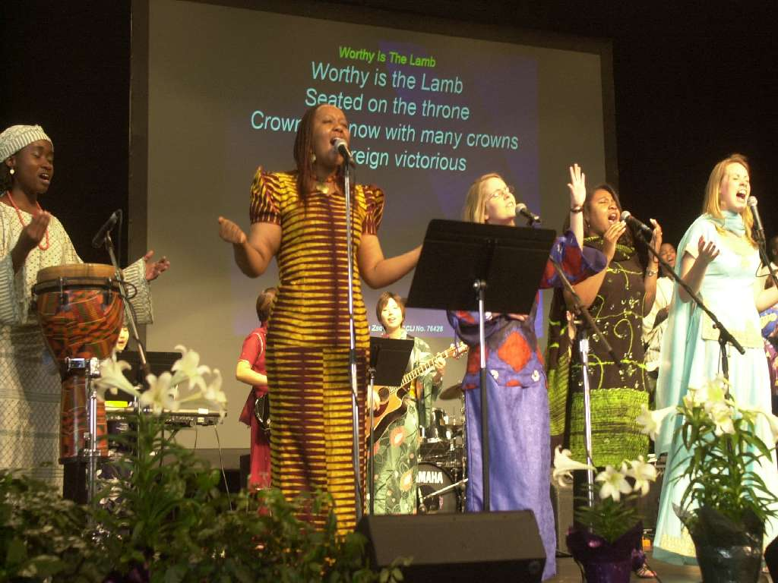
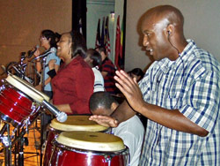
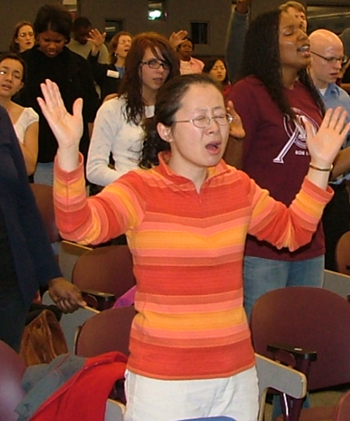
All Nations
Int’l Student Conference
May 21-26

Slide 13
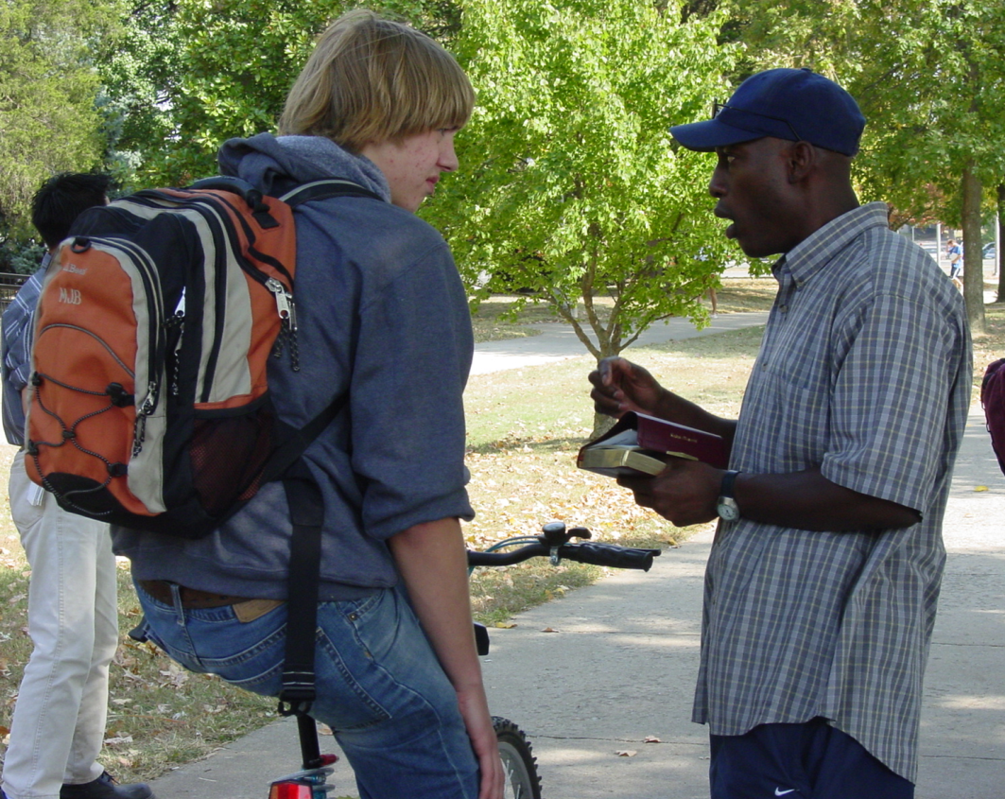
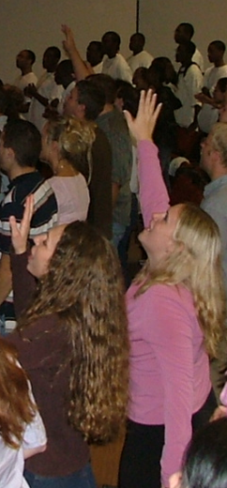
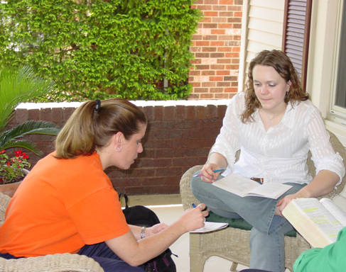
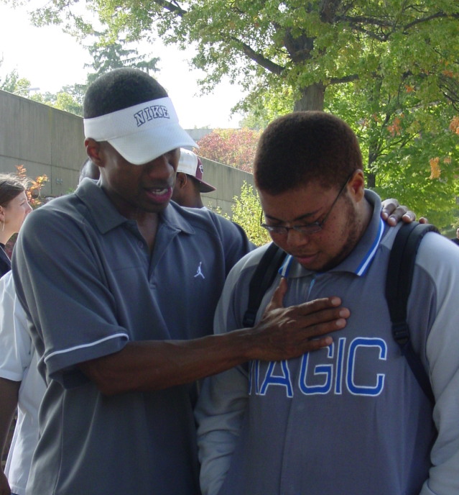
Chi Alpha U
Training Conference
June 15-18

Slide 14
N = Neutrality
E = Entitlement
T = Time

Slide 15
2 Samuel 11:1-5
(p.217)

Slide 16
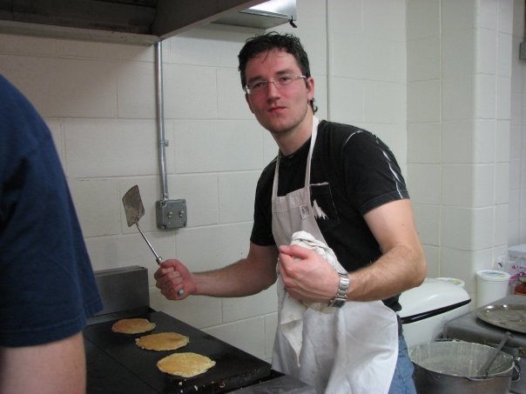
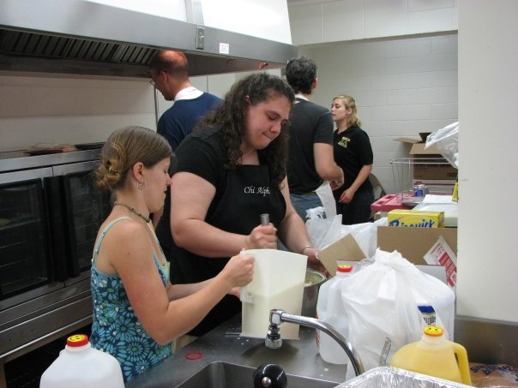
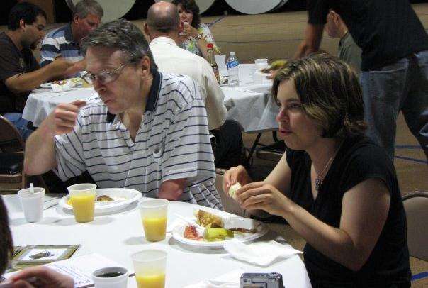
XA Connection Points
Saturday, June 13
2nd Annual
Pancake Breakfast!

Slide 17
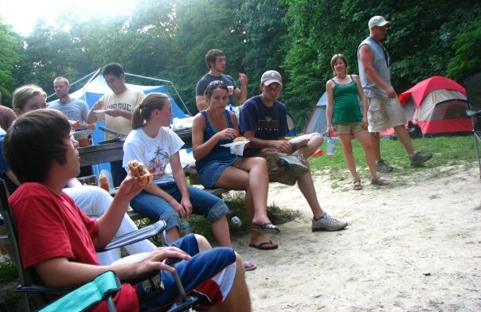
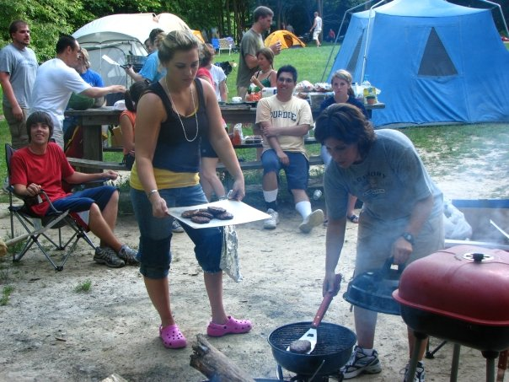
July 10-11 Float/Camping Trip @ Turkey Run!

Slide 18
August 7-8 All-Night Prayer Meeting! (week of prayer/fasting Aug. 2-7)

Slide 19
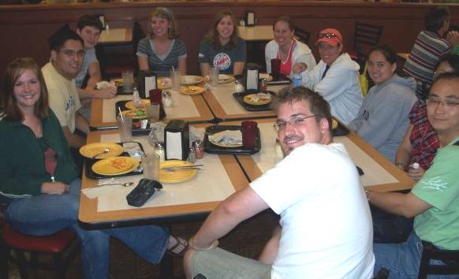
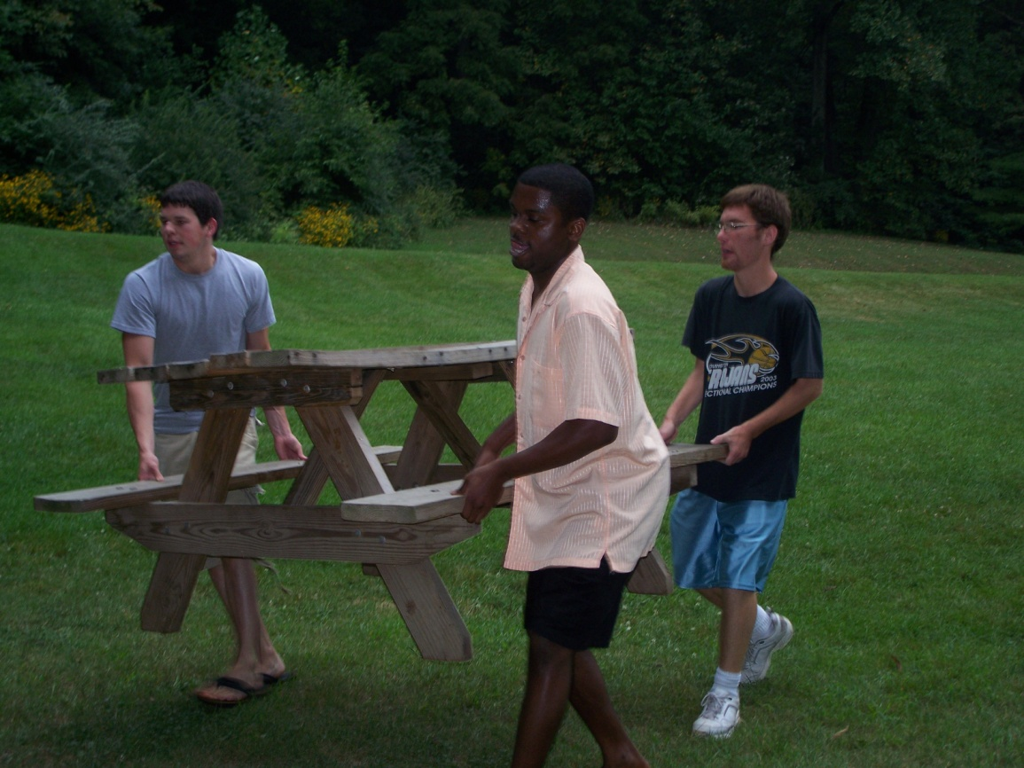
August 9-22 Int’l Orientation & BGR

