Slide 1
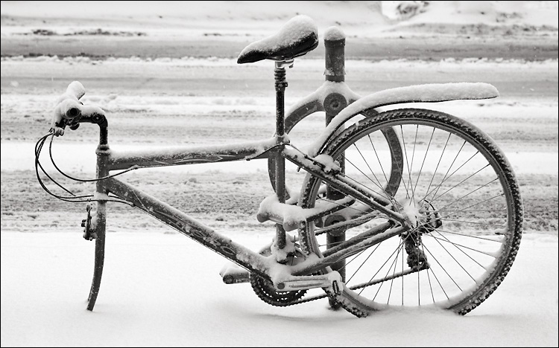

Slide 2
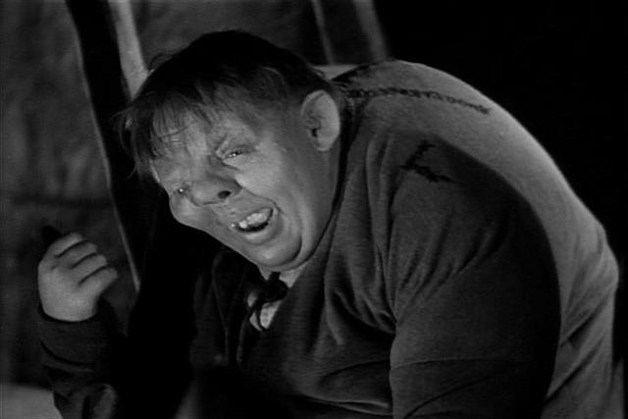
Incarnational
HOW you go
What people see as you go

Slide 3
