Slide 1
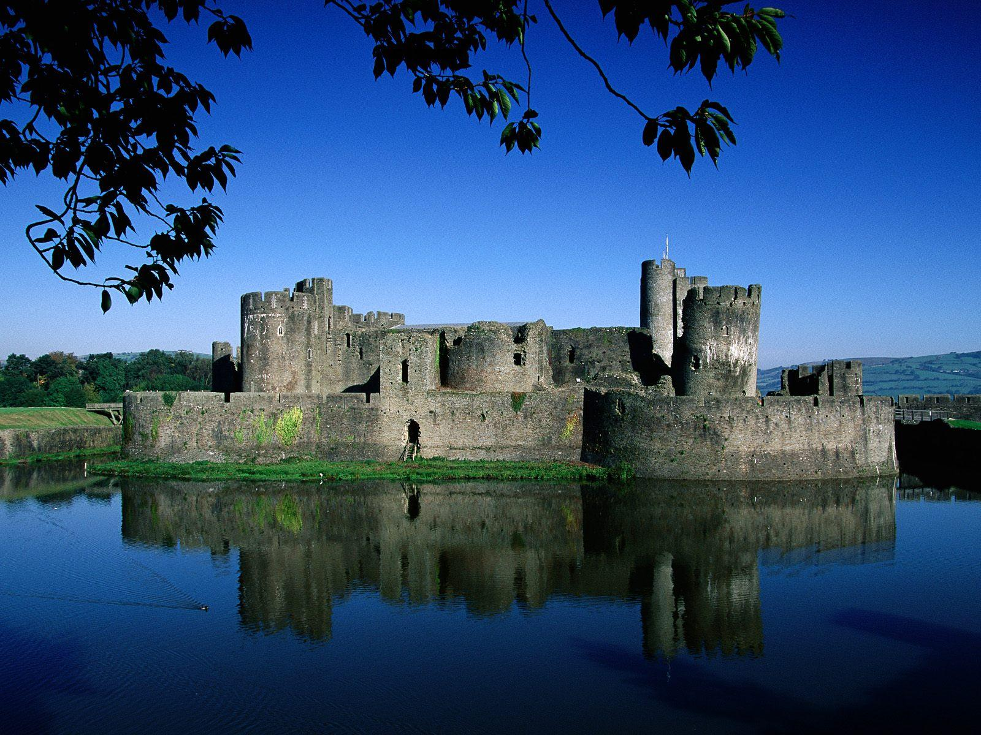
The Kingdom of God

Slide 2
Define a Paradox
A. Mallard mates
B. A couple of surgeons
C. Two piers
D. A statement seemingly self-contradictory or absurd but, in reality, expressing a truth

Slide 3
Kingdom Paradox
We are called to represent the kingdom,
and to preach the kingdom,
yet we don’t know what it is.
We are….king-dumb! ☺

Slide 4
The Kingdom of God:
It’s Not A Democracy

Slide 5
The Kingdom of God was central
to Jesus’ ministry

Slide 6
Luke 1:31-33
“You will be with child and give birth to a son, and you are to give Him the name Jesus. ³² He will be great and will be called the Son of the Most High. The Lord God will give Him the throne of His father David, ³³ and He will reign over the house of Jacob forever; His kingdom will never end.”

Slide 7
Mark 1:15
“The kingdom of God is near. Repent and believe the good news.”

Slide 8
Mark 4:23
Jesus went throughout Galilee, teaching in their synagogues, preaching the good news of the kingdom, and healing every disease and sickness among the people.

Slide 9
80% of Jesus’ parables were explanations of what the Kingdom of God is like

Slide 10
Matthew 21:5
See, your king comes to you, gentle and riding on a donkey, on a colt, the foal of a donkey.

Slide 11
Matthew 24:14
And this gospel of the kingdom will be preached in the whole world as a testimony to all nations, and then the end will come.

Slide 12
Acts 1:3
After His suffering, He showed himself to these men and gave many convincing proofs that He was alive. He appeared to them over a period of forty days and spoke about the kingdom of God.

Slide 13
Revelation 19:16
On his robe and on his thigh he has this name written: king of kings and lord of lords.

Slide 14
Acts 8:12
But when they believed Philip as he preached the good news of the kingdom of God and the name of Jesus Christ, they were baptized, both men and women.

Slide 15
Acts 19:8
Paul entered the synagogue and spoke boldly there for three months, arguing persuasively about the kingdom of God.

Slide 16
Acts 20:25
Now I know that none of you among whom I have gone about preaching the kingdom will ever see me again.

Slide 17
Acts 28:31
Boldly and without hindrance he preached the kingdom of God and taught about the Lord Jesus Christ.

Slide 18
Acts 28:23
From morning till evening he explained and declared to them the kingdom of God and tried to convince them about Jesus from the Law of Moses and from the Prophets.

Slide 19
Galatians 5:21
I warn you, as I did before, that those who live like this will not inherit the kingdom of God.

Slide 20
Ephesians 5:5-6
For of this you can be sure: No immoral, impure or greedy person — such a man is an idolater — has any inheritance in the kingdom of Christ and of God.

Slide 21
2 Peter 1:10-11
For if you do these things, you will never fall, and you will receive a rich welcome into the eternal kingdom of our Lord and Savior Jesus Christ.

Slide 22
Hebrews 12:28-29
Therefore, since we are receiving a kingdom that cannot be shaken, let us be thankful, and so worship God acceptably with reverence and awe, for our “God is a consuming fire.”

Slide 23
Psalm 10:16
The Lord is King for ever and ever

Slide 24
Psalm 24:8
Who is this King of glory? The Lord strong and mighty, the Lord mighty in battle.

Slide 25
Psalm 29:10
The Lord sits enthroned over the flood; the Lord is enthroned as King forever

Slide 26
Psalm 47:2
How awesome is the Lord Most High, the great King over all the earth!

Slide 27
Psalm 145:1
I will exalt you, my God the King; I will praise Your name for ever and ever.

Slide 28
Kingdom vs. Democracy
Rule of King – who owns Kingdom
Rules for life
Makes laws himself
Unlimited authority overall
Authority = binding/absolute
Subjects dependent on king
Don’t like king's decree? Too bad!
Imprisonment
death
Law can only be changed by king
Rule of People
Vote in leaders
Vote on laws
Elected leaders have limited power
Vote bad leaders out
Will of majority
Don’t like it, vote to change it
Laws can only be changed by the will of the majority of the people

Slide 29
Kingdom of God
Rule of King – who owns Kingdom

Slide 30
Psalm 24:1
The earth is the Lord’s, and everything in it, the world, and all who live in it

Slide 31
Kingdom of God
Rule of King – who owns Kingdom
Rules for life

Slide 32
Exodus 15:18
The Lord will reign forever and ever.

Slide 33
Kingdom of God
Rule of King – who owns Kingdom
Rules for life
Makes laws himself

Slide 34
Psalm 115:3
Our God is in heaven;
He does whatever pleases Him.

Slide 35
Kingdom of God
Rule of King – who owns Kingdom
Rules for life
Makes laws himself
Unlimited authority overall

Slide 36
Psalm 103:19
The Lord has established his throne in heaven, and His kingdom rules over all.

Slide 37
Kingdom of God
Rule of King – who owns Kingdom
Rules for life
Makes laws himself
Unlimited authority overall
Authority = binding/absolute

Slide 38
Matthew 6:13
For Yours is the kingdom and the power and the glory forever.

Slide 39
Kingdom of God
Rule of King – who owns Kingdom
Rules for life
Makes laws himself
Unlimited authority overall
Authority = binding/absolute
Subjects dependent on king

Slide 40
John 15:5
Apart from Me you can do nothing.

Slide 41
Kingdom of God
Rule of King – who owns Kingdom
Rules for life
Makes laws himself
Unlimited authority overall
Authority = binding/absolute
Subjects dependent on king
Don’t like king's decree? Too bad!
Imprisonment
Death

Slide 42
Hebrews 10:26-27
If we deliberately keep on sinning after we have received the knowledge of the truth, no sacrifice for sins is left, but only a fearful expectation of judgment and of raging fire that will consume the enemies of God. “

Slide 43
Kingdom of God
Rule of King – who owns Kingdom
Rules for life
Makes laws himself
Unlimited authority overall
Authority = binding/absolute
Subjects dependent on king
Don’t like king's decree? Too bad!
Imprisonment
Death
Law can only be changed by king

Slide 44
Psalm 89:34
I will not violate My covenant
or alter what my lips have uttered.

Slide 45
A kingdom is a realm ruled by a king.

Slide 46
Luke 17:20-21
Once, having been asked by the Pharisees when the kingdom of God would come, Jesus replied, “The kingdom of God does not come with your careful observation, nor will people say, ‘Here it is,’ or ‘There it is,’ because the kingdom of God is within you.

Slide 47
Luke 19:11-27
(around page 729 in visitor Bibles)

Slide 48
John 3:30
He must become greater;
I must become less.

