Slide 1
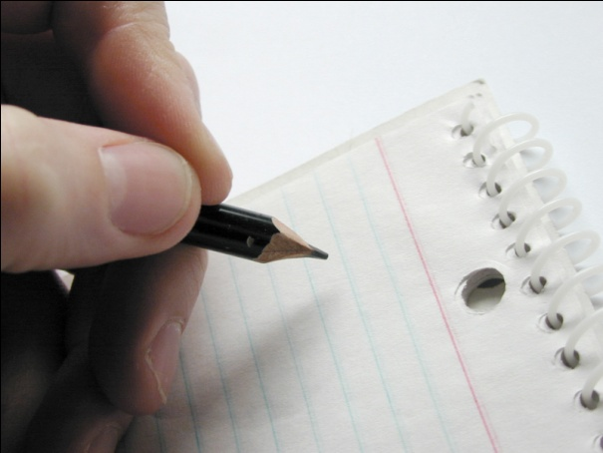
Creating a Monthly Newsletter That People Will Actually Read!

Slide 2
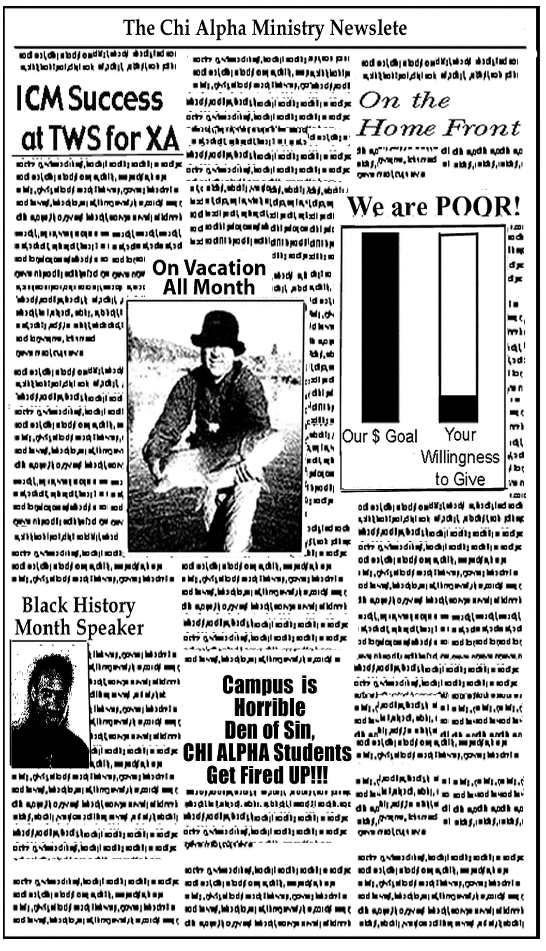

Slide 3
The Ten Commandments of Layout and Design for Donor Newsletters
And Curt Harlow, the National Chi Alpha Resource Guy, spoke all these words:
“I am married to a great graphic designer and she brought me out of the land of bad newsletters and spake unto me….

Slide 4
Commandment 1
Thou shalt clearly display thy NAME, picture, and FULL NAME OF THY MINISTRY at the top of thy newsletter, and thou shalt indicate that thou art an AG US missionary and SEND A COPY to thy distinguished department head.

Slide 5
Commandment 2
Thou shalt not make for thyself a newsletter that is OVER CROWDED. Nor shall it have small text, and a cacophony of images or thou wilt not receive support for a thousand generations.

Slide 6
Commandment 3
Thou shalt not use THE COLOR BURNT ORANGE (or similar Kinko’s discount paper colors) on your newsletter.

Slide 7
Commandment 4
Remember the Sabbath and actually SCHEDULE TIME every month to do the job with excellence. If thou doeth it at the last minute, thy supporters shall thinketh, “This is a sloppy ministry and I shall find another place to invest my coin.”

Slide 8
Commandment 5
Thou shalt HONOR THY SUPPORTERS in every letter and it will go well with you. Tell them thanks, yet avoid financial appeal (as it will fall wistfully on barren ground) and never use “poor” talk.

Slide 9
Commandment 6
Thou shalt not murder the English language.
FIND A PROOFREADER.
(And no, spell check does not count.)

Slide 10
Commandment 7
Thou shalt not engage in BAD PHOTOCOPIES.

Slide 11
Commandment 8
Thou shalt STEAL GOOD IDEAS from friends in ministry.

Slide 12
Commandment 9
Thou shalt not give five testimonies and seven updates with six prayer requests and fourteen scriptures. STICK TO ONE MAIN THEME and this shalt thou do creatively.

Slide 13
Commandment 10
Do covet thy neighbor’s COLOR INK JET PRINTER. Raise your budget and get thine own.

Slide 14
I will mostly likely read your newsletter if…
You send them to me.
How often should you send newsletters?
What percentage of your recipients do you think thoroughly read your letters?
What is the best time to send your newsletters?

Slide 15
Something to think about…
Consider sending your newsletters every month to your donors. Send them quarterly to others on your list.
Set a deadline each month.
Consider holding 5 -10 back every month to write personal notes.

Slide 16
I will read your newsletters if…
You tell me stories.
This month we had our annual J.E.E.P. (Jesus Evangelistic Excitement Party) put on by our W.E.E.P. (We Evangelize Everything Powerfully) Committee. It was a great outreach on campus because we brought in guest speaker Ricky P. Anointed. A lot of students came to hear him. It was a great evening. Sure cost a lot to pay him though. Please remember to give this month.

Slide 17
How about this instead?
Sheryl had never been to church. But by the grace of God, the church did come to her. You see Sheryl has a Christian roommate who also happens to be a Chi Alpha leader at the U of O. Her name is Joanne and she has been sharing the Gospel with her suite mate every week one- on-one since the school year began.

Slide 18
In fact the entire fellowship had been praying for her every Wednesday as well. That is why none of us were too surprised when Sheryl showed up for our meeting during our annual evangelistic outreach last week. Surprised no. Excited to see what God would do…yes. And He did not let us down. As the altar call was given Sheryl…

Slide 19
From “7 Deadly Diseases of Ministry Marketing, Confessions of a Christian Fundraiser”:
“If the ministry is actually accomplishing something of value, it is somehow helping people.”
If no such testimonies can be found, it means one of two horrible things: either (a) the ministry has no adequate apparatus for collecting such stories, or (b) the ministry isn’t really accomplishing anything in people’s lives.

Slide 20
From “7 Deadly Diseases of Ministry Marketing, Confessions of a Christian Fundraiser”:
Please don’t let (b) be true; the answer must be (a)!
The vast majority of ministries have no apparatus at all for collecting success stories – I’ll call them “testimonies” – because they do not understand the crucial importance of sharing them with donors.

Slide 21
From “7 Deadly Diseases of Ministry Marketing, Confessions of a Christian Fundraiser”:
I can relate to another human being – better than I can relate to statistics about thousands of people helped.
S.O.T.O stands for: story of the one.
The average donor is far more interested in what happened to someone than they are in how your program works, or why.

Slide 22
I will read your newsletters if…
They are interesting.
If the donor comes to expect boring, low-energy communication from you mailing after mailing, the relationship is doomed.

Slide 23
I will read your newsletters if…
You write to me and not some generic group.
When you write, imagine a real friend sitting across the table from you.
Think of a specific donor and how they will read your letter.

Slide 24
I will read your newsletters if…
You remind me over and over again why your ministry is unique and important.
Only you can tell what God is doing inside your ministry, where He’s leading you, what’s on the horizon.
Continually push to reflect the specific accomplishments of your ministry.
Let me meet the individuals impacted by the work.

Slide 25
I will read your newsletters if…
Let me see the specific changes that have come about as a result of this ministry.
Take me behind the scenes, into your heart, into the hearts of those whose lives will never be the same because this ministry intersected with them at some wonderful point in time!

Slide 26
I will read your newsletters if…
They are short.
“If your newsletter is too wordy, people will read it later or they won’t read it at all!”

Slide 27
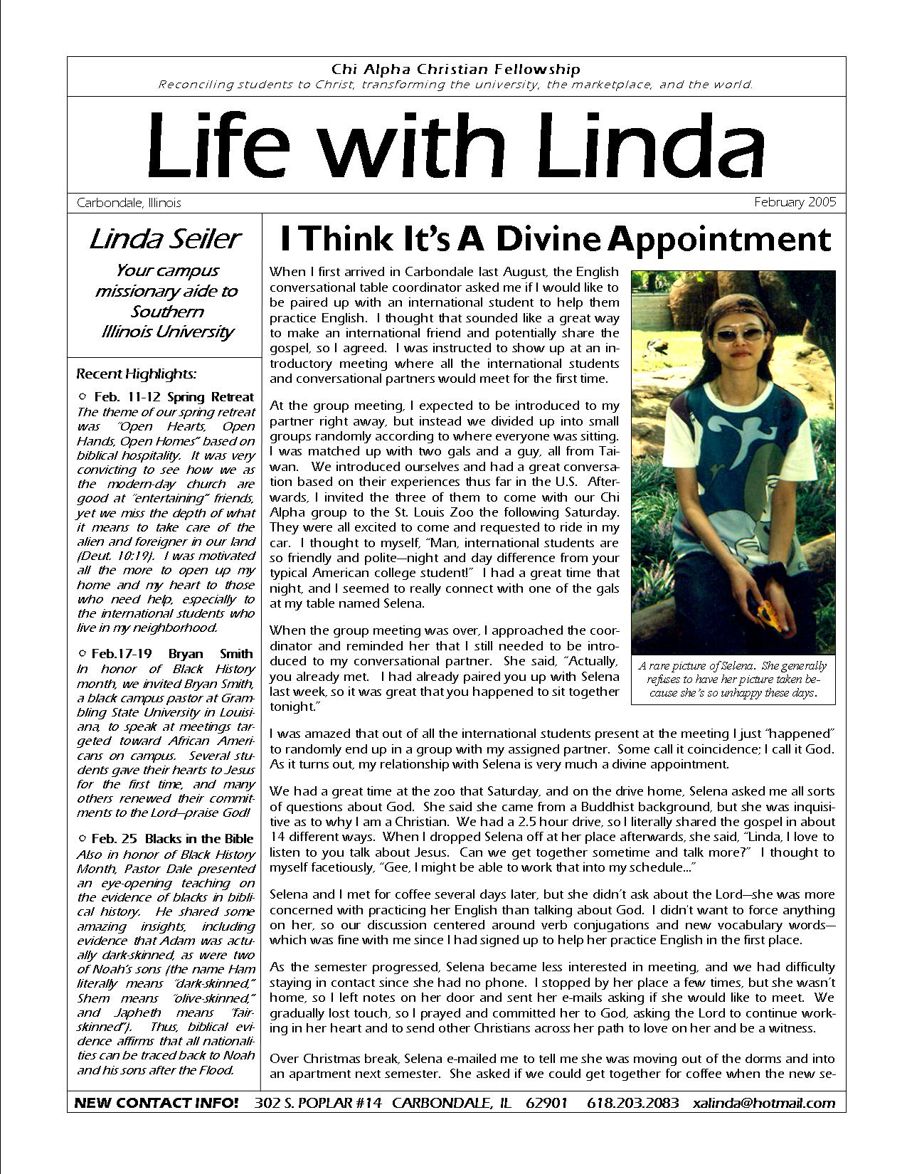
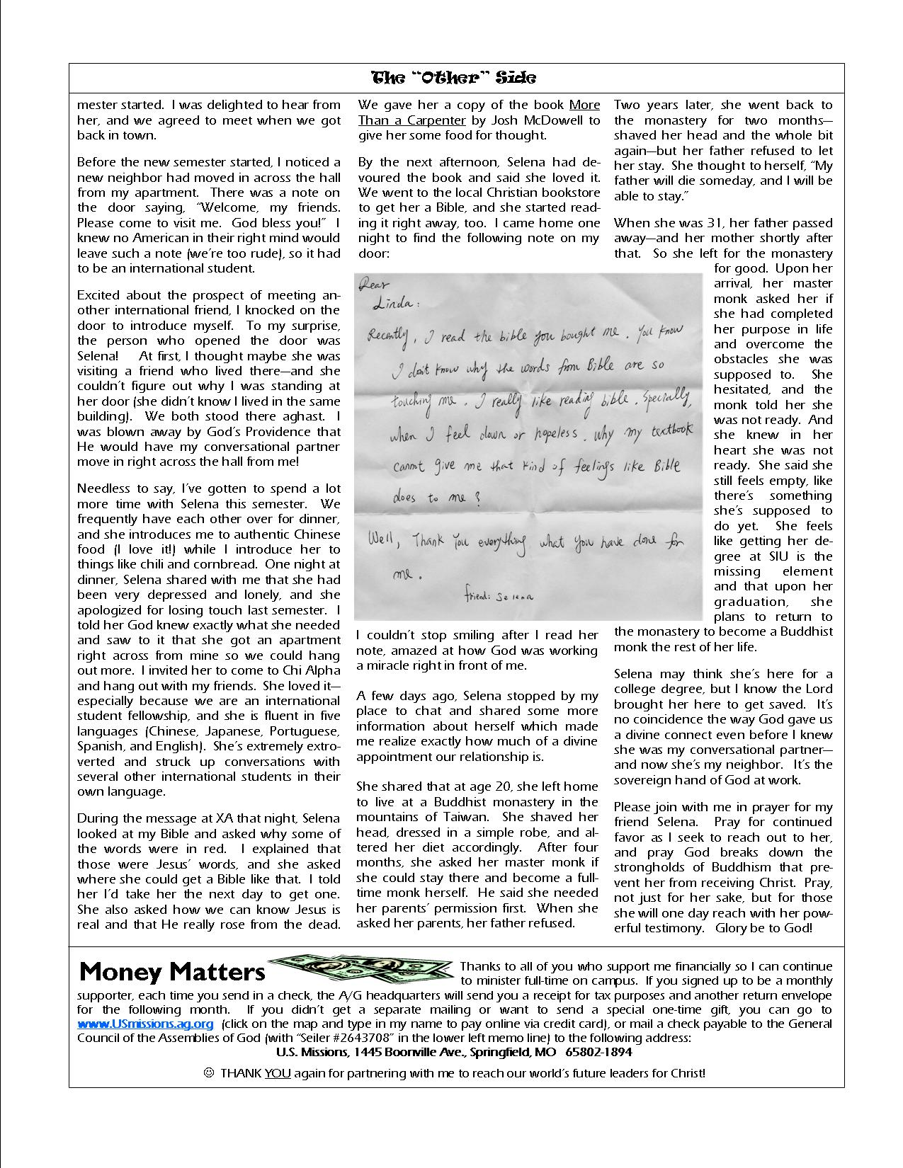

Slide 28
Keep it short…
No sermonettes from your quiet time that only your mother will read ☺
One topic, one page!
Use email intro for personal note…
Focus on ministry, not personal life

Slide 29
If will read your newsletters if…
They are well-written.
Find proofreader!
Only two fonts max!
Serif is easier to read
It’s sure been a long time since I’ve written…
Concise and to the point
Interesting introduction

Slide 30
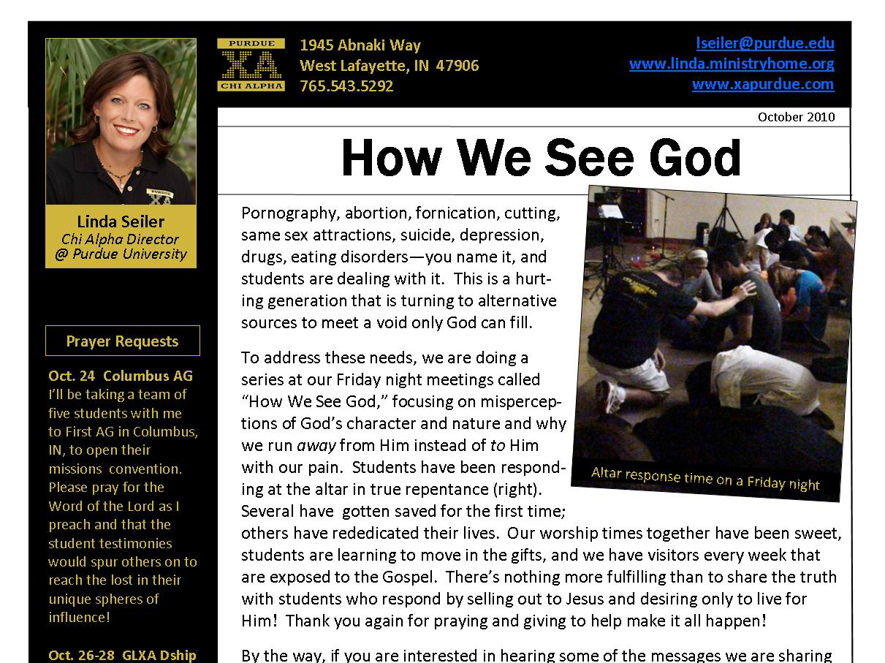

Slide 31
If will read your newsletters if…
They are well-written.
Avoid Christianese jargon
Avoid generalities
Use specific date

Slide 32
If will read your newsletters if…
8. They contain lots of white space.
It lets the reader know that the text will not take too much of his time.
It also can be used to make the letter look creative.

Slide 33
I will read your newsletters if…
You use great photos.

Slide 34
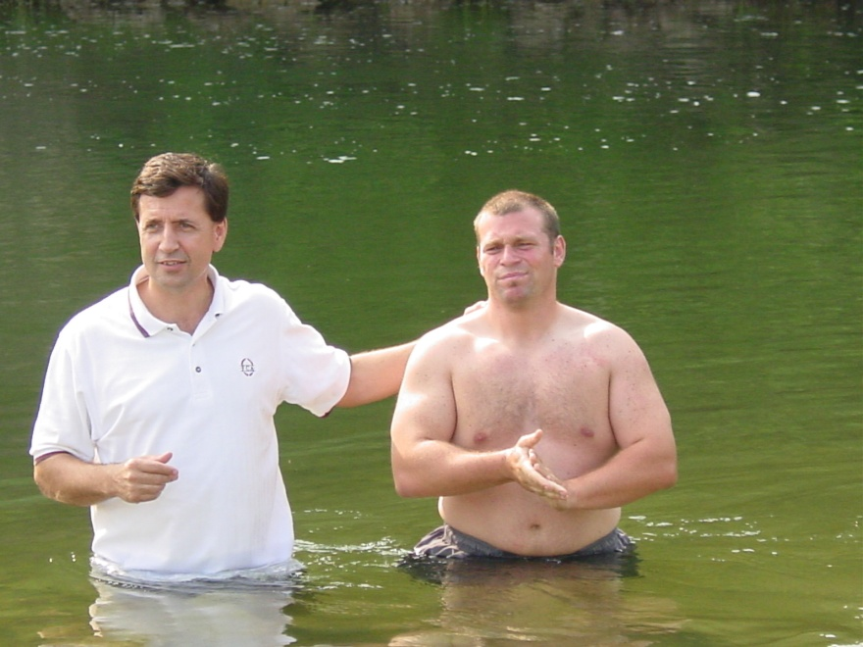
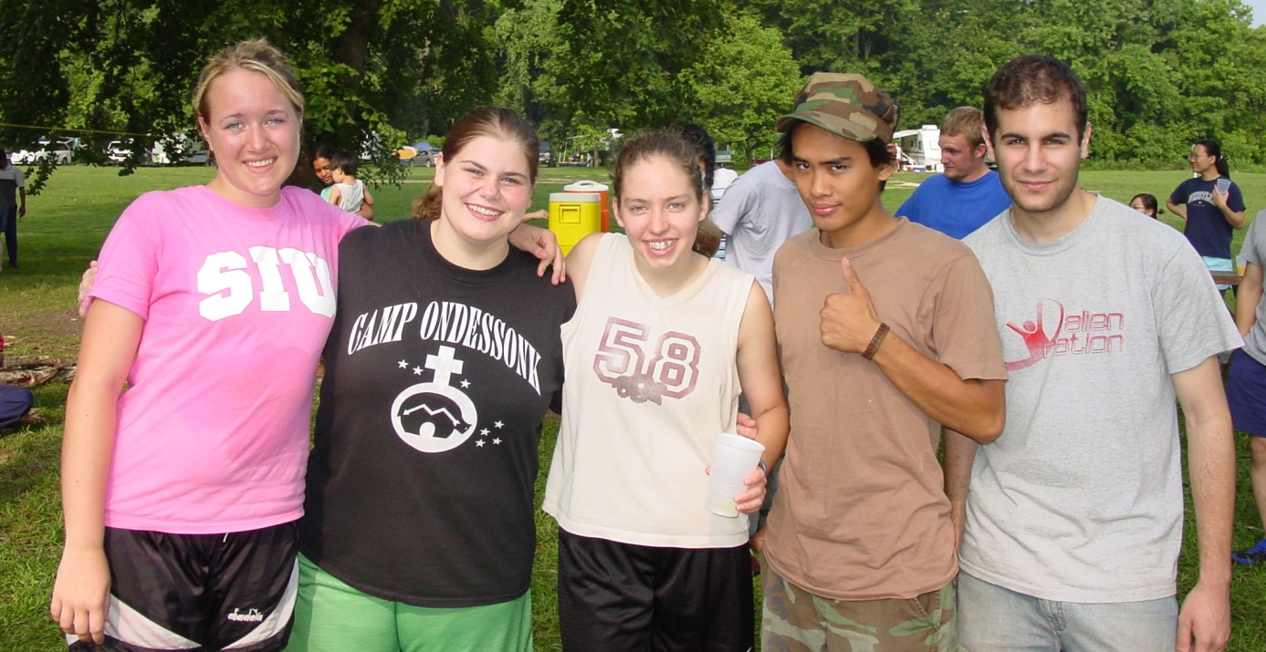
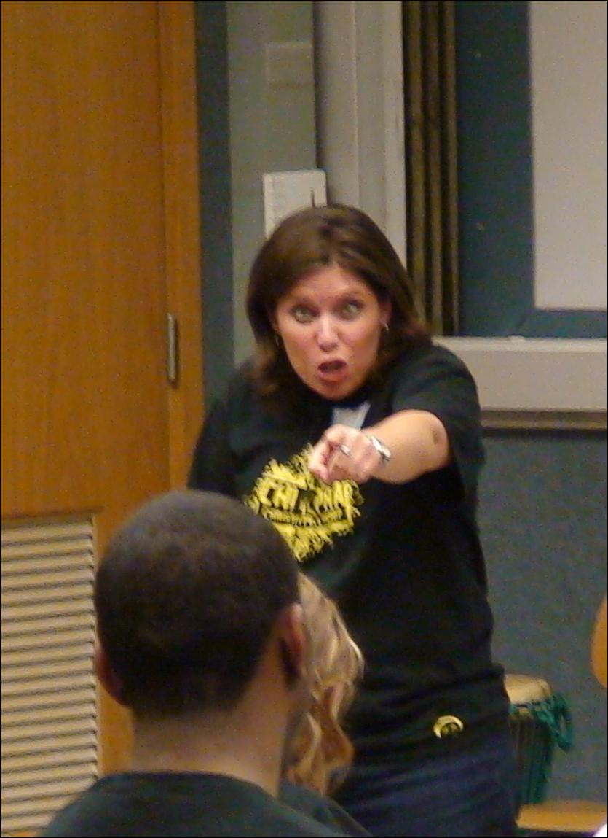

Slide 35
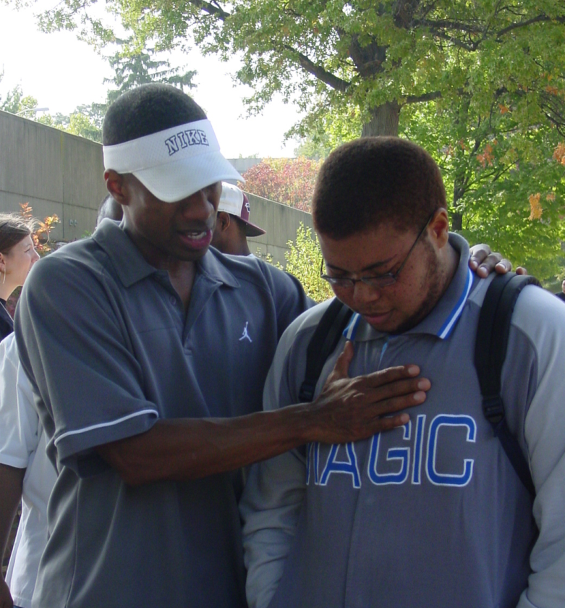
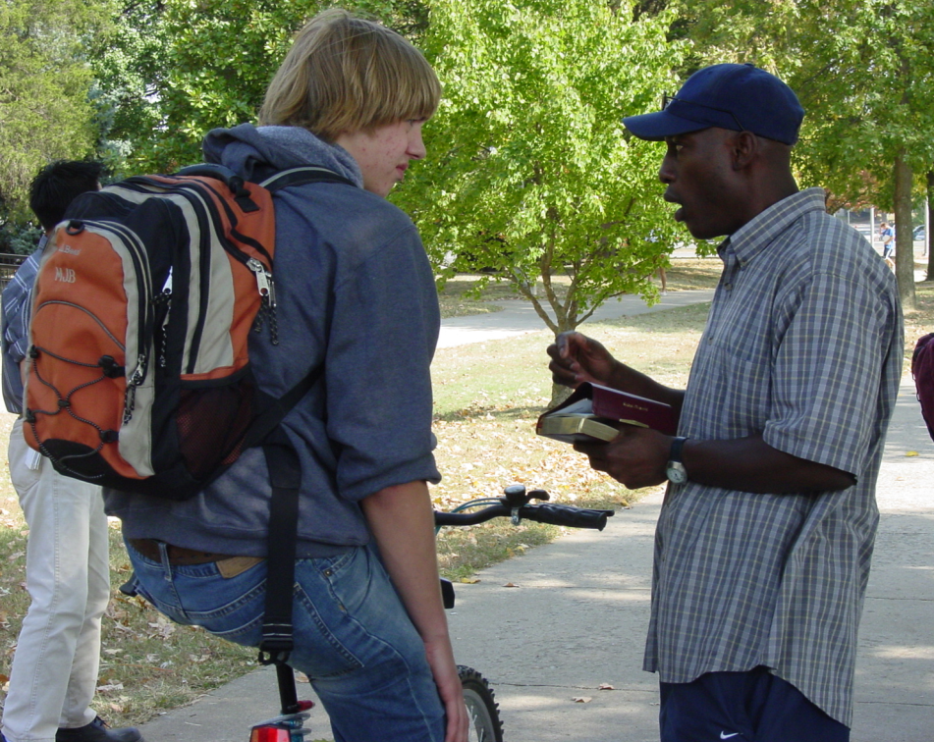
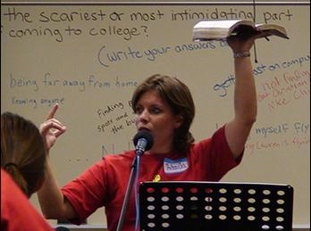
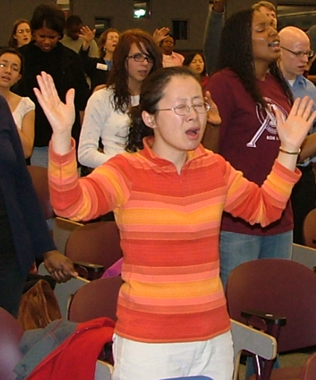
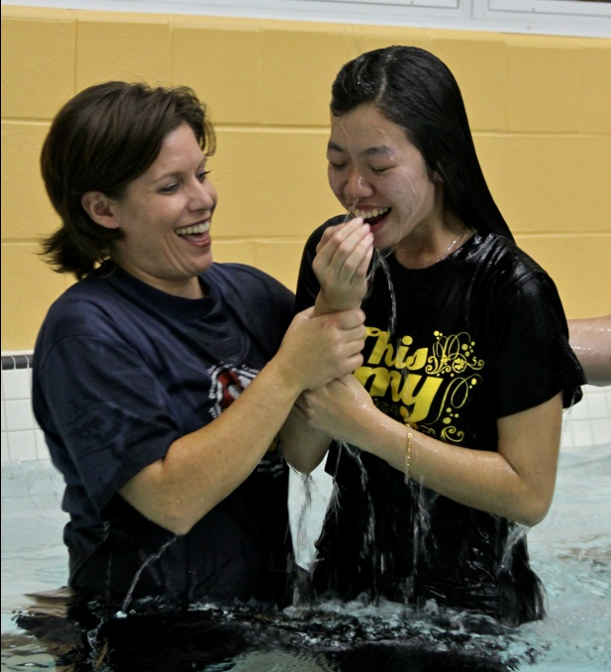
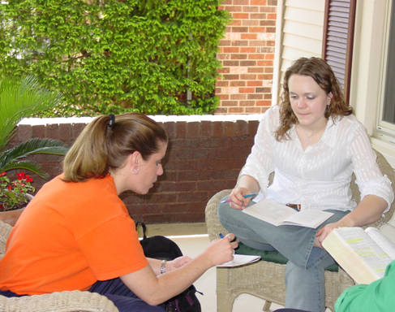

Slide 36
I will read your newsletters if…
You don’t ask for money all the time.
Pray in private, don’t ask for pitty.
When the check isn’t in the mail… (next)
Your newsletter is a tool for raising vision, not for raising support.

Slide 37
What about e-mailing your newsletters?
Always send a hard copy to donors unless they request an email version

Slide 38
E-mail intro sample
Dear Friends & Supporters,
I’m getting ready to host a bunch of students for the Super Bowl and rooting for the team in yellow! ☺ Some of the students coming tonight are internationals who have never watched a football game before—talk about an American cultural experience!
Click on http://www.linda.ministryhome.org/files/prayerletters/Feb_2011.pdf to see pictures and read the latest about Alain, an international student who recently got saved and is now living for Jesus!
As always, thanks for praying and giving so that students like Alain can experience the life-transforming love of Jesus Christ and take the Gospel to the ends of the earth!
Blessings,
Linda

Slide 39
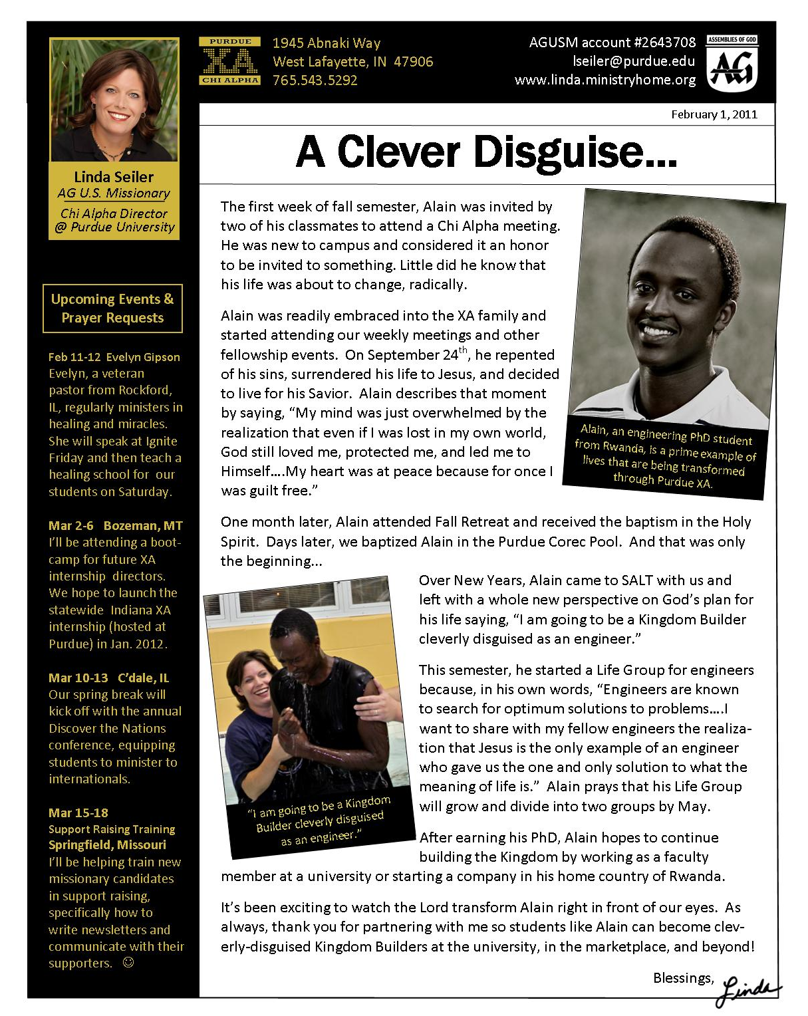

Slide 43
Complete your newsletter in less than 30 minutes!
www.chalkline.org
Color printing
Envelopes
Address labels
Stamps
*Time*

