Slide 1
The Power of the Seed

Slide 2
What does a seed represent?

Slide 3
1 Peter 1:23
“For you have been born again, not of perishable seed, but of imperishable, through the living and enduring word of God.”

Slide 4
Psalm 81:6
He says, “I removed the burden from their shoulders…”

Slide 6
Proverbs 4:20-22
(around p.443 in visitor Bibles)

Slide 7
John 6:63
“The words I have spoken to you are Spirit and they are life.”

Slide 8
Joshua 1:8
“Do not let this book of the Law depart from your mouth; meditate on it day and night, so that you may be careful to do everything written in it. Then you will be prosperous and successful.”

Slide 9
Psalm 1:1-3
“Blessed is the man who does not walk in the counsel of the wicked or stand in the way of sinners or sit in the seat of mockers.
² But his delight is in the law of the LORD, and on his law he meditates day and night.
³ He is like a tree planted by streams of water, which yields its fruit in season and whose leaf does not wither. Whatever he does prospers.

Slide 16
Mark 4
(around page 696 in visitor Bibles)

Slide 17
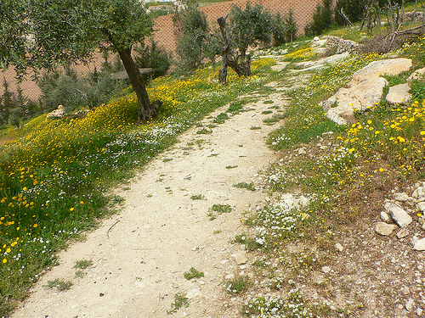

Slide 18
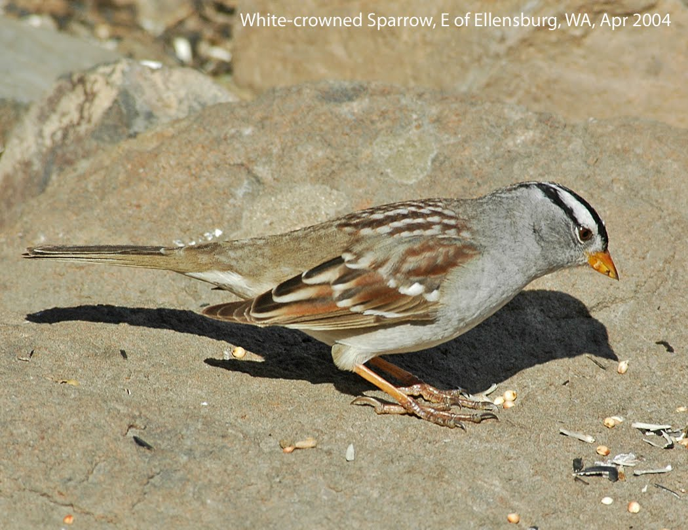

Slide 19
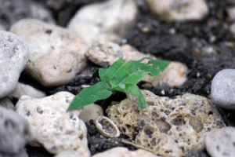

Slide 22
Luke 8:15
“But the seed on good soil stands for those with a noble and good heart, who hear the word, retain it [hold it fast], and by persevering, produce a crop.”

Slide 23
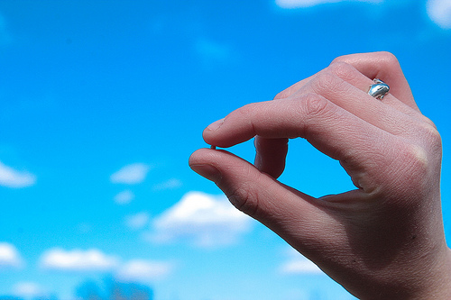
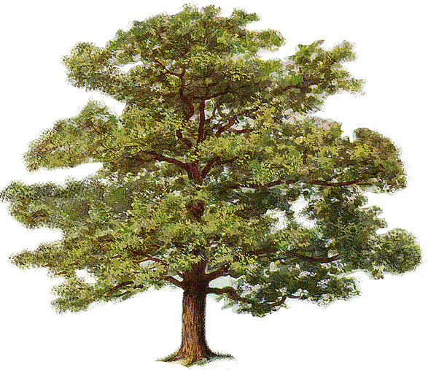

Slide 24
Hebrews 11:1
“Now faith is being sure of what we hope for and certain of what we do not see.”

Slide 25
2 Corinthians 4:18
“So we fix our eyes not on what is seen, but on what is unseen. For what is seen is temporary, but what is unseen is eternal.”

Slide 26
1 Corinthians 3:6-7
“I planted the seed, Apollos watered it, but God made it grow. So neither he who plants nor he who waters is anything, but only God, who makes things grow.”

Slide 27
Isaiah 55:10-11
“As the rain and the snow come down from heaven, and do not return to it without watering the earth and making it bud and flourish, so that it yields seed for the sower and bread for the eater, so is my word that goes out from My mouth: It will not return to Me empty, but will accomplish what I desire and achieve the purpose for which I sent it.”

Slide 28
Ephesians 5:25-26
“Husbands, love your wives, just as Christ loved the church and gave himself up for her to make her holy, cleansing her by the washing with water through the word…”

Slide 29
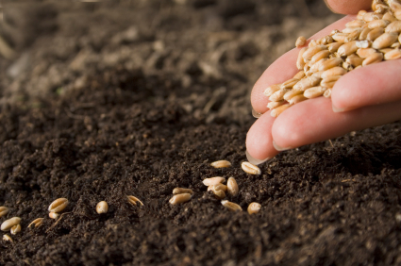
http://www.youtube.com/watch?v=T-Z53GVinpk

Slide 30
Matthew 17:20
“I tell you the truth, if you have faith as small as a mustard seed, you can say to this mountain, ‘Move from here to there’ and it will move. Nothing will be impossible for you.”

Slide 32
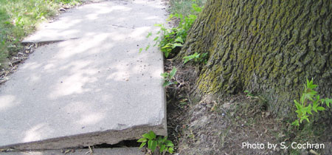

Slide 33
John 15:7
“If you remain in Me and My words remain in you, ask whatever you wish, and it will be given you.”

Slide 34
Is there seed in your field?

