Slide 1
Triad Talks
Name/major
What’s one “take away” you got from Dick’s message on prayer last week?
What is one thing that keeps you from praying?

Slide 2
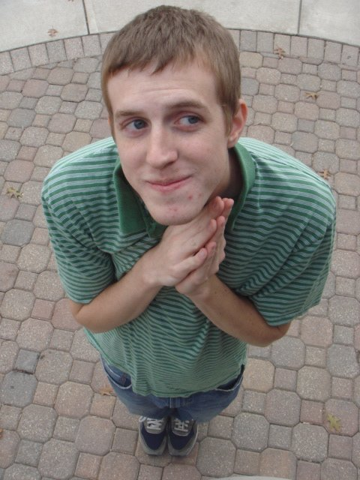
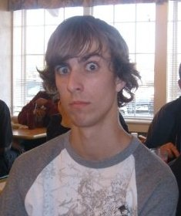
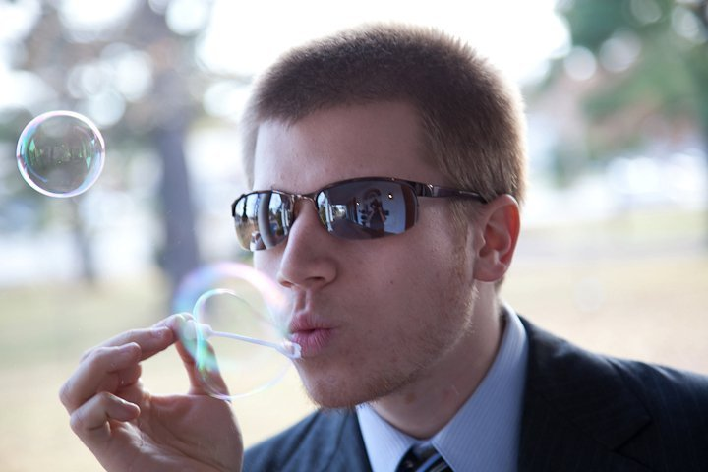
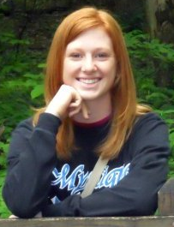
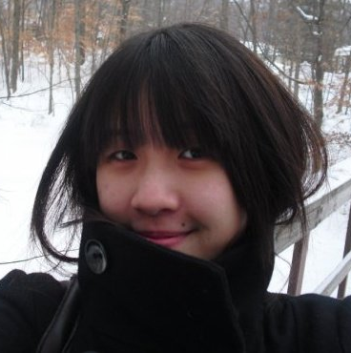
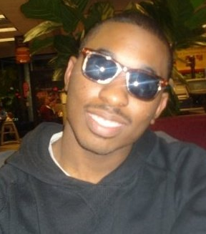
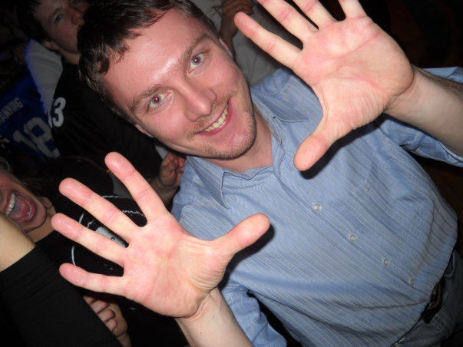
Evangelism Workshop Tomorrow! 10:30am @ LWSN B151

Slide 3
The Power & Practics of Private Prayer

Slide 5
If you don’t abide in the secret place with God, secret sin will abide in your life

Slide 6
Secret prayer is the litmus test of devotion to God

Slide 7
“In these days, there is no time to pray; but without time, and a lot of it, we shall never learn to pray.”
—Samuel Chadwick
(written 100 years ago)

Slide 8
Hebrews 11:6
And without faith it is impossible to please God, because anyone who comes to him must believe that he exists and that he rewards those who earnestly seek him.

Slide 9
“Prayers are measured neither by time nor by number, but by intensity”
—Samuel Chadwick

Slide 11
Jeremiah 29:13-14
You will seek me and find me when you seek me with all your heart. ¹⁴ I will be found by you,” declares the LORD…

Slide 12
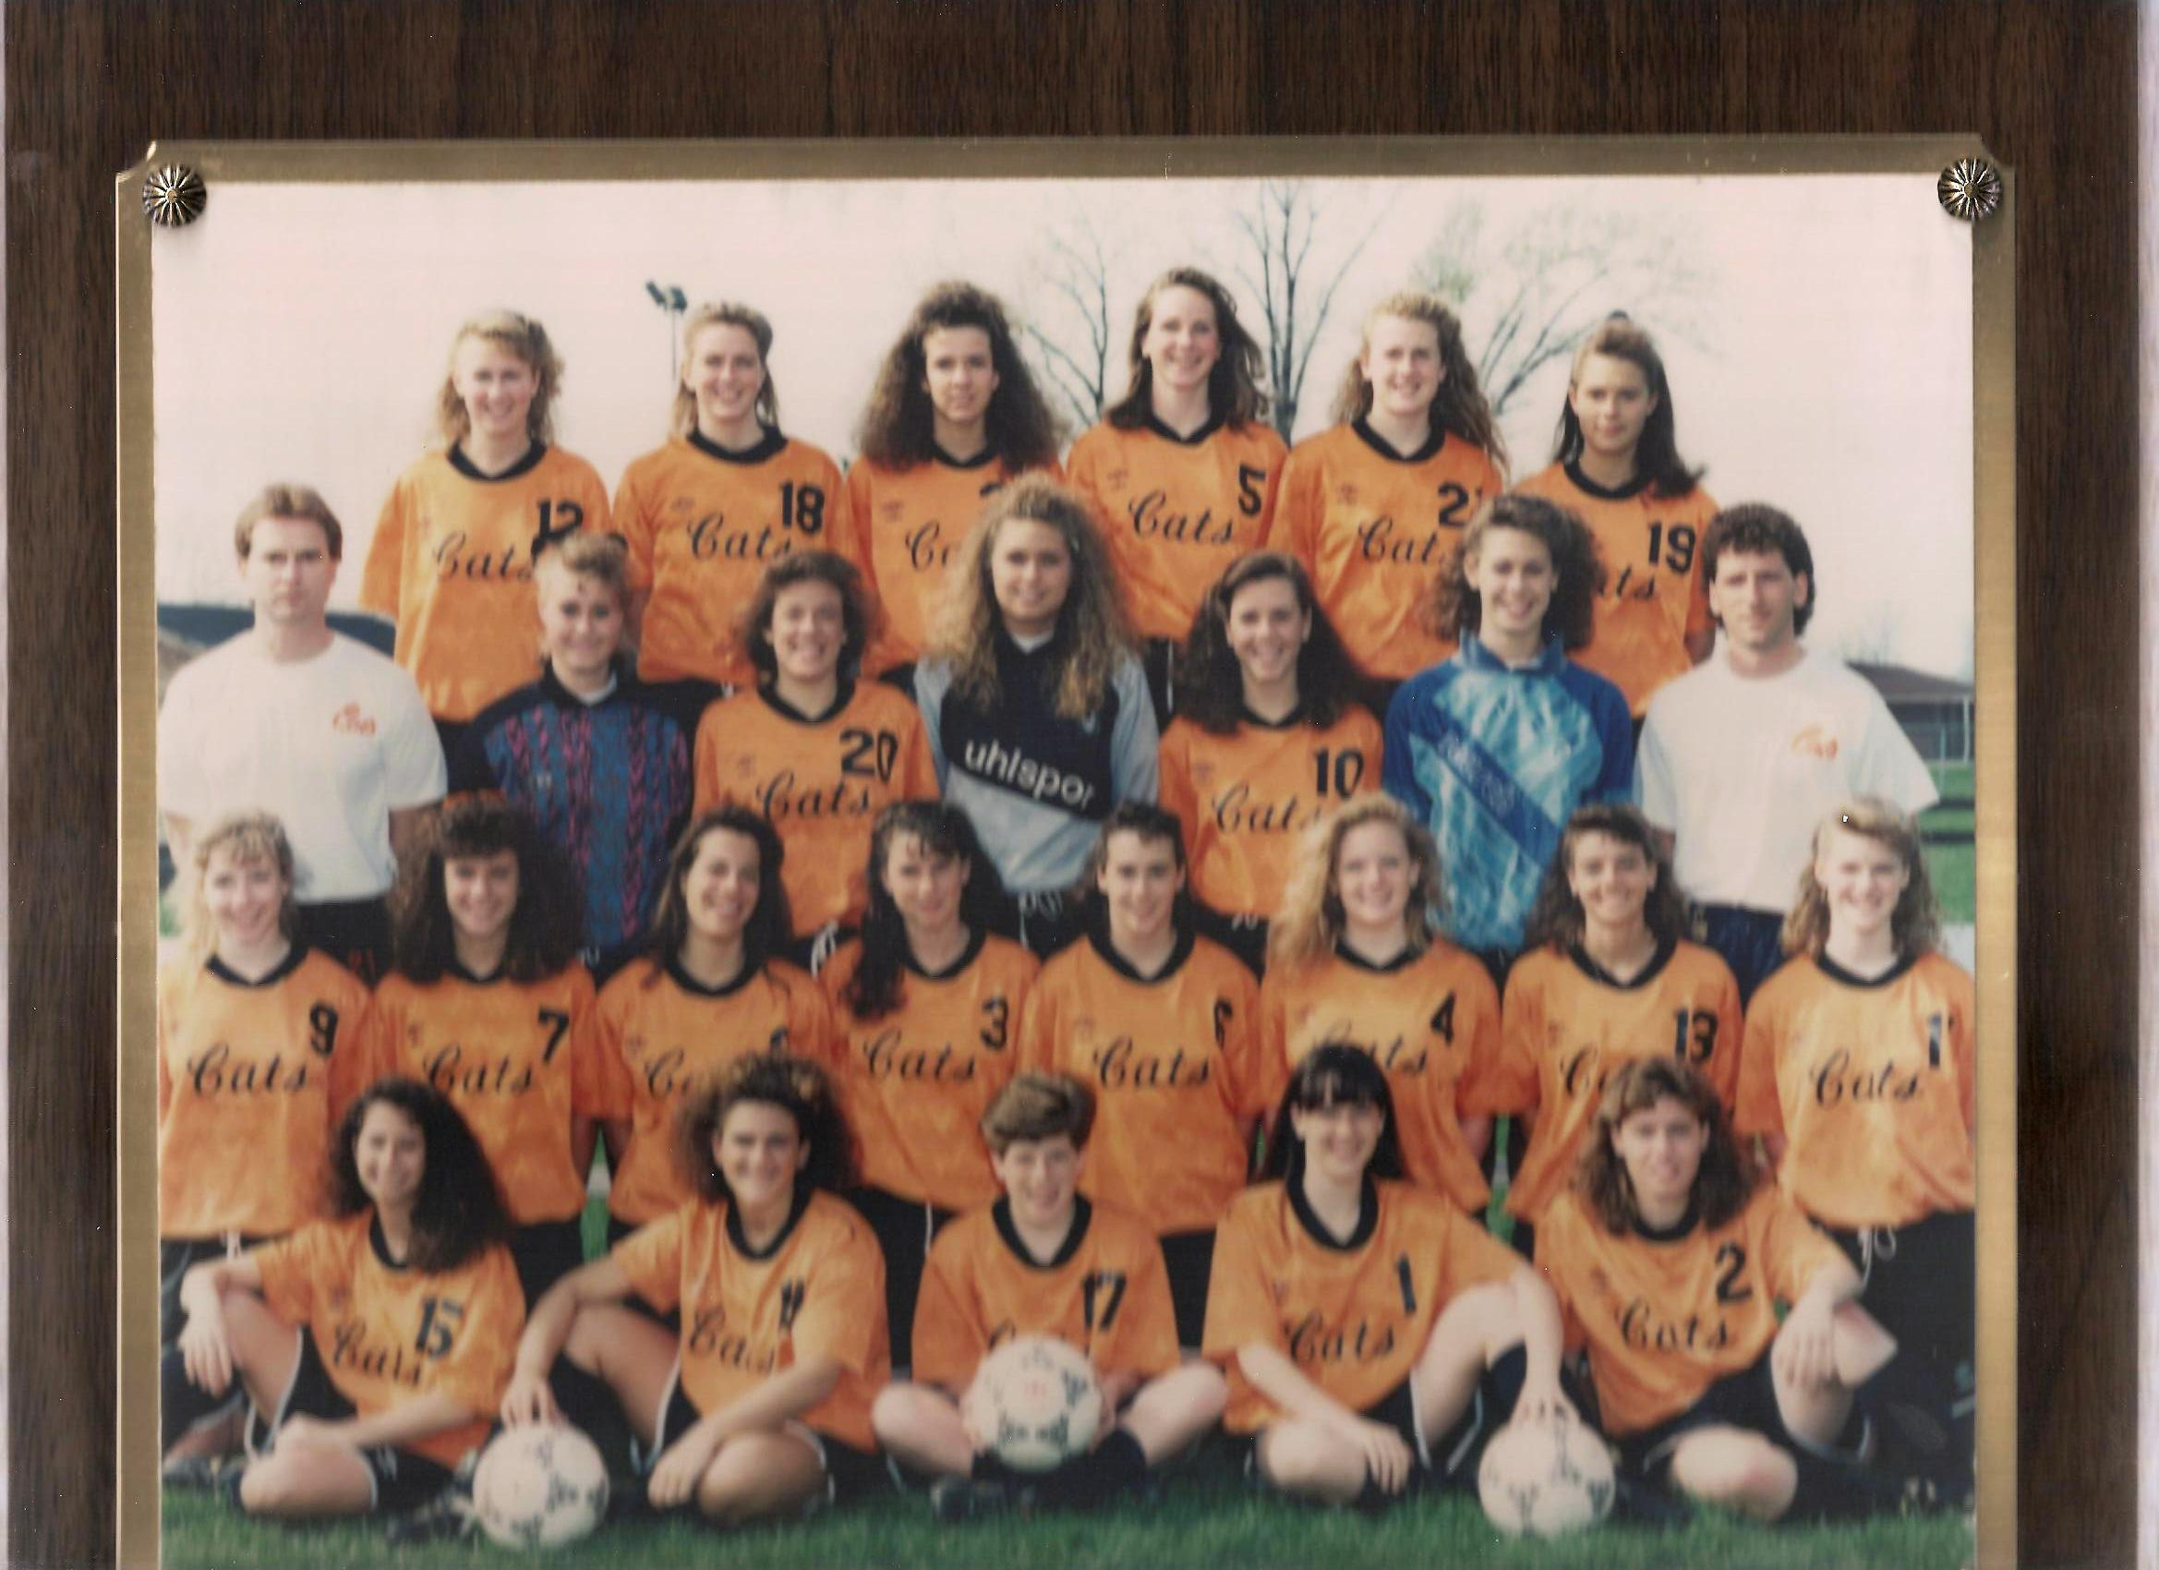

Slide 13
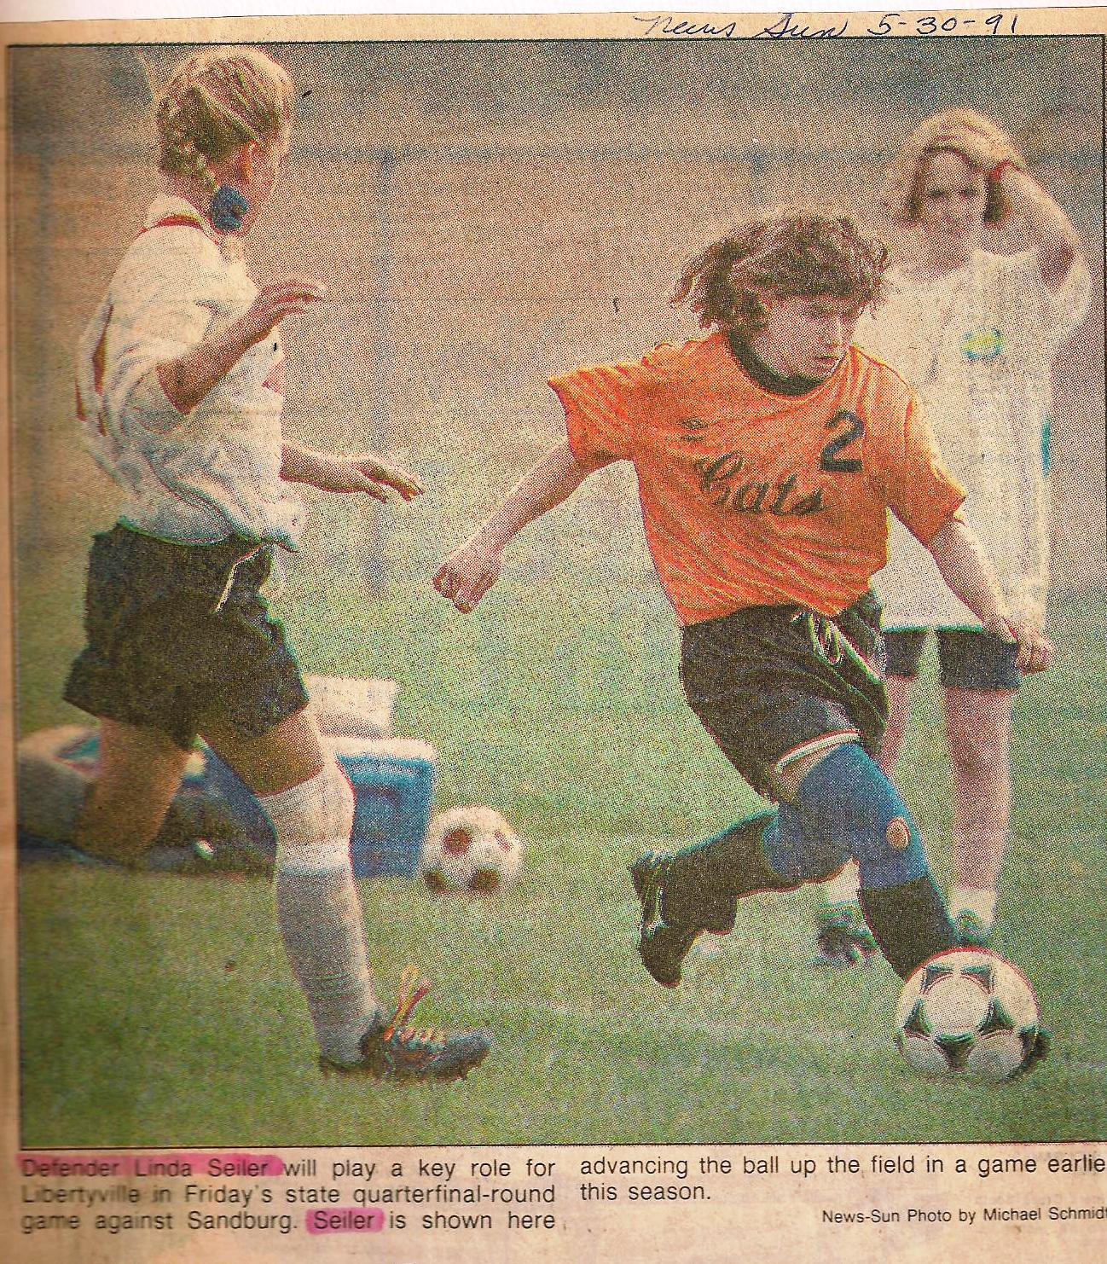
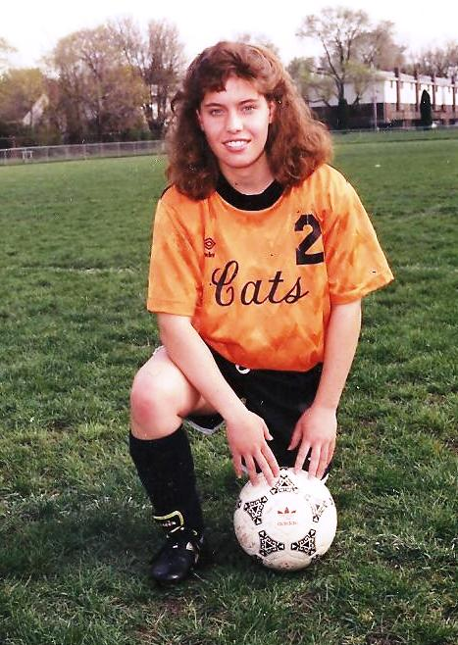

Slide 14
“If prayer is the greatest achievement on earth, we may be sure it will call for a discipline that corresponds to its power.”
—Samuel Chadwick

Slide 15
Entering His Presence…
Lord’s Prayer
Worship each Person of the Trinity
Names of God – Jehovah Shammah…
Alphabet – Almighty, Beloved, Creator, Daddy…
Psalm of Day
Armor of God
Temple format
Memory Verses
Pray though your day
Worship song
Hand on heart – He is as near as your breath

Slide 16
Romans 8:26
In the same way, the Spirit helps us in our weakness. We do not know what we ought to pray for, but the Spirit himself intercedes for us with groans that words cannot express.

Slide 17
“It would seem the biggest thing in God’s universe is a man who prays. There is only one thing more amazing, and that is—that man, knowing this, should not pray.”
—Samuel Chadwick

