Slide 1
Self-Leadership
“His master replied, ‘Well done, good and faithful servant! You have been faithful with a few things; I will put you in charge of many things. Come and share your master's happiness!’”
—Matthew 25:21

Slide 3
“Anxiety is caused by a lack of control, organization, preparation, and action.”
—David Kekich

Slide 4
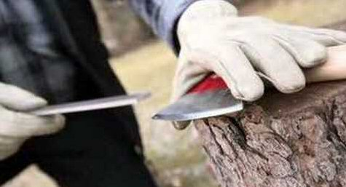

Slide 5
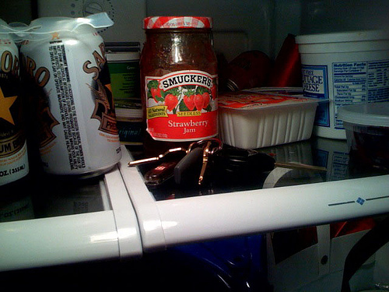

Slide 6
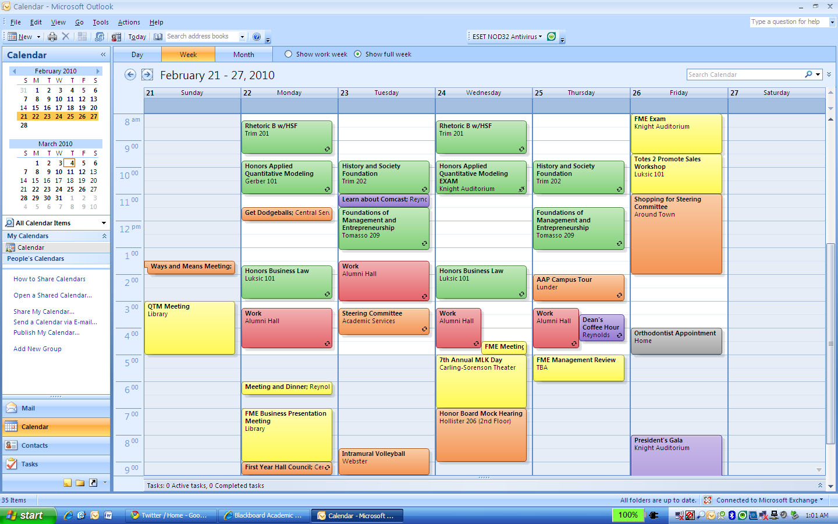

Slide 7
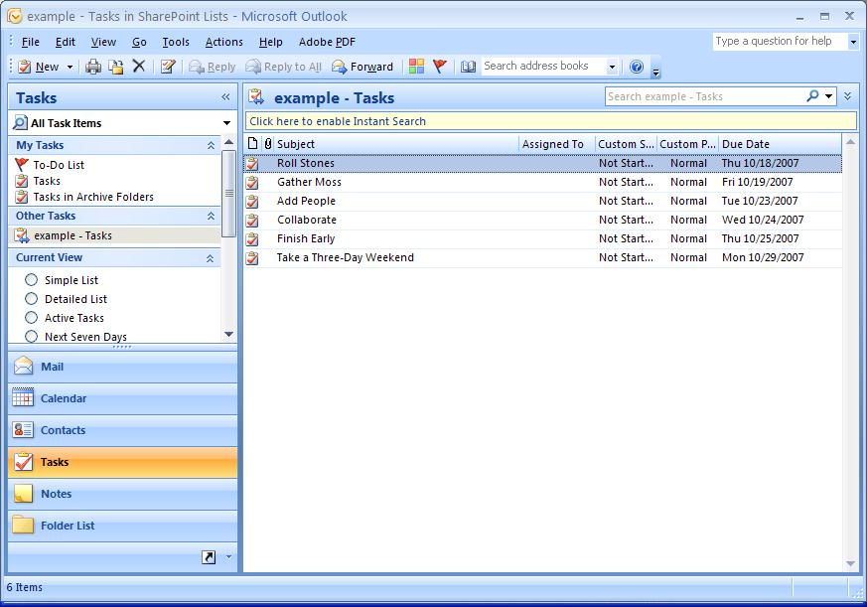

Slide 8
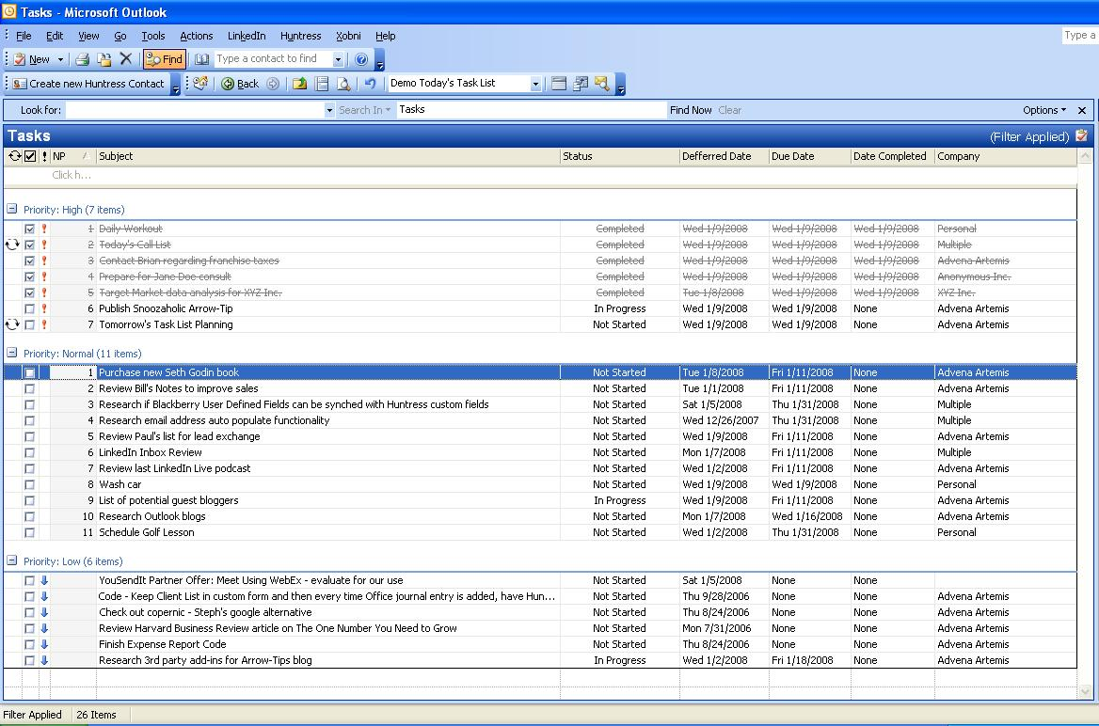

Slide 9
“Stuff”
What is it?
Do I need to take action?
Trash
Yes
No
Someday
Will it take less than 2 minutes?
Resource
Yes
No
Just do it!
Delegate
Calendar/Plan

Slide 11
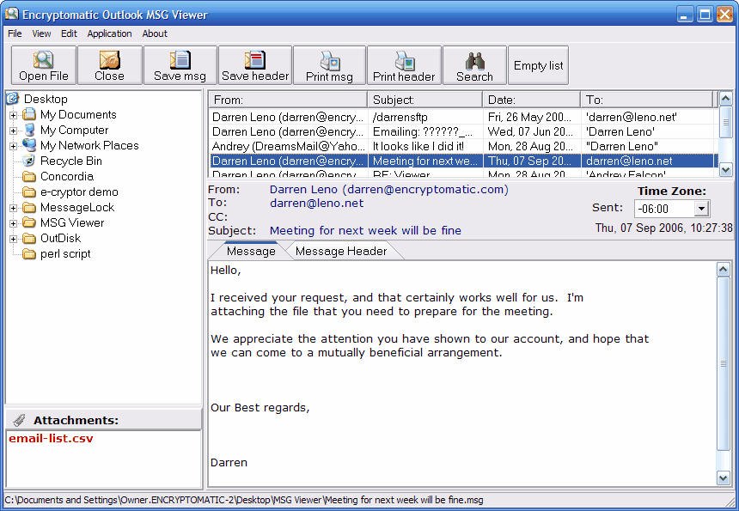

Slide 12
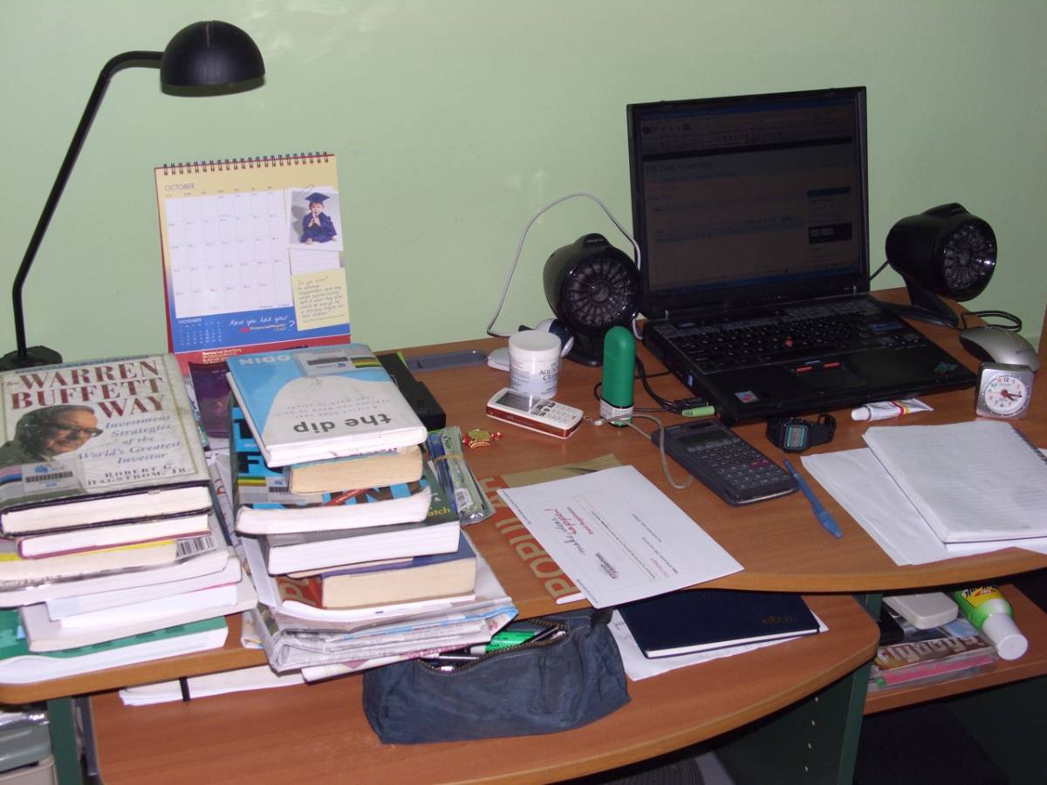
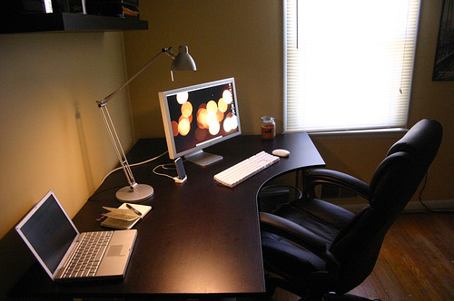

Slide 13
How to decide what to do when:
Priority/Urgency
Context limitations
Time Constraints
Energy Needed

