Slide 1
The Healer of My
basic step towards inner healing

Slide 2
We are triune beings
Body
Soul
(mind, emotions, will)
Spirit

Slide 3
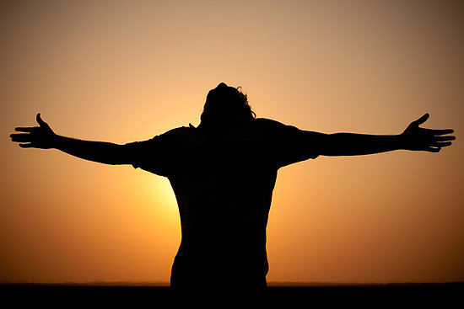
What is your motive for wanting healing?

Slide 4
Principles of Inner Healing

Slide 5
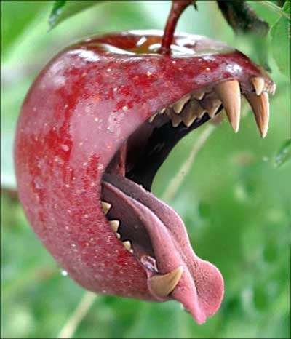
1. Bad fruit =

Slide 6
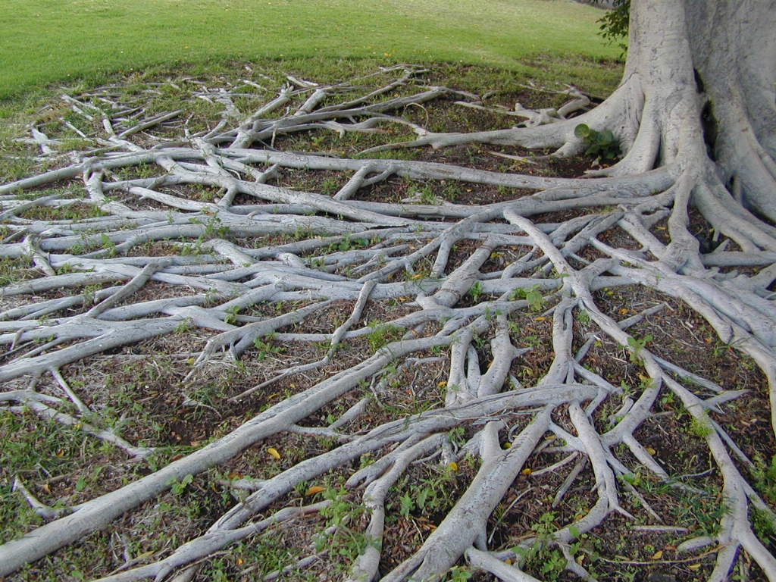
1. Bad fruit = bad root

Slide 7
2. Healing may not come the way you expect
→ 2 Kings 5:1-14 (around p. 258 in visitor Bible)

Slide 8
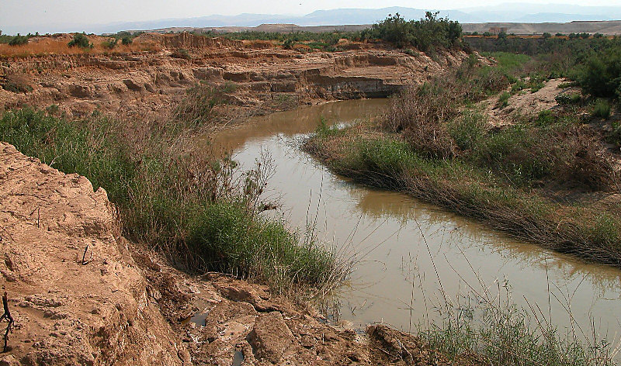

Slide 9
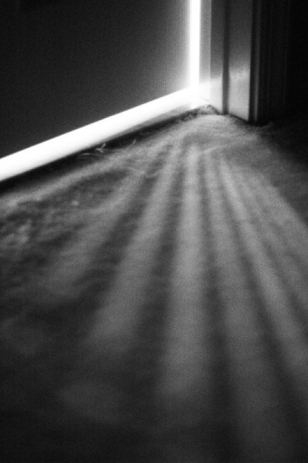
3. The enemy works in darkness

Slide 10
Genesis 3:7-10 ⁷ Then the eyes of both of them were opened, and they realized they were naked; so they sewed fig leaves together and made coverings for themselves. ⁸ Then the man and his wife heard the sound of the Lord God as he was walking in the garden in the cool of the day, and they hid from the Lord God among the trees of the garden. ⁹ But the Lord God called to the man, “Where are you?” ¹⁰ He answered, “I heard you in the garden, and I was afraid because I was naked; so I hid.”

Slide 11
Ephesians 5:11
Have nothing to do with the fruitless deeds of darkness, but rather expose them.

Slide 12
James 5:16
Therefore confess your sins to each other and pray for each other so that you may be healed.

Slide 13
Ephesians 4:26-27
“In your anger do not sin”: Do not let the sun go down while you are still angry, and do not give the devil a foothold.

Slide 14
The enemy’s tactic
Body
Soul
(mind, emotions, will)
Spirit

Slide 15
Hebrews 12:15 See to it that no one misses the grace of God and that no bitter root grows up to cause trouble and defile many.

Slide 16
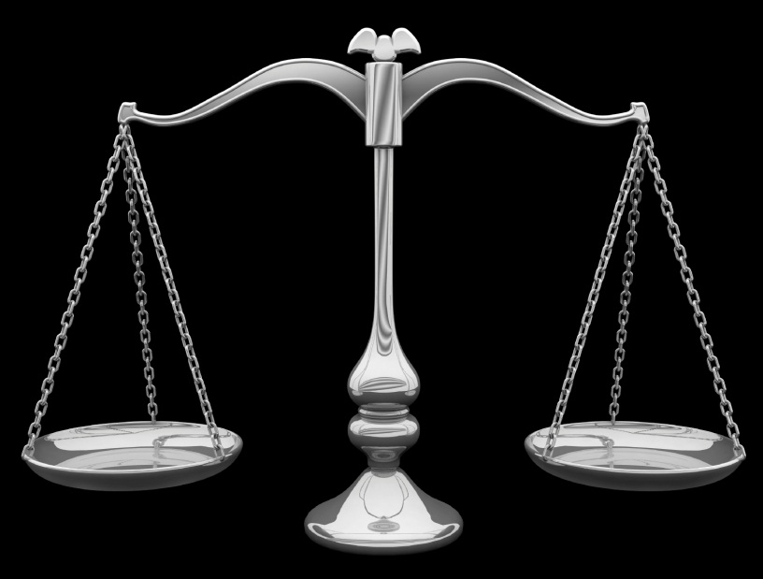
4. God’s Laws always work
Honor your mother & father and life will
go well for you (Eph. 6:2)
Unforgiveness = open door for enemy (Eph. 4:26-27)
You will reap what you sow (Gal. 6:7-8)
Life & death are in the power of your tongue (Proverbs 18:21)

Slide 17
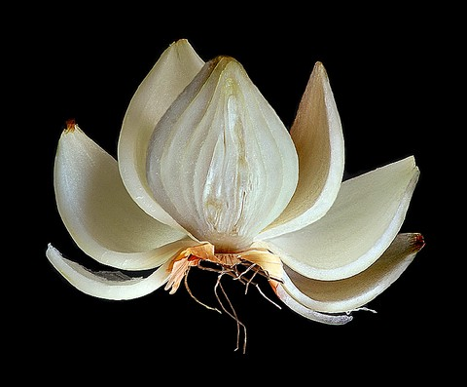
5. Inner healing is a process, not a one-time event.

Slide 18
Practical Steps to Freedom
Be willing to do anything God asks

Slide 19
Find a trusted leader/ authority & confess
→ sins you’ve committed
→ sins done to you

Slide 20
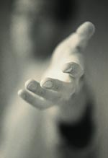
As an act of your will, forgive those who hurt you

Slide 21
Luke 17:3-6 So watch yourselves. “If your brother sins, rebuke him, and if he repents, forgive him. ⁴ If he sins against you seven times in a day, and seven times comes back to you and says, ‘I repent,’ forgive him.” ⁵ The apostles said to the Lord, “Increase our faith!”

Slide 22
4. Repent for your wrong responses to sin

Slide 23
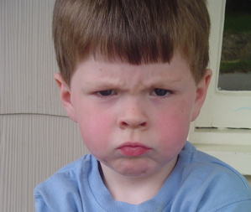
5. Renounce Inner Vows
I’ll never be like mom/dad…
I’ll never be emotional or show weakness
I’ll never open up or trust anyone
like that again
I’ll never let a man/woman do
that to me again
I’ll always be in control
I’ll never get angry like that
I’ll meet my own needs
I’m not worth spending time with

Slide 24
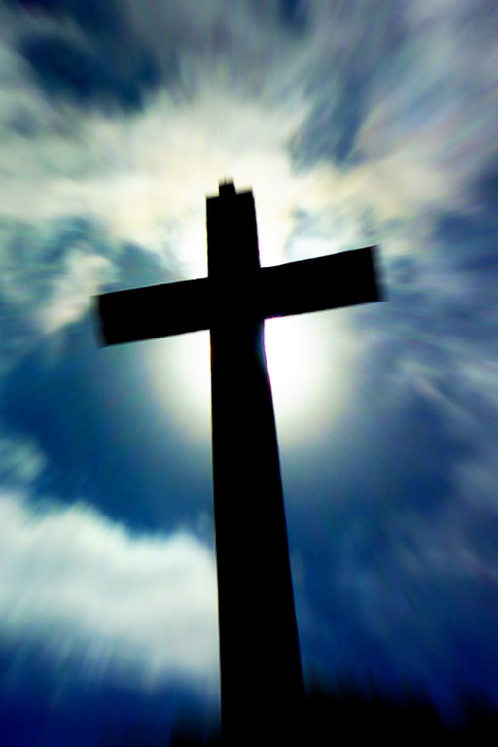
Bring it all to death on Cross (let hurt pain go up and out of you and into Jesus)

Slide 25
Ask Jesus what lie you believe because of that wound

Slide 26
Ask Jesus what His truth is to replace that lie

Slide 27
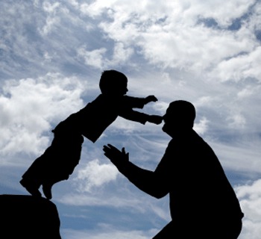
Ask for a greater revelation of the Father’s love

Slide 28
Father’s Love Letter

