Slide 2
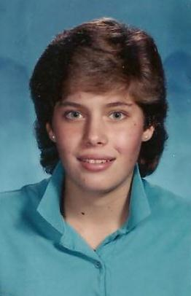
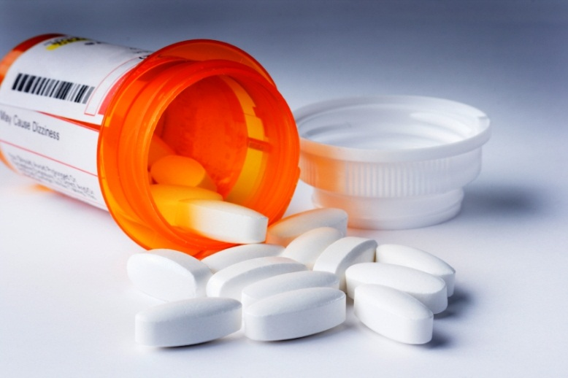
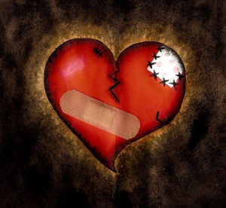
Rejection
Depression
Loneliness
Guilt

Slide 3
The Healer of My
the power of being forgiven

Slide 4
Psalm 32
(around page 380 or 389 in guest Bible)

Slide 5
1. Why do we even need forgiveness?

Slide 6
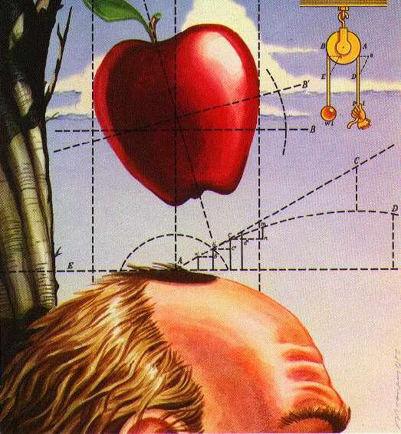
Law of Gravity

Slide 7
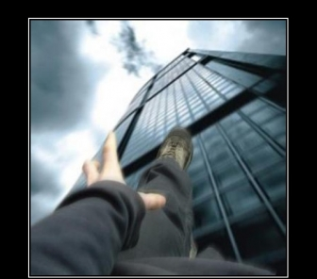
Gravity.
Not just a theory; it’s a law.

Slide 8
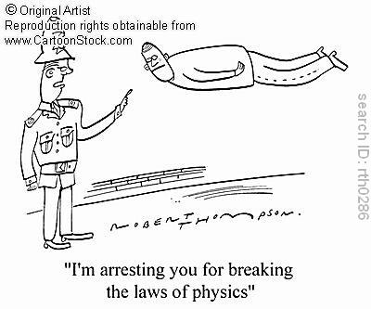

Slide 9
Romans 3:23
For all have sinned and fall short of the glory [perfection] of God

Slide 10
Romans 6:23
The wages of sin is death…

Slide 11
2. What’s required for forgiveness?

Slide 12
Hebrews 9:22
In fact, the law requires that nearly everything be cleansed with blood, and without the shedding of blood there is no forgiveness.

Slide 13
Ephesians 1:7
In Him we have redemption through His blood, the forgiveness of sins, in accordance with the riches of God’s grace…

Slide 14
Ephesians 2:13
But now in Christ Jesus you who once were far away have been brought near by the blood of Christ.

Slide 15
3. God paid the price Himself

Slide 16
Other Religions
Christianity
God
God
Man
Man

Slide 17
2 Corinthians 5:21
God made Him who had no sin to be sin for us, so that in Him we might become the righteousness of God.

Slide 18
The Blood of Jesus:
Washes away our sin
Perfectly satisfies God’s eternal justice

Slide 19
Isaiah 53:5
But He was pierced for our transgressions, He was crushed for our iniquities [willful sin];
the punishment that brought us peace was on Him, and by His wounds we are healed.

Slide 20
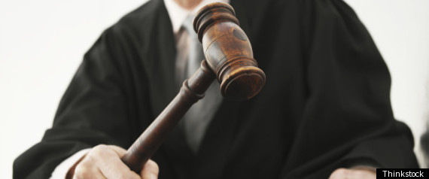

Slide 21
1 John 4:18
There is no fear in love. But perfect love drives out fear, because fear has to do with punishment.

Slide 22
The Blood of Jesus:
Washes away our sin
Satisfies the justice of God
Gives us spiritual life

Slide 23
Body
Soul
(mind, emotions, will)
Spirit

Slide 24
Body
Soul
(mind, emotions, will)
Spirit

Slide 25
Ephesians 2:1-9
As for you, you were dead in your transgressions and sins, ² in which you used to live when you followed the ways of this world and of the ruler of the kingdom of the air, the spirit who is now at work in those who are disobedient. ³ All of us also lived among them at one time, gratifying the cravings of our flesh and following its desires and thoughts. Like the rest, we were by nature deserving of wrath.

Slide 26
Ephesians 2:1-9
⁴ But because of His great love for us, God, who is rich in mercy, ⁵ made us alive with Christ even when we were dead in transgressions—it is by grace you have been saved. ⁶ And God raised us up with Christ and seated us with him in the heavenly realms in Christ Jesus, ⁷ in order that in the coming ages he might show the incomparable riches of his grace, expressed in his kindness to us in Christ Jesus. ⁸ For it is by grace you have been saved, through faith—and this is not from yourselves, it is the gift of God— ⁹ not by works, so that no one can boast.

Slide 27
4. The price was paid once for all

Slide 28
Romans 6:23
The wages of sin is death but the gift of God is eternal life in Christ Jesus our Lord

Slide 29
1 Peter 3:18
For Christ also suffered once for sins, the righteous for the unrighteous, to bring you to God.

Slide 30
Psalm 103:10-12
He does not treat us as our sins deserve or repay us according to our iniquities. ¹¹ For as high as the heavens are above the earth, so great is his love for those who fear him; ¹² as far as the east is from the west, so far has he removed our transgressions from us.

Slide 31
Jeremiah 31:34
For I will forgive their wickedness and will remember their sins no more.

Slide 32
Micah 7:19
You will again have compassion on us; You will tread our sins underfoot and hurl all our iniquities into the depths of the sea.

Slide 33
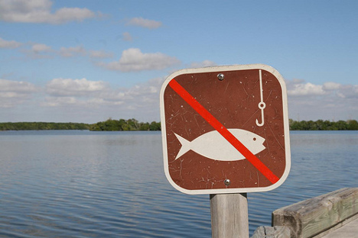

Slide 34
5. How do we receive God’s gift of salvation?

Slide 35
Psalm 32:3,5
3 When I kept silent, my bones wasted away through my groaning all day long.
5 Then I acknowledged my sin to you and did not cover up my iniquity. I said, “I will confess my transgressions to the LORD.” And you forgave the guilt of my sin.

Slide 36
1 John 1:9
If we confess our sins, He is faithful and just and will forgive us our sins and purify us from all unrighteousness.

Slide 37
2 Peter 3:9
The Lord is not slow in keeping His promise, as some understand slowness. Instead He is patient with you, not wanting anyone to perish, but everyone to come to repentance.

Slide 38
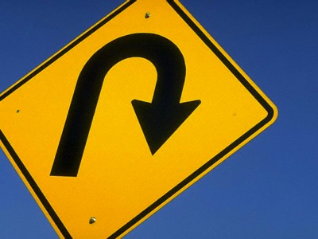

Slide 39
Repentance is NOT…
Wishing we had done better
Promising to do better next time
Feeling sorry for what we have done
Being brokenhearted for ourselves only
Blaming others/making excuses for sin
Convenient
Without surrender/Lordship

Slide 40
Repentance IS…
Accepting the truth when confronted with sin
Making no excuses for our sin
Facing consequences
Being willing to let God to change our heart/mind
“Feeling” the damage done to another
Focusing attention on the wounded one

Slide 41
Isaiah 30:15
In repentance and rest is your salvation, in quietness and trust is your strength

Slide 42
Acts 2:38
Peter replied, “Repent and be baptized, every one of you, in the name of Jesus Christ for the forgiveness of your sins.

Slide 43
6. We must also be willing to forgive ourselves…

Slide 44
Psalm 32:1-5
1 Blessed [happy, to be envied] is the one whose transgressions are forgiven, whose sins are covered.
2 Blessed [happy, to be envied] is the one whose sin the LORD does not count against them and in whose spirit is no deceit.
3 When I kept silent, my bones wasted away through my groaning all day long.
4 For day and night Your hand was heavy on me; my strength was sapped as in the heat of summer.
5 Then I acknowledged my sin to You and did not cover up my iniquity. I said, “I will confess my transgressions to the LORD.” And You forgave the guilt of my sin.

Slide 45
Because Daddy Loves Me…
He is slow to lose patience with me, even when I fail.
He does not treat me as an object to be possessed and manipulated.
He is for me. He wants to see me mature and develop in His love.
He does not keeps score of all my sins and then beat me over the head with them whenever He gets the chance.
etc, etc., etc…..

Slide 46
Do you want to receive God’s free gift of forgiveness and eternal life?

