Slide 1
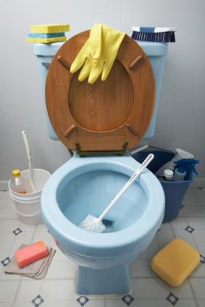
Instructions on how to clean your toilet

Slide 2
Instructions on how to clean your toilet
1. Put both lids of the toilet up and add 1/8 cup of pet shampoo to the water in the bowl.

Slide 3
Instructions on how to clean your toilet
2. Pick up the cat and soothe him while you carry him towards the bathroom.

Slide 4
Instructions on how to clean your toilet
3. In one smooth movement, put the cat in the toilet and close both lids. You may need to stand on the lid.

Slide 5
Instructions on how to clean your toilet
4. The cat will self-agitate and make ample suds. Never mind the noises that come from the toilet, the cat is actually enjoying this.

Slide 6
Instructions on how to clean your toilet
5. Flush the toilet three or four times. This provides a "power-wash" and rinse.

Slide 7
Instructions on how to clean your toilet
6. Have someone open the front door of your home. Be sure that there are no people between the bathroom and the front door.

Slide 8
Instructions on how to clean your toilet
7. Stand behind the toilet as far as you can, and quickly lift both lids.

Slide 9
Instructions on how to clean your toilet
8. The cat will rocket out of the toilet, streak through the bathroom, and run outside where he will dry himself off.

Slide 10
Instructions on how to clean your toilet
9. Both the commode and the cat will be sparkling clean.

Slide 11
Instructions on how to clean your toilet
Hope this works well for
you, too.
Sincerely,

Slide 12
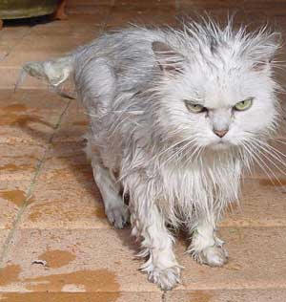
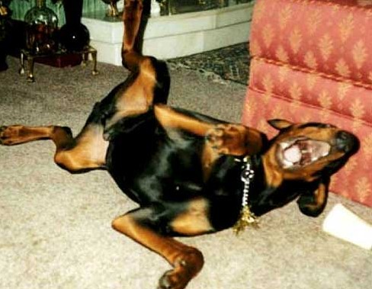
Instructions on how to clean your toilet
Hope this works well for
you, too.
Sincerely,
The Dog

Slide 13
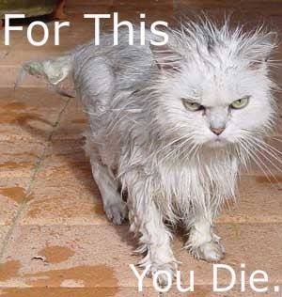

Slide 14
The Healer of My
the power to forgive

Slide 15
2 Corinthians 2:10-11
If you forgive anyone, I also forgive him. And what I have forgiven—if there was anything to forgive—I have forgiven in the sight of Christ for your sake, in order that Satan might not outwit us. For we are not unaware of his schemes.

Slide 16
Ephesians 4:26-27
In your anger do not sin: Do not let the sun go down while you are still angry, and do not give the devil a foothold.

Slide 18
Matthew 6:9-14
This, then, is how you should pray:
“Our Father in heaven, hallowed be Your name,
Your kingdom come, Your will be done, on earth as it is in heaven.
Give us today our daily bread.
And forgive us our debts, as we also have forgiven our debtors.
And lead us not into temptation, but deliver us from the evil one.”
For if you forgive other people when they sin against you, your heavenly Father will also forgive you. But if you do not forgive others their sins, your Father will not forgive your sins.

Slide 19
Matthew 18:21-35
around page 673 in guest Bible

Slide 20
Ephesians 4:32
Be kind and compassionate to one another, forgiving each other, just as in Christ God forgave you.

Slide 21
Colossians 3:13
Bear with each other and forgive whatever grievances you may have against one another. Forgive as the Lord forgave you.

Slide 22
Luke 17:3-5
“If your brother sins, rebuke him, and if he repents, forgive him. If he sins against you seven times in a day, and seven times comes back to you and says, ‘I repent,’ forgive him.”
The apostles said to the Lord,
“Increase our faith!”

Slide 23
Proverbs 20:22
Do not say, “I’ll pay you back for this wrong!” Wait for the LORD, and He will deliver you.

Slide 24
1 Peter 2:23
When they hurled their insults at Him, He did not retaliate; when He suffered, He made no threats. Instead, He entrusted Himself to Him who judges justly.

Slide 25
Psalm 103:6
The LORD works righteousness and justice for all the oppressed.

Slide 26
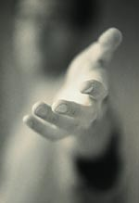
Forgiveness is NOT…
Approval of what they did
Excusing what they did
Denying what they did
Forgetting
Denying your hurt and anger
The same as reconciliation
Having to “work” to change your feelings

Slide 27
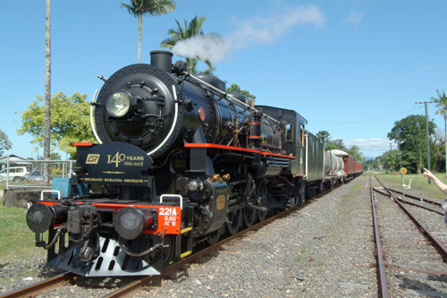

Slide 28
Forgiveness IS…
A choice I make with my will to fall out of agreement with the enemy and into agreement with God’s will
A choice I make that allows Jesus’ work on the Cross to remove hurts, judgments, bitterness, resentments and hatred from my heart
Surrendering my right to be paid back

Slide 29
Luke 23:34
Jesus said, “Father, forgive them, for they do not know what they are doing.”

Slide 30
Forgiveness IS…
A choice I make with my will to fall out of agreement with the enemy and into agreement with God’s will
A choice I make that allows Jesus’ work on the Cross to remove hurts, judgments, bitterness, resentments and hatred from my heart
Surrendering my right to be paid back
Cancelling a debt & then asking God not to hold it against them

Slide 31
Luke 23:34
Jesus said, “Father, forgive them, for they do not know what they are doing.”

Slide 32
Romans 12:17-21
¹⁷ Do not repay anyone evil for evil. Be careful to do what is right in the eyes of everybody. ¹⁸ If it is possible, as far as it depends on you, live at peace with everyone. ¹⁹ Do not take revenge, my friends, but leave room for God’s wrath, for it is written: “It is mine to avenge; I will repay,” says the Lord. ²⁰ On the contrary:
“If your enemy is hungry, feed him; if he is thirsty, give him something to drink. In doing this, you will heap burning coals on his head.”
²¹ Do not be overcome by evil, but overcome evil with good.

Slide 33
Forgiveness IS…
Being fully aware of what someone did and choosing to forgive them
Choosing to keep no record of wrongs
Not telling others what they did

Slide 34
Psalm 142:1-2
I cry aloud to the LORD; I lift up my voice to the LORD for mercy. I pour out my complaint before Him; before Him I tell my trouble.

Slide 35
Forgiveness IS…
Being fully aware of what someone did and choosing to forgive them
Choosing to keep no record of wrongs
Not telling what they did
Extending mercy

Slide 36
Luke 6:35-36
But love your enemies, do good to them, and lend to them without expecting to get anything back. Then your reward will be great, and you will be sons of the Most High, because he is kind to the ungrateful and wicked. Be merciful, just as your Father is merciful.

Slide 37
Forgiveness IS…
Being fully aware of what someone did and choosing to forgive them
Choosing to keep no record of wrongs
Not telling what they did
Extending mercy
An inner condition of heart

Slide 38
Forgiveness IS…
Being fully aware of what someone did and choosing to forgive them
Choosing to keep no record of wrongs
Not telling what they did
Extending mercy
An inner condition of heart
Absence of bitterness

Slide 39
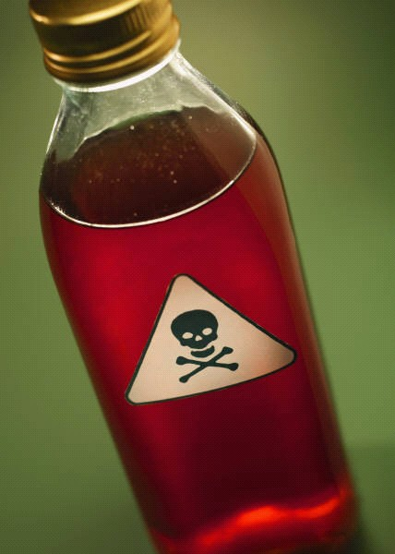
Bitterness
is a poison you drink in hopes that someone else will suffer its effect

Slide 40
“See to it that no one misses the grace of God and that no bitter root grows up to cause trouble and defile many.”
—Hebrews 12:15

Slide 41
Forgiveness IS…
Being fully aware of what someone did and choosing to forgive them
Choosing to keep no record of wrongs
Not telling what they did
Extending mercy
An inner condition of heart
Absence of bitterness
Praying for them to be blessed

Slide 42
The greater sin you must forgive, the greater the measure of the Spirit will come to you.
—Total Forgiveness, p.89

Slide 43
The greater the pain, the greater the opportunity for a measure of anointing you may not get any other way…

Slide 44
Philippians 3:10-11
I want to know Christ and the power of his resurrection and the fellowship of sharing in his sufferings, becoming like Him in his death, and so, somehow, to attain to the resurrection from the dead.

Slide 45
God gives grace to the humble,
but He opposes those too proud to forgive.

Slide 46
Forgiveness IS…
Being fully aware of what someone did and choosing to forgive them
Choosing to keep no record of wrongs
Not telling what they did
Extending mercy
An inner condition of heart
Absence of bitterness
Praying for them to be blessed
Forgiving others as we forgive ourselves

Slide 47
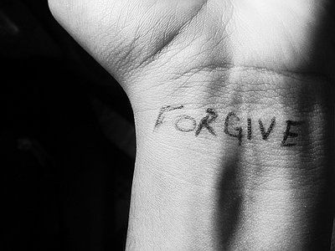
The ABC’s of Forgiveness
Air your complaint with God first
Be mindful that forgiveness is not “fair”
Choose to forgive & not to take revenge

Slide 48
Forgiveness Prayer
“___________,I choose to forgive you for _________. When you did that I felt (go into detail about all the resulting emotions and pain it caused you), but I’m choosing to forgive you the same way Jesus has forgiven me for hurting Him countless times. I release you into the loving and just hands of Jesus, and I will not bring this incident up again. Father, I pray You would bless ____________ and use this situation to draw him/her to Yourself the same way You did with me. Jesus, I give You the pain from this incident (tell Him all about it) and pray it will all come up and out of me and into the Cross. Thank You for dying in my place to pay for my sins and for the sins committed against me. I’m so grateful I can walk in daily forgiveness and peace because You have first forgiven me.
In Jesus’ Name,
Amen.”

