Slide 1
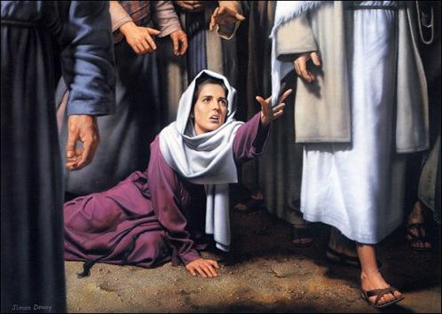
Keys to Divine Healing

Slide 2
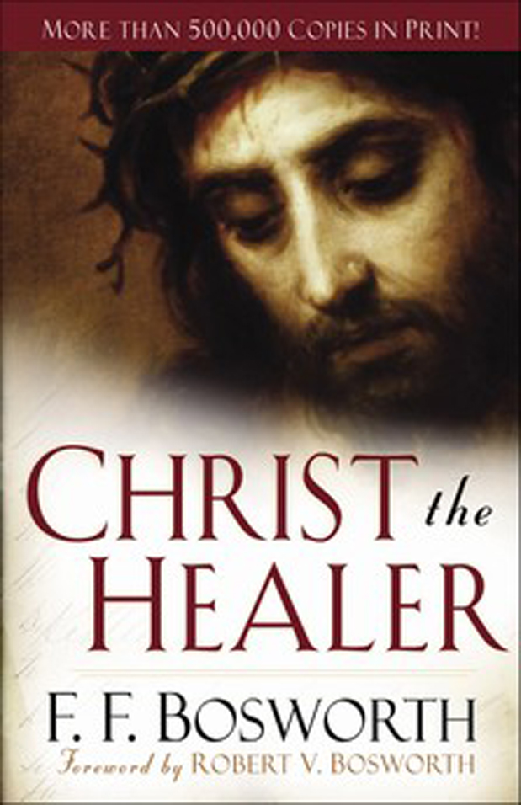

Slide 3
The power of God can only be claimed where the will of God is known.

Slide 4
Mark 1:40-41
A man with leprosy came to Him [Jesus] and begged Him on his knees, “If You are willing, you can make me clean.”
⁴¹ Filled with compassion, Jesus reached out His hand and touched the man. “I am willing,” He said. “Be clean!” ⁴² Immediately the leprosy left him and he was cured.

Slide 5
Psalm 103:1-5
Praise the LORD, O my soul; all my inmost being, praise his holy name.
Praise the LORD, O my soul, and forget not all his benefits—
who forgives all your sins and heals all your diseases,
who redeems your life from the pit and crowns you with love and compassion,
who satisfies your desires with good things so that your youth is renewed like the eagle’s.

Slide 6
Isaiah 53:4-5
Surely he took up our infirmities (sicknesses) and carried our sorrows (pains),
yet we considered Him stricken by God, smitten by Him, and afflicted.
But He was pierced for our transgressions, He was crushed for our iniquities;
the punishment that brought us peace was upon Him, and by His wounds we are healed.”

Slide 7
Matthew 8:16-17
When evening came, many who were demon-possessed were brought to Him, and He drove out the spirits with a word and healed all the sick. This was to fulfill what was spoken through the prophet Isaiah: He took up our infirmities and carried our diseases.

Slide 8
Mark 16:17-18
And these signs will accompany those who believe: In my name they will drive out demons; they will speak in new tongues; ¹⁸ they will pick up snakes with their hands; and when they drink deadly poison, it will not hurt them at all; they will place their hands on sick people, and they will get well.

Slide 9
James 5:14-16
Is any one of you sick? He should call the elders of the church to pray over him and anoint him with oil in the name of the Lord. And the prayer offered in faith will make the sick person well; the Lord will raise him up. If he has sinned, he will be forgiven. Therefore confess your sins to each other and pray for each other so that you may be healed.

Slide 10
If sickness is God’s will, then…
“Every physician is a lawbreaker; every trained nurse is defying the Almighty; every hospital is a house of rebellion, instead of a house of mercy.”
—FF Bosworth
Christ the Healer

Slide 11
Revelation 5:12
Worthy is the Lamb, who was slain…

Slide 12
Isaiah 50:7
Because the Sovereign LORD helps me,
I will not be disgraced.
Therefore have I set my face like flint,
and I know I will not be put to shame.

Slide 13
Romans 10:9
That if you confess with your mouth, “Jesus is Lord,” and believe in your heart that God raised him from the dead, you will be saved.

Slide 14
Romans 10:17 (NKJV)
So then faith comes by hearing, and hearing by the word of God.

Slide 15
Psalm 107:20
“He sent forth his word and healed them”

Slide 16
James 3:2
We all stumble in many ways. If anyone is never at fault in what he says, he is a perfect man, able to keep his whole body in check.

Slide 17
Proverbs 18:21
“The tongue has the power of life and death, and those who love it will eat its fruit.”

Slide 18
Psalm 27:13
I am still confident of this: I will see the goodness of the LORD in the land of the living.

Slide 19
Proverbs 12:14, 18
From the fruit of his lips a man is filled with good things as surely as the work of his hands rewards him.
Reckless words pierce like a sword, but the tongue of the wise brings healing.”

Slide 20
Romans 12:2 (NAS)
And do not be conformed to this world, but be transformed by the renewing of your mind, so that you may prove what the will of God is, that which is good and acceptable and perfect.

Slide 21
James 2:26 (NAS)
For just as the body without the spirit is dead, so also faith without works is dead.
words!

Slide 22
2 Corinthians 4:13
It is written:
“I believed; therefore I have spoken.”
With that same spirit of faith we also believe and therefore speak…

Slide 23
Psalm 34:8
Taste and see that the LORD is good.

Slide 24
Proverbs 4:20-22
²⁰ My son, pay attention to what I say; listen closely to my words. ²¹ Do not let them out of your sight, keep them within your heart; ²² for they are life to those who find them and health to a man’s whole body.

Slide 25
www.xapurdue.com
Resource page
Healing Scriptures
Because Daddy Loves Me

Slide 26
Battling sin/temptation
Expose lie
Tell truth
Quote word

Slide 27
Triad Talks
Do you have a negative confession that you need to change?
In what area do you need to start confessing the Word over yourself? Which Scripture will you use?
Pray for each other

