Slide 1
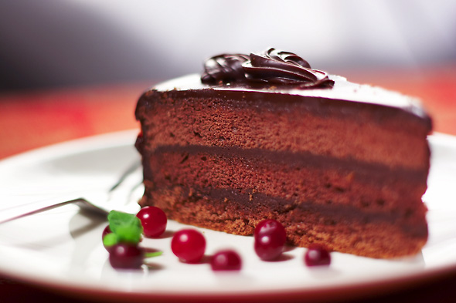
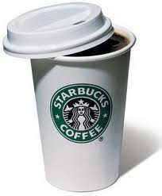
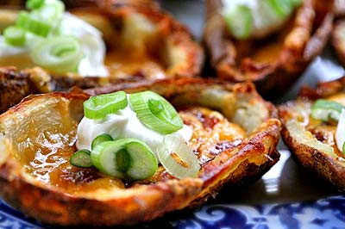
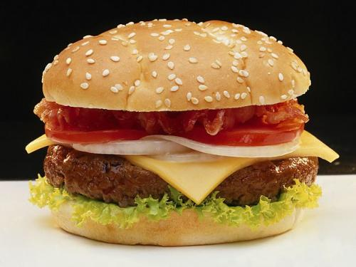
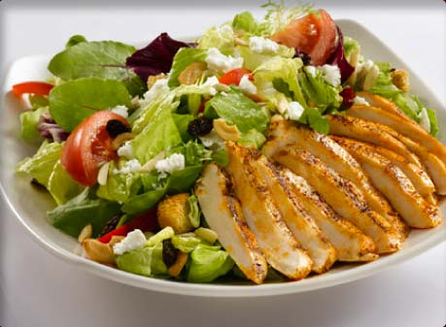
You Are What You Eat

Slide 2
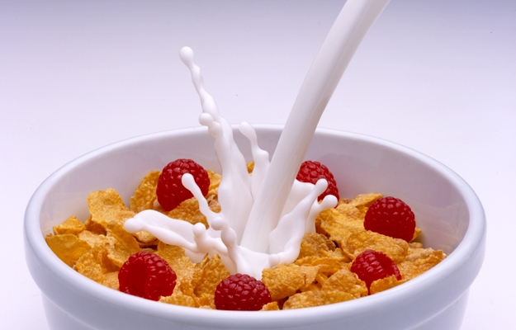
What did you eat for breakfast?

Slide 3
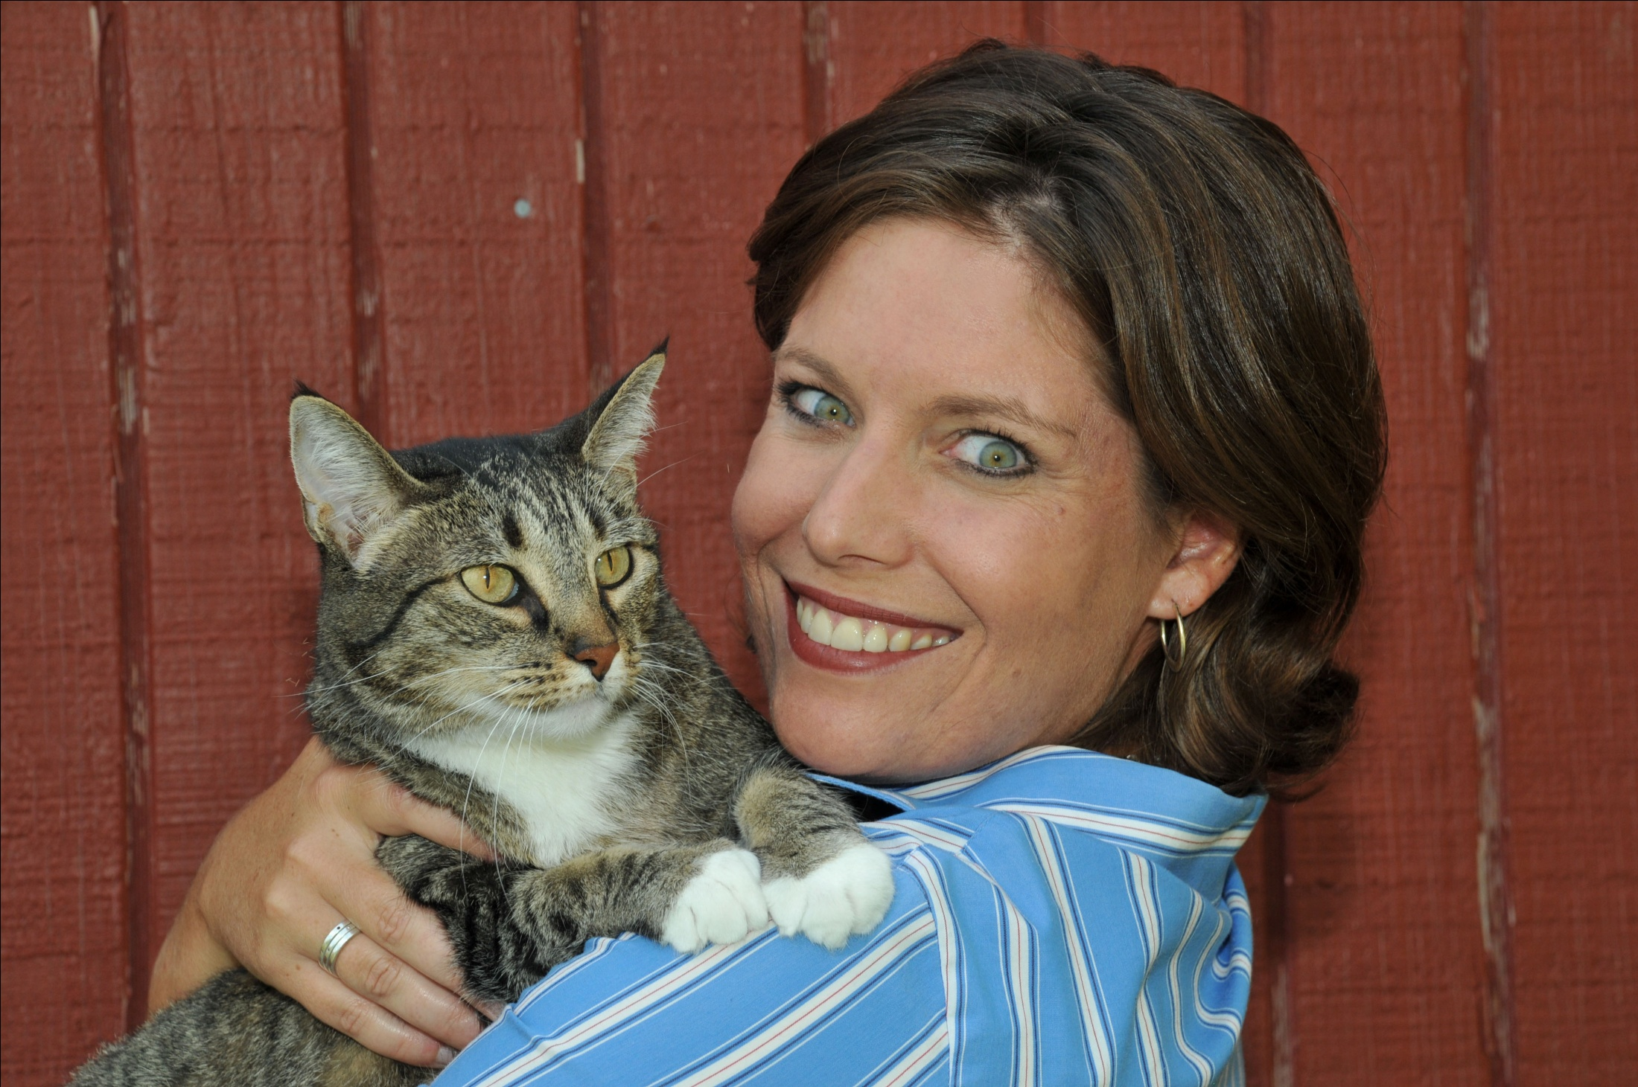

Slide 4
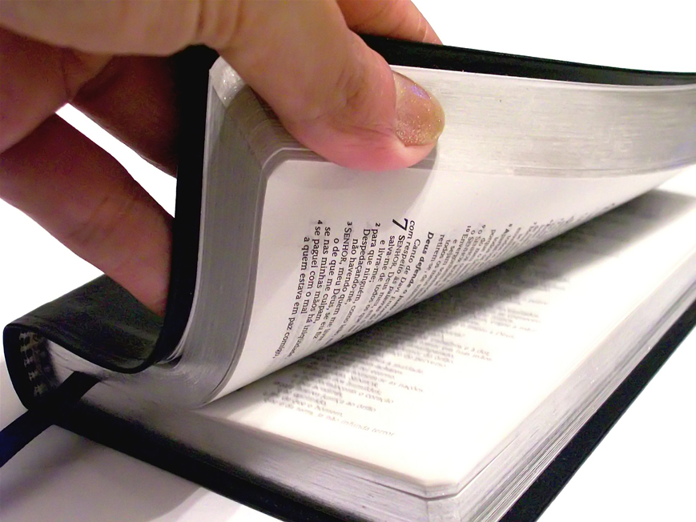
Logos vs. Rhema
Logos = totality of Bible; Jesus
Rhema
Word comes alive to a specific situation
Information becomes revelation

Slide 5
How the rhema word of God fuels our spiritual man:
Energizes your faith
Guides you
Fights for you

Slide 6
1. Energizes Your Faith!
Hebrews 1:3 The Son is the radiance of God’s glory and the exact representation of his being, sustaining all things by his powerful [rhema] word.
John 6:63 The words [rhema] I have spoken to you are spirit and they are life.

Slide 7
1. Energizes Your Faith!
Romans 10:17 So faith comes from hearing, and hearing by the [rhema] word of Christ.

Slide 8
2. Guides You!
John 15:7 If you remain in Me and My words [rhema] remain in you, ask whatever you wish and it will be given to you.
2 Corinthians 13:1 Every matter [rhema] must be established by the testimony of two or three witnesses.

Slide 9
Rhemas for Purdue
Joshua 18:7 The Levites, however, do not get a portion among you, because the priestly service of the LORD is their inheritance.
Psalm 74:17
¹⁷ It was You who set all the boundaries of the earth; You made both summer and winter.

Slide 10
Rhemas for Purdue
Romans 12:1 Therefore, I urge you, brothers, in view of God's mercy, to offer your bodies as living sacrifices, holy and pleasing to God—this is your spiritual act of worship.

Slide 11
Principles of Guidance
Word of God (Logos)
Spiritual authorities
Peace
Circumstances

Slide 12
3. Fights for You!
Ephesians 6:14, 17 Stand firm, then, with the belt of truth buckled around your waist.… take the sword of the Spirit, which is the [rhema] word of God.

Slide 13
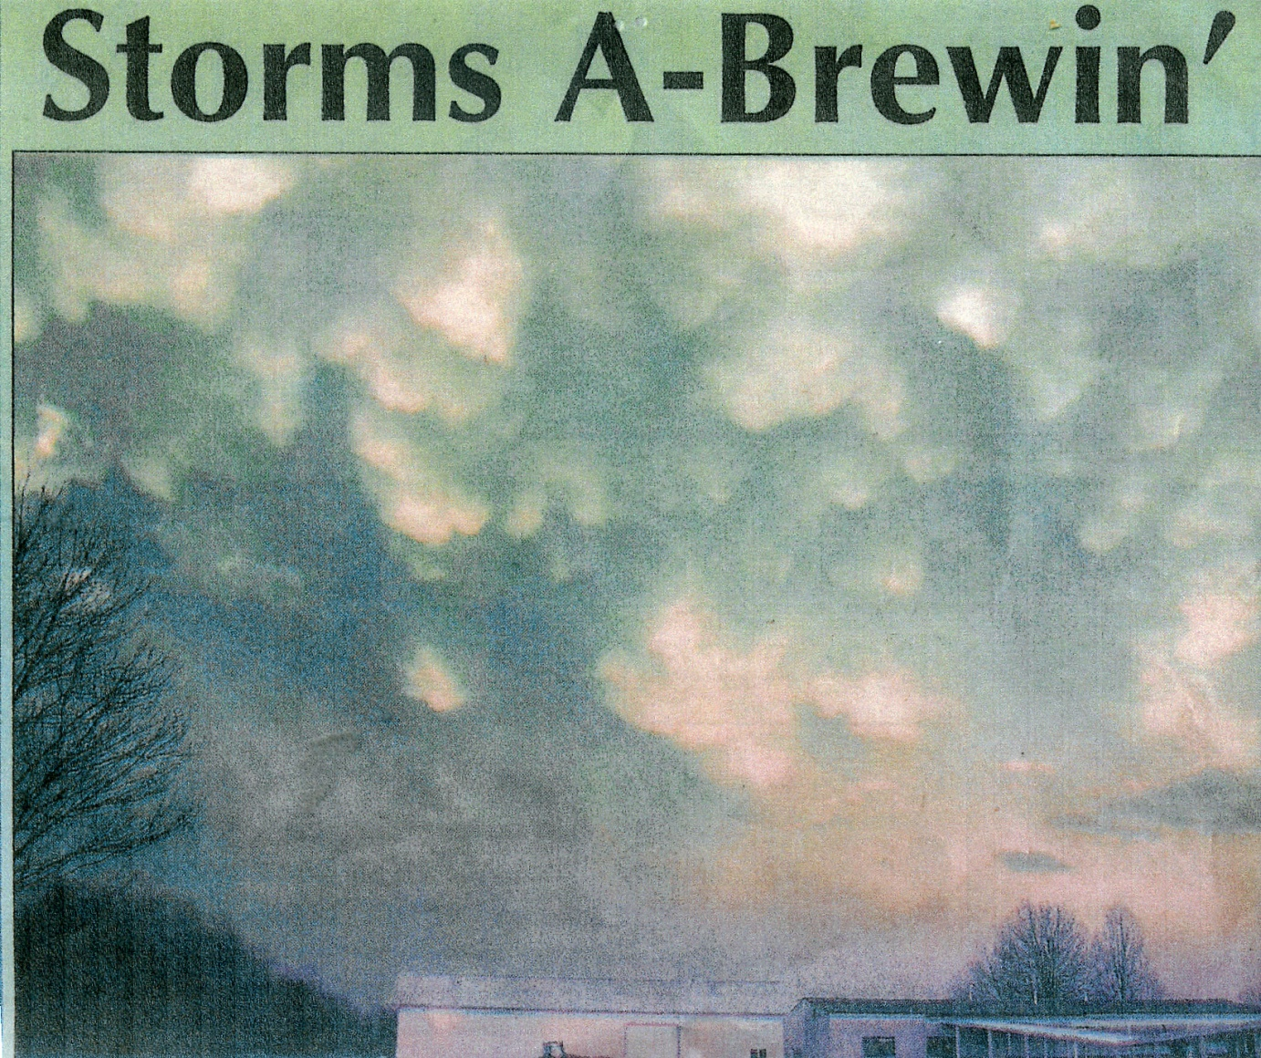

Slide 14
Journal – April 8, 2008
Yesterday: God sovereignly spoke to me through the televangelist and the Word about healing. But my heart is afraid to “put all my eggs in one basket” and believe You for healing, Lord. What if?.... Please reaffirm this morning as I seek You for rhemas. Have Your way, O God.

Slide 15
Isaiah 35:3-6
Strengthen the feeble hands,
steady the knees that give way;
say to those with fearful hearts,
“Be strong, do not fear;
your God will come, He will come with vengeance;
with divine retribution He will come to save you.”
Then will the eyes of the blind be opened
and the ears of the deaf unstopped.
Then will the lame leap like a deer,
and the mute tongue shout for joy.

Slide 16
Morning, Pastor Linda -
As I opened my Bible today the following verses just jumped out of there….I think the verses are awesome, and if that bears witness with your heart let's cling to His Word.
So here it is: Hab. 2:2-4
“For the vision is yet for an appointed time, but at the end it shall speak, and not lie: though it tarry, wait for it; because it will surely come, it will not tarry....but the just shall live by his faith. (I think this is just awesome!)

Slide 17
You Are What You Eat
Daily intake of Word
Journal
Pray rhemas back to God

